Slide 1
Solution Chemistry
Dealing with mixtures

Slide 2
Solutions
A solution is a homogenous mixture consisting of a solvent and at least one solute.
The solvent is the most prevalent species.
The solute is the less prevalent species.

Slide 3
Examples of Solutions
Saline (salt water) is a solution. The solvent is water, the solute is salt.
Wet salt is also a solution. The solvent is salt, the solute is water.

Slide 4
160 proof Vodka
What is the solvent?
Alcohol – It is 80% alcohol.
What is the solute?
Water – It is 20% water.

Slide 5
Aqueous Solutions
Aqueous solutions are specifically solutions where water is the solvent.
Aqueous solutions are a very common medium for performing chemical reactions.

Slide 6
Advantages of Aqueous Solutions
Mixing – you can stir the solution.
Ability to dissipate heat (or cold) – the mass of the solvent allows it to absorb significant amounts of heat (or cold).
“Universal solvent” – water dissolves many different materials, especially ionic materials.

Slide 7
Concentration
Because a solution is a mixture – there are different ratios of solvent/solute quantities possible.
For example, I could put 1 teaspoon of salt in a cup of water OR I could put 2 teaspoons of salt in a cup of water.
Both are saline solutions, but they have different amounts of salt.

Slide 8
Concentration
Almost any unit of measure can be used to specify concentration. (teaspoon solute/cup solvent would work!)
There are certain common units of measuring solution concentration that are most frequently used. Understanding their UNITS! UNITS! UNITS! And being able to manipulate those UNITS! UNITS! UNITS! is crucial.

Slide 9
Common units of concentration
Normality $\frac{equivalent moles solute}{L solution}$
ppt – $\frac{g solute}{1000 g solution}$
ppm – $\frac{g solute}{1,000,000 g solution}$
ppb – $\frac{g solute}{1,000,000,000 g solution}$
lb/million gallons - $\frac{lb solute}{1,000,000 gal solution}$
% by mass – $\frac{g solute}{100 g solution}$
% by volume $\frac{mL solute}{100 mL solution}$
% by mass-volume $\frac{g solute}{100 mL solution}$
Molarity – $\frac{moles solute}{L solution}$
Molality – $\frac{moles solute}{kg solvent}$

Slide 10
Converting units
What is the molarity of a 10% by mass aqueous NaCl solution?
UNITS! UNITS! UNITS!
10 g NaCl = moles NaCl
100 g NaCl solution L solution
To convert g NaCl to moles, you need to know…
Molar mass of NaCl
To convert g solution to L solution, you need to know…
Density of the solution

Slide 11
The Density
We ALWAYS know the molar mass of any substance.
But what about the density?

Slide 12
How much sugar can I put in a cup (8 oz) of boiling coffee?
8 Oz
4 teaspoons
16 oz
2 oz
It doesn’t matter – says the cynical student in the back row.

Slide 13
The Density
You don’t always know the density.
Density depends on concentration.
Sometimes you know the density.
Sometimes you can figure out the density.
Sometimes you just have to ASSUME the density.

Slide 14
The Density
If you don’t know anything except what was given:
What is the molarity of a 10% by mass aqueous NaCl solution?
What would you do?
Assume the density is that of pure water (1.0 g/mL at 25°C)

Slide 15
The Density
Suppose I had further information:
What is the molarity of a 10% by mass aqueous NaCl solution? (Density of 5% NaCl solution = 1.05 g/mL, Density of 20% NaCl solution = 1.13 g/mL)
Now what would you do?
I can either ASSUME that 5% is “close enough” to 10%.
OR I can “interpolate” the density between 5% and 20%.

Slide 16
Linear Interpolation
Do you know what a “linear interpolation is”?
I assume that there is a linear (straight-line) dependence of the density on the concentration. (By the way, this is not true, but it is an OK assumption if the range is narrow enough.)
Then I draw a straight line between the two points I know and find the interpolated concentration at my concentration of interest.

Slide 18
I can plug and chug….
$$Density=0.0053 \left(\% by mass\right)+1.0223$$
$$Density=0.0053 \left(10\right)+1.0223=1.075≈1.08 g/mL$$

Slide 19
You can also do it without the graph.
What is the molarity of a 10% by mass aqueous NaCl solution? (Density of 5% NaCl solution = 1.05 g/mL, Density of 20% NaCl solution = 1.13 g/mL)
I find the slope of the line: Δ Density
Δ % NaCl
1.13 g/mL – 1.05 g/mL = 5.33x10⁻³ g/mL
20% - 5 % %

Slide 20
My Problem
What is the molarity of a 10% by mass aqueous NaCl solution? (Density of 5% NaCl solution = 1.05 g/mL, Density of 20% NaCl solution = 1.13 g/mL)
5.33x10⁻³ g/mL means that every 1% change in concentration
% results in a 5.33x10⁻³ g/mL change in density
10%-5% = 5% change
5.33x10⁻³ g/mL * 5 % = 0.0267 g/mL change
%
1.05 g/mL + 0.0267 g/mL = 1.077 g/mL = 1.08 g/mL interpolated density

Slide 21
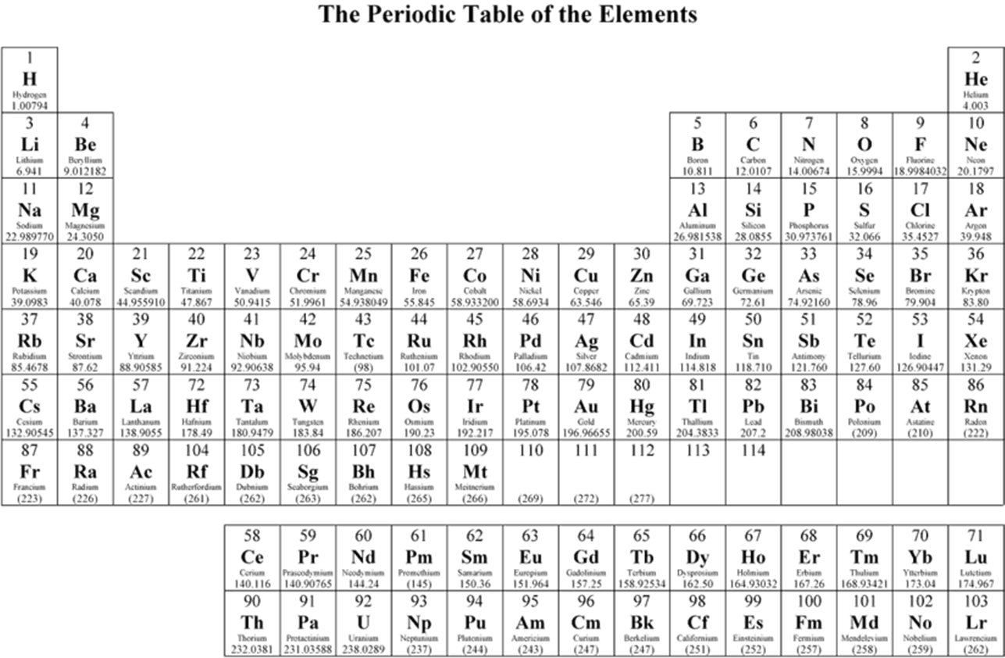

Slide 22
Solving the problem
What is the molarity of a 10% by mass aqueous NaCl solution? (Density of 5% NaCl solution = 1.05 g/mL, Density of 20% NaCl solution = 1.13 g/mL)
10 g NaCl * 1 mol NaCl = 0.171 mol NaCl
100 g solution 58.45 g NaCl 100 g solution
0.171 mol NaCl * 1.08 g solution * 1000 mL = 1.84 mol NaCl
100 g solution 1 mL solution 1 L L solution

Slide 23
Converting units
Typically speaking, you can convert any of the concentration units into any of the others as long as you have the Molar Mass and the Density!

Slide 24
Density – your critical judgment
For a solution, sometimes you know the density, sometimes you don’t.
There are tables, but they are not all inclusive.
You might, for example, find in a table that:
Density (30% HCl) = 1.12 g/mL
Density (40% HCl) = 1.23 g/mL
Density (36% HCl) = ???

Slide 25
Interpolate or Assume
Density (30% HCl) = 1.12 g/mL
Density (40% HCl) = 1.23 g/mL
Density (36% HCl) = ???
You could assume that 36% is closest to 40% and use 1.23 g/mL. This is legitimate, although not 100% accurate. Results may vary, depending on how good the assumption is.

Slide 26
Interpolate or Assume
Density (30% HCl) = 1.12 g/mL Density (40% HCl) = 1.23 g/mL
Density (36% HCl) = ???
You could assume that density changes linearly with concentration (it doesn’t, but it is pseudo-linear for small changes). In that case, you would “linearly interpolate” the density.
1.23 g/mL – 1.12 g/mL = 0.011 g/mL = 0.011 g
40% HCl-30%HCl % mL%
1.12 g/mL + 0.011 g/mL% * 6% = 1.186 g/mL = 1.19 g/mL
This is legitimate, although still not 100% accurate, but probably better than the previous assumption.

Slide 27
If I don’t have Density tables…
For dilute solutions, you can get pretty close by assuming the density of the solution is the same as the density of pure water.
For concentrated solutions (like 36%), this is probably not a good assumption, but it is better than nothing!

Slide 28
Some Other Examples

Slide 29
Further Example
56.0 g of Fe₂O₃ was dissolved in water yielding a total solution volume of 2.65 L. What is the molarity of the resulting solution?
56.0 g Fe₂O₃ * 1 mol Fe₂O₃ = 0.351 mol Fe₂O₃
159.69 g Fe₂O₃
0.351 mol Fe₂O₃ = 0.132 M Fe₂O₃
2.65 L

Slide 30
What’s it all about?
MOLES! MOLES! MOLES!
Specifically, doing reactions!

Slide 31
An example
56.50 mL of a 2.15 M ammonium sulfate solution is mixed with 36.0 g of iron (III) chloride. If the reaction proceeds with a 65% yield, how much iron (III) sulfate would be acquired?

Slide 32
Limiting Reagent Problem
What’s the first thing you need?
A balanced equation!
(NH₄)₂SO₄ + FeCl₃ → Fe₂(SO₄)₃ + NH₄Cl
How do you know this is the right products?
Charges! This is an example of a double replacement reaction. The cations get switched (or the anions, if you prefer).

Slide 33
Limiting Reagent Problem
We still need to balance it!
(NH₄)₂SO₄ + FeCl₃ → Fe₂(SO₄)₃ + NH₄Cl
3 (NH₄)₂SO₄ + 2 FeCl₃ → Fe₂(SO₄)₃ + 6 NH₄Cl

Slide 34
Armed with Stoichiometry!
56.50 mL of a 2.15 M ammonium sulfate solution is mixed with 36.0 g of iron (III) chloride. If the reaction proceeds with a 65% yield, how much iron (III) sulfate would be acquired?
3 (NH₄)₂SO₄ + 2 FeCl₃ → Fe₂(SO₄)₃ + 6 NH₄Cl

Slide 35
Armed with Stoichiometry!
56.50 mL of a 2.15 M ammonium sulfate solution is mixed with 36.0 g of iron (III) chloride. If the reaction proceeds with a 65% yield, how much iron (III) sulfate would be acquired?
3 (NH₄)₂SO₄ + 2 FeCl₃ → Fe₂(SO₄)₃ + 6 NH₄Cl
36.0 g FeCl₃ *1 mol FeCl₃ * 1 mol Fe₂(SO₄)₃ * 399.87 g Fe₂(SO₄)₃= 44.37 g Fe₂(SO₄)₃
162.21 g FeCl₃ 2 mol FeCl₃ 1 mol Fe₂(SO₄)₃

Slide 36
Armed with Stoichiometry!
56.50 mL of a 2.15 M ammonium sulfate solution is mixed with 36.0 g of iron (III) chloride. If the reaction proceeds with a 65% yield, how much iron (III) sulfate would be acquired?
3 (NH₄)₂SO₄ + 2 FeCl₃ → Fe₂(SO₄)₃ + 6 NH₄Cl
$$2.15 M {\left(NH_{4}\right)}_{2}SO_{4}=\frac{2.15 mol{\left(NH_{4}\right)}_{2}SO_{4}}{L solution}$$
Like any ratio of units, this is really just a conversion factor!!!

Slide 37
Armed with Stoichiometry!
56.50 mL of a 2.15 M ammonium sulfate solution is mixed with 36.0 g of iron (III) chloride. If the reaction proceeds with a 65% yield, how much iron (III) sulfate would be acquired?
3 (NH₄)₂SO₄ + 2 FeCl₃ → Fe₂(SO₄)₃ + 6 NH₄Cl
$$56.50 mL solution\frac{1 L}{1000 mL}\frac{2.15 mol{\left(NH_{4}\right)}_{2}SO_{4}}{L solution}=0.121 mol{\left(NH_{4}\right)}_{2}SO_{4}$$
$$0.121 mol {\left(NH_{4}\right)}_{2}SO_{4}\frac{1 mol Fe_{2}{\left(SO_{4}\right)}_{3}}{3 mol {\left(NH_{4}\right)}_{2}SO_{4}}\frac{399.87 g Fe_{2}{\left(SO_{4}\right)}_{3}}{1 mol}=16.13 g Fe_{2}{\left(SO_{4}\right)}_{3}$$

Slide 38
Armed with Stoichiometry!
56.50 mL of a 2.15 M ammonium sulfate solution is mixed with 36.0 g of iron (III) chloride. If the reaction proceeds with a 65% yield, how much iron (III) sulfate would be acquired?
3 (NH₄)₂SO₄ + 2 FeCl₃ → Fe₂(SO₄)₃ + 6 NH₄Cl
Limiting Reagent is (NH₄)₂SO_{4:} 16.13 g Fe₂(SO₄)₃ theoretical
16.13 g Fe₂(SO₄)₃ theoretical * 65 g actual = 10.48 g actual Fe₂(SO₄)₃
100 g theoretical

Slide 39
Clicker Question
I have 1 L of a solution that is 5.4% by mass sodium sulfate. If the density of 5% sodium sulfate is 1.085 g/mL, how much silver (I) chloride would I need to add to precipitate all of the sulfate?
A. 59 g
B. 257 g
C.118 g
D. 129 g
E. 25.4 g

Slide 41
Na₂SO₄ + 2 AgCl → 2 NaCl + Ag₂SO₄
1L * 1000 mL * 1.085 g *5.4 g Na₂SO₄ = 58.59 g Na₂SO₄
1L 1 mL 100 g solution
58.59 g Na₂SO₄ * 1 mol Na₂SO₄ = 0.4126 mol Na₂SO₄
142 g Na₂SO₄
0.4126 mol Na₂SO₄ * 2 mol AgCl = 0.825 mol AgCl
1 mol Na₂SO₄
0.825 mol AgCl * 143 g AgCl = 118 g AgCl
1 mol AgCl

Slide 42
Question
When 50.00 mL of 0.125 mol/L silver (I) nitrate is mixed with 50.00 mL of 0.250 M sodium sulfate a greyish solid forms. If I recover 0.813 g of solid, what is the yield of the reaction?

Slide 43
2 AgNO₃ (aq)+ Na₂SO₄ (aq)
→Ag₂SO₄ (s) + 2 NaNO₃ (aq)
$$50.0 mL AgNO_{3}solution\frac{1.00 L}{1000 mL}\frac{0.125 mol AgNO_{3} }{L solution}=6.25×{10}^{−3}mol AgNO_{3}$$
$$50.0 mL Na_{2}SO_{4}\frac{1 L}{1000 mL}\frac{0.250 mol Na_{2}SO_{4}}{L solution}=0.0125 mol Na_{2}SO_{4}$$

Slide 44
2 AgNO₃ (aq)+ Na₂SO₄ (aq)
→Ag₂SO₄ (s) + 2 NaNO₃ (aq)
$$6.25×{10}^{−3}mol AgNO_{3}\frac{1 mol Ag_{2}SO_{4}}{2 mol AgNO_{3}}=3.125×{10}^{−3}mol Ag_{2}SO_{4}$$
$$0.0125 mol Na_{2}SO_{4}\frac{1 mol Ag_{2}SO_{4}}{1 mol Na_{2}SO_{4}}=0.0125 mol Ag_{2}SO_{4}$$

Slide 45
2 AgNO₃ (aq)+ Na₂SO₄ (aq)
→Ag₂SO₄ (s) + 2 NaNO₃ (aq)
$$6.25×{10}^{−3}mol AgNO_{3}\frac{1 mol Ag_{2}SO_{4}}{2 mol AgNO_{3}}=3.125×{10}^{−3}mol Ag_{2}SO_{4}$$
$$3.125×{10}^{−3} mol Ag_{2}SO_{4}\frac{310 g Ag_{2}SO_{4}}{mol}=0.968 g Ag_{2}SO_{4}$$

Slide 46
$$\% yield= \frac{g actual product}{g expected product}x100$$
$$\frac{0.813 g "got"}{0.968 g "expected"}x100=84.0\% yield$$

