Slide 1
Electronic Structure of Atoms
Chemistry is Electrons

Slide 2
What’s this thing called light?
Light is an oscillating electromagnetic wave!
There are two ways to look at any wave:
Freeze the wave and walk along it.
Stay put and watch the wave go by.

Slide 3

Freeze the wave and walk…

Slide 4
What do I see on my walk?
The wave going up and down and up and down and up and down and up and down and…

Slide 5
What do I see on my walk?
The distance between two peaks is called the wavelength: how far I walked!

Slide 6
What do I see on my walk?
Wavelength is abbreviated as λ

Slide 7

What if instead of walking I sit still and let the wave go by…

Slide 8
I see it go up and down and up and down…
The number of times it goes up and down in a second (or minute or hour or day…) is called its frequency and this is abbreviated ν (Greek letter “nu”)

Slide 9
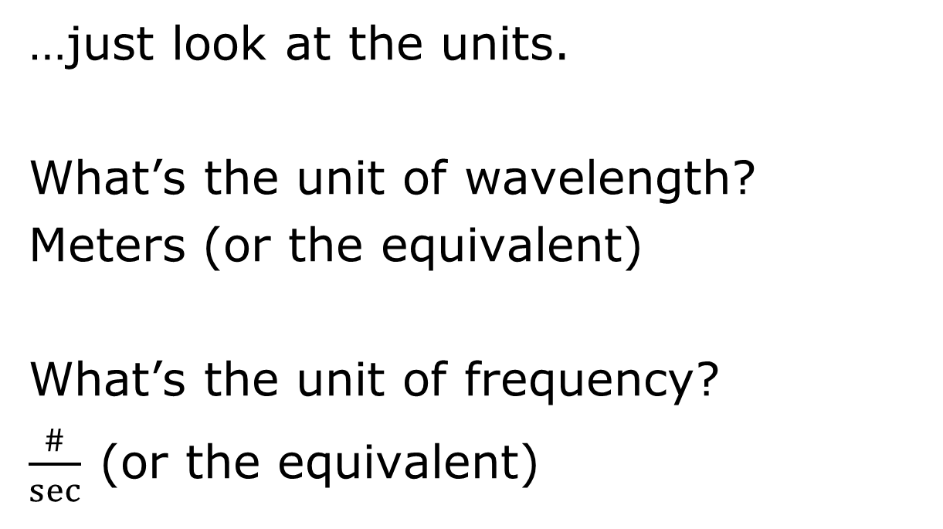
Wavelength and frequency are related…
…just look at the units.
What’s the unit of wavelength?
Meters (or the equivalent)
What’s the unit of frequency?
$\frac{\#}{sec}⁡$(or the equivalent)

Slide 10
What do you get when you combine distance and time?
VELOCITY!!!
Distance per Time
Miles per hour
Meters per second
Kilometers per day

Slide 11
λν=c
Where c is the speed of light.
The speed of light is actually constant in vacuum and has a value of 2.997x10⁸ m/s or (3.00 x10⁸ m/s)
Why constant in vacuum?

Slide 12
No molecules in a vacuum…
If the light keeps bumping into molecules, it slows it down!
Air is actually pretty close to vacuum (at least to 3 sig figs) and we use the same value in air.

Slide 13
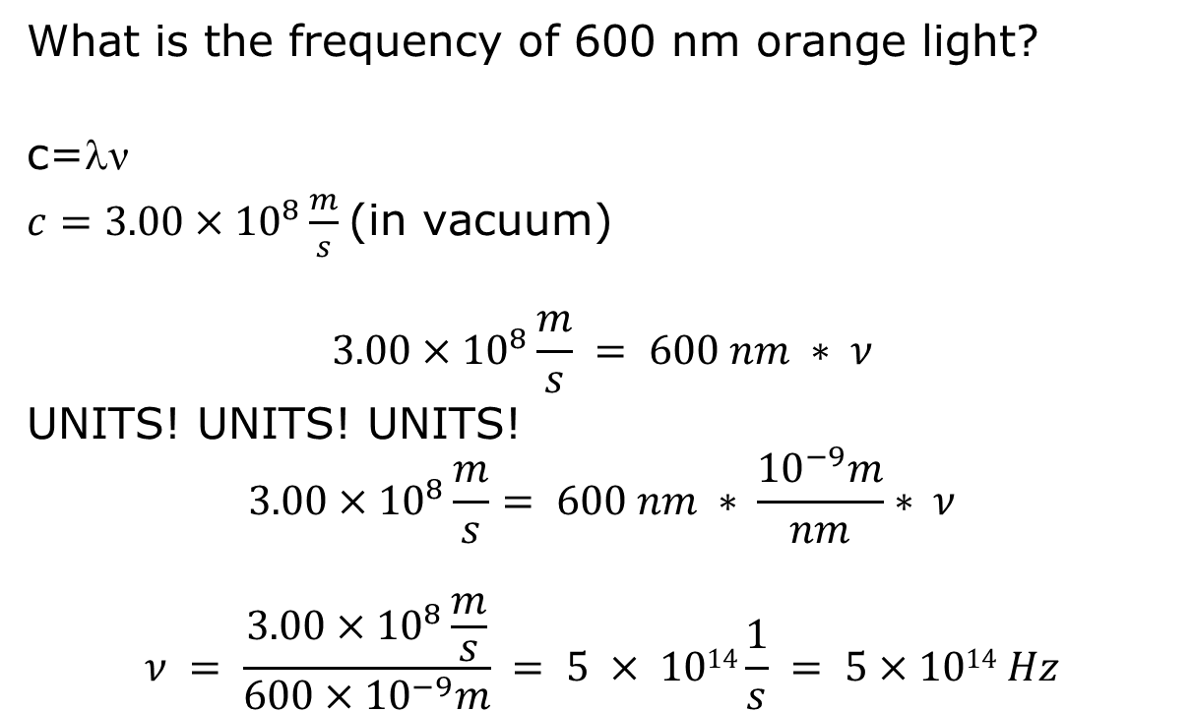
What is the frequency of 600 nm orange light?
c=λν
$c=3.00×{10}^{8}\frac{m}{s}$(in vacuum)
$$3.00×{10}^{8}\frac{m}{s} = 600 nm ∗ ν$$
UNITS! UNITS! UNITS!
$$3.00×{10}^{8}\frac{m}{s}= 600 nm ∗ \frac{{10}^{−9}m}{nm}∗ ν$$
$$ν = \frac{3.00×{10}^{8}\frac{m}{s}}{600×{10}^{−9}m} = 5 × 1014\frac{1}{s} = 5×1014 Hz$$

Slide 14
Light is another form of energy!
Important Fact #1
Light is just another form of energy.
[But it is special, behaving differently than we might expect.]

Slide 16
Boy, I need a few more slides here…
The energy contained in a beam of light was actually a source of confusion.
In our everyday experience, a 1000 W light bulb is much hotter than a 25 W light bulb…no matter what color it is!
Why is it hotter?
It has more energy!

Slide 17
But why does it have more energy?
It has more energy because it has more light waves in it NOT because the light waves are bigger.
Think of the ocean and compare a tsunami to a million ripples…

Slide 18
When light strikes matter…
What happens? Or what COULD happen?

Slide 19
When light strikes matter…
What happens? Or what COULD happen?
It bounces off.
It goes right through.
It gets absorbed.

Slide 20
Absorbed light
Important Fact #2:
Absorbing light becomes a means of probing matter.
When light is absorbed it must be tuned to the energy difference between two states.

Slide 21
Different wavelengths of light interact with different things:
Infrared light (longer than 700 nm) interacts with the vibrations of bonds.
Microwave light (even longer wavelengths) interact with rotations of bonds.
Visible (400-700 nm) or ultraviolet (shorter than 400 nm) interact with the electrons.

Slide 22
The Bohr Model and the Photoelectric effect.
e-
Nucleus
n
p
p
n
e-
p
n
e-
n
Absorbing UV or visible light moves the electrons to a higher electron state.

Slide 23
Bohr model and the photoelectric effect.
What if you absorb a LOT of energy? So much so that there are no more orbitals for the electron to go into?
The electron is knocked out of the atom! This is called the “photoelectric effect”.

Slide 24
Stupid Clicker Question
I hit your rubber body with a 1000 lb truck going 50 mph and you land 1 mile away. If I hit you consecutively with two 500 lb trucks going 50 mph, do you land…
More than 1 mile away
1 mile away
Less than 1 mile away
I’m offended by the whole idea of this question
Your mother.

Slide 25
You are an electron. I hit you with a 50 lb mallet and you move up two orbitals. If I hit you consecutively with 2-25lb mallets, do you:
Go up less than 2 orbitals
Go up 2 orbitals
Go up more than 2 orbitals
Stay put and throw the finger
Your mother

Slide 26
Tsunami or a million ripples…
Suppose I need 10⁻¹⁸ J of energy to knock an electron off. This is called the work function of a material: the smallest amount of energy that will cause an electron to be emitted.
If I need 10⁻¹⁸ J of energy, where am I going to get it?

Slide 27
I’m an atom and I need an Eve…
My work function is 10⁻¹⁸ J. Can I get the energy from:
A 10⁻¹⁸ J light bulb (white light)
10 light waves with 10⁻¹⁹ J
A single light wave with 10⁻¹⁸ J of energy
A 100 W light bulb (100 J/s)
All of the above

Slide 28
All of the above seems correct…
…so it isn’t.
It turns out that light energy is not additive in the way that normal heat is. It comes prepackaged in single waves called “photons” where the energy of each photon is related to its frequency (or wavelength).

Slide 29

Enter Planck and his constant
$$E=hγ$$
$$E=h\frac{c}{λ}$$
h=Planck’s constant = 6.626x10⁻³⁴ J s

Slide 30
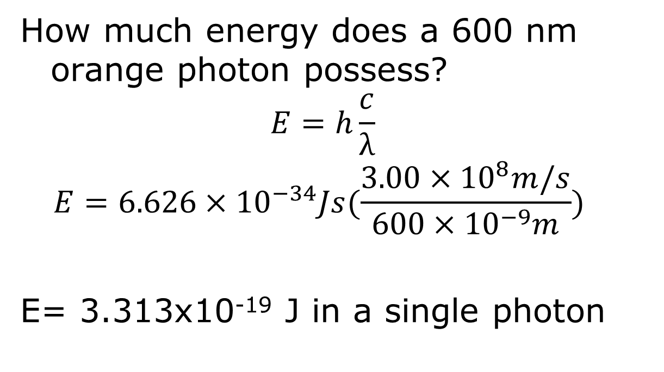
How much energy does a 600 nm orange photon possess?
$$E=h\frac{c}{λ}$$
$$E=6.626×{10}^{−34}Js(\frac{3.00×{10}^{8}m/s}{600×{10}^{−9}m})$$
E= 3.313x10⁻¹⁹ J in a single photon

Slide 31
Total energy in a beam of light?
Like all energy, the energy in a beam of light should be the sum of the energies of each little wave of light.
So, if you take four 600 nm photons, the total energy is:
4* 3.313x10⁻¹⁹ J = 1.33x10⁻¹⁸ J
That should be enough to knock my electron off!

Slide 32
Damn electron won’t leave!
But if you shine four 600 nm photons with a total energy of 1.33x10⁻¹⁸ J onto a material with a work function of 10⁻¹⁸ J no electron is emitted!!!
In fact if you have a 100 W 600 nm light bulb and shine it on the surface for an hour, the surface will be exposed to 360,000 Joules of energy and not a single electron will be emitted.

Slide 33
This is quantization.
In order for an electron to make the jump it must have a landing pad. Only photons with the correct energy can be absorbed.
Or, as we scientists say, no halvesies!

Slide 34
You must tune the energy to the energy separation between orbitals.
e-
Nucleus
n
p
p
n
e-
p
n
e-
n

Slide 35
Chemical Reactivity
The nucleus is encased in electrons.
The nucleus is stable and unchanged in chemical reactions.
When 2 atoms meet, it is their electrons that bump together.

Slide 36
Chemical Reactivity…
…is all about the electrons.

Slide 37
Electronic Structure of Atoms
Since the electrons are so important, understanding the electronic structure of atoms is critical to understanding why atoms react with each other.
The first thing we need to do is move beyond classical physics and the Bohr Model

Slide 38
What’s wrong with the Bohr Model?
The electrons should collapse into the nucleus
e-
Nucleus
n
p
p
n
e-
p
n
e-
n

Slide 39
It doesn’t ☺
The electron “orbits” are stable and electrons can move between them by absorbing light (higher energy orbitals) or emitting light (moving into lower energy orbitals).

Slide 40
It’s CSI!
The absorption and emission of light are characteristic of the materials.
The energy of the transition is just:
ΔE = E_{final state} – E_{initial state}
The math gets complicated in a hurry…

Slide 41
It’s just charge to charge attraction…
e-
Nucleus
n
p
p
n
e-
p
n
e-
n
BUT…there’s also charge to charge repulsion….

Slide 42
Anything beyond hydrogen…
…becomes hard to come up with a simple algebraic relationship.
Where R=1.097x10⁷ m⁻¹ is the “Rydberg constant” and m and n are the initial and final orbitals.

Slide 43
Important Facts about Light and Matter
Important Fact #1 – Light is just another form of energy
Important Fact #2 – For light to be absorbed, it must be tuned to a specific energy transition in matter.

Slide 44
Quantum electronic structure
The solution to the electron paradox is that the world of the atom is not “classical” but “quantum mechanical”.
Important Fact #3
In a quantum world, only certain discrete energy levels are allowed. You cannot slowly decay in orbit until you crash into the nucleus.

Slide 45
Important Chapter 7 Fact #4
Electron orbitals:
Electron orbitals are diffuse. The electron is not a hard little pellet, but a “probability cloud”.
Electron orbitals are 95% probability intervals.
Allowed electron orbitals are determined by 4 quantum numbers.

Slide 46
Electron Orbitals

Slide 47
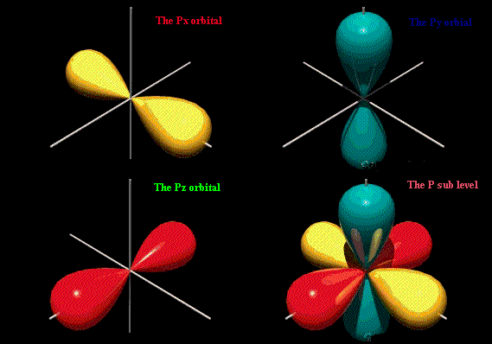
p-orbital

Slide 48
Electron Orbitals
Every electron is represented by 4 quantum numbers. These electron Quantum numbers are:
n = principal quantum number (kind of like the Bohr orbit)
l = angular momentum quantum number
m_{l} = magnetic quantum number
m_{s} = spin quantum number

Slide 49
Allowed Quantum numbers
n = 1, 2, 3, 4, 5….
l = 0, 1, 2, 3, 4…(n-1)
m_{l} = -l, -l+1…-1, 0, 1…l-1, l
m_{s} = -1/2, ½
Notice that l depends on n and m_{l} depends on l

Slide 50
Possible Quantum numbers
n = 1, l=0, m_{l} = 0, m_{s}=-1/2
n = 1, l=0, m_{l} = 0, m_{s}=+1/2
n = 2, l=0, m_{l} = 0, m_{s}=-1/2
n = 2, l=0, m_{l} = 0, m_{s}=+1/2
n = 2, l=1, m_{l} = -1, m_{s}=-1/2
n = 2, l=1, m_{l} = -1, m_{s}=+1/2
n = 2, l=1, m_{l} = 0, m_{s}=-1/2
n = 2, l=1, m_{l} = 0, m_{s}=+1/2
n = 2, l=1, m_{l} = 1, m_{s}=-1/2
n = 2, l=1, m_{l} = 1, m_{s}=+1/2

Slide 51
Possible Quantum numbers
n = 1 l=0 m_{l} = 0 m_{s}=-1/2
m_{s}=+1/2
n = 2 l=0 m_{l} = 0 m_{s}=-1/2
m_{s}=+1/2
l=1 m_{l} = -1 m_{s}=-1/2
m_{s}=+1/2
m_{l} = 0 m_{s}=-1/2
m_{s}=+1/2
m_{l} = 1 m_{s}=-1/2
m_{s}=+1/2

Slide 52
What do these numbers mean?
n is like the Bohr orbit number. It gives the “shell” the electron is in.
l is the orbital number, it specifies the type of orbital within the same shell.
m_{l} gives the orientation of the orbital – these are different flavors of the same orbital
m_{s} is the magnetic spin of the electron (think N and S pole) – this is specific to the electron not the orbital

Slide 53
Shorthand Notation
Orbitals are specified by letters:
l=0 is an s orbital
l=1 is a p orbital
l=2 is a d orbital
l=3 is an f orbital
l=4 is a g orbital (then h, i, j, k…)

Slide 54
s-orbital (l=0)

Slide 55
p-orbital (l=1)

Slide 56
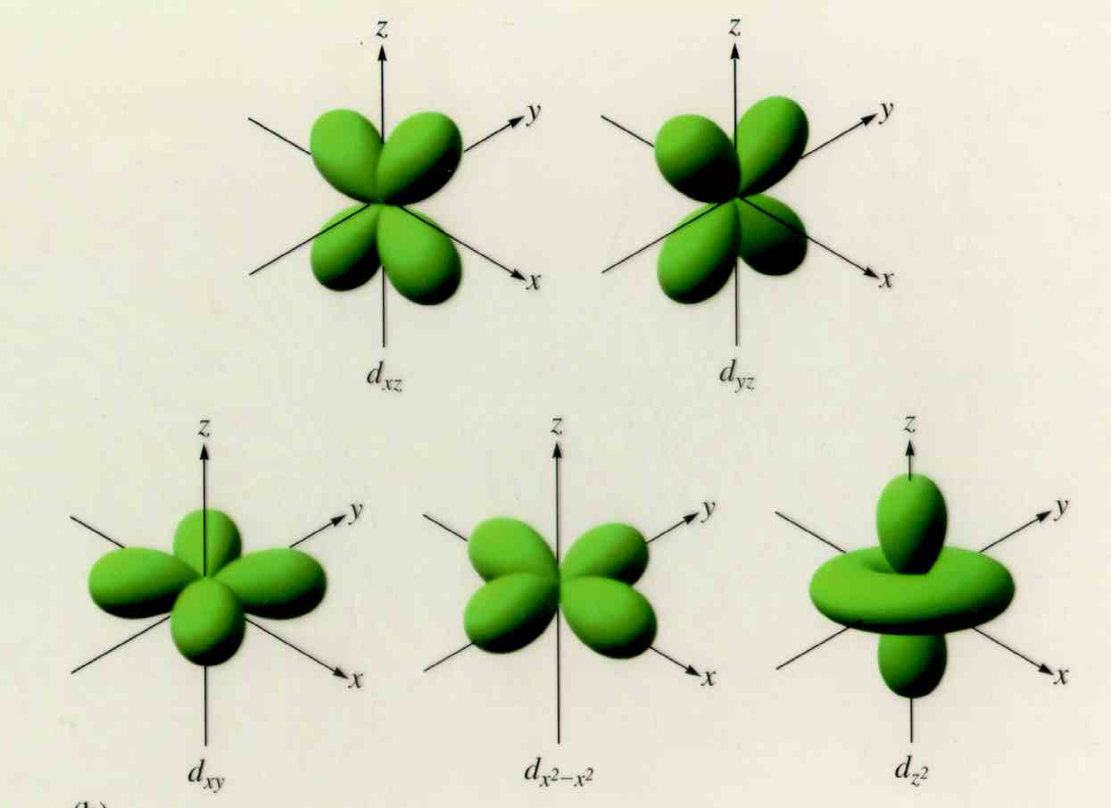
d-Orbitals (l=2)

Slide 57
Shorthand notation
n=1, l=0 is called a 1s orbital
n=2, l=0 is called a 2s
n=2, l=1 is called a 2p
n=3, l=2 is called a 3d
The number of electrons in each orbital are indicated as a superscript.
1s² means 2 electrons are in the 1s orbital
3d⁷ means 7 electrons are in the 3d orbital

Slide 58
Rules Governing Electrons
Pauli Exclusion Principle - No two electrons in an atom can have the same 4 quantum numbers
Lowest energy orbitals fill first
Hund’s rule – Electrons pair up as a last resort
An orbital being full or half-full is good! (lower in energy)

Slide 59
Pauli Exclusion Principle
Every electron has a unique address.
n=principal quantum number
n=# of different types of orbitals
n=1 – only 1 type (s)
n=2 – 2 types (s, p)
n=3 – 3 types (s, p, d

Slide 60
m_{l} = # of orientations
m_{l} = -l, -l+1, …0…1, 2…l
# m_{l} = 2l+1
l=0, m_{l} = 2(0) + 1 = 1
l=1, m_{l} = 2(1) + 1 = 3
l=2, m_{l} = 2(2) + 1 = 5
etc.

Slide 61
m_{s} = +1/2, -1/2
So you can put 2 electrons in each orbital!

Slide 62
Possible Quantum numbers
n = 1 l=0 m_{l} = 0 m_{s}=-1/2
m_{s}=+1/2
n = 2 l=0 m_{l} = 0 m_{s}=-1/2
m_{s}=+1/2
l=1 m_{l} = -1 m_{s}=-1/2
m_{s}=+1/2
m_{l} = 0 m_{s}=-1/2
m_{s}=+1/2
m_{l} = 1 m_{s}=-1/2
m_{s}=+1/2

Slide 63
So, take a principal quantum number like n=4
n=4 will have 4 orbital types (s, p, d, f)
Based on the l values, there is 1 s orbital (2(0)+1), 3 p orbitals (2(1) +1), 5 d orbitals and 7 f orbitals.

Slide 64
Based on the l values, there is 1 s orbital (2(0)+1), 3 p orbitals (2(1) +1), 5 d orbitals and 7 f orbitals.
So that is a total of 16 orbitals (1+3+5+7).
Each orbital can hold 2 electrons, so you can get 32 electrons in your n=4 orbit.
The other way to see that is:
1 s orbital – 2 electrons
3 p orbitals – 6 electrons
5 d orbitals – 10 electrons
7 f orbitals – 14 electrons

Slide 65
If n=7…how many different shape orbitals are there?
5
7
14
30
64

Slide 66
How many electrons could you put in n=7?
A.32
B.64
C 98
D. 216
E 70

Slide 67
Rules Governing Electrons
Pauli Exclusion Principle - No two electrons in an atom can have the same 4 quantum numbers
Lowest energy orbitals fill first
Hund’s rule – Electrons pair up as a last resort
An orbital being full or half-full is good! (lower in energy)

Slide 68
Energy of the Orbitals
1s
2s 2p
3s 3p 3d
4s 4p 4d 4f
5s 5p 5d 5f 5g
6s 6p 6d 6f 6g 6h
7s 7p 7d 7f 7g 7h 7i
So, 1s fills first then 2s, then 2p, then 3s then 3p then 4s!!!

Slide 70
It’s just charge to charge attraction…
e-
e-
Nucleus
n
p
p
n
e-
e-
p
n
e-
e-
n
BUT…there’s also charge to charge repulsion….

Slide 71
Energy of the Orbitals
1s
2s 2p
3s 3p 3d
4s 4p 4d 4f
5s 5p 5d 5f 5g
6s 6p 6d 6f 6g 6h
7s 7p 7d 7f 7g 7h 7i
Notice that the next s always fills before the d (5s before 4d, 6s before 5d)

Slide 72
Energy of the Orbitals
1s
2s 2p
3s 3p 3d
4s 4p 4d 4f
5s 5p 5d 5f 5g
6s 6p 6d 6f 6g 6h
7s 7p 7d 7f 7g 7h 7i
And look at the f’s!

Slide 73
Electron Configurations
If you need to figure out the electron configuration, you just count the electrons and start filling from lowest energy to highest.
For example, consider C
Carbon has 6 electrons, where do they go.

Slide 74
Carbon
C – 6 electrons
1s is the lowest energy orbital, it takes 2
2s is the next lowest, it also takes 2
2p comes next, it can take up to 6, so it gets the last 2 electrons
1s²2s²2p²

Slide 75
What’s the electron configuration of Mg?

Slide 76
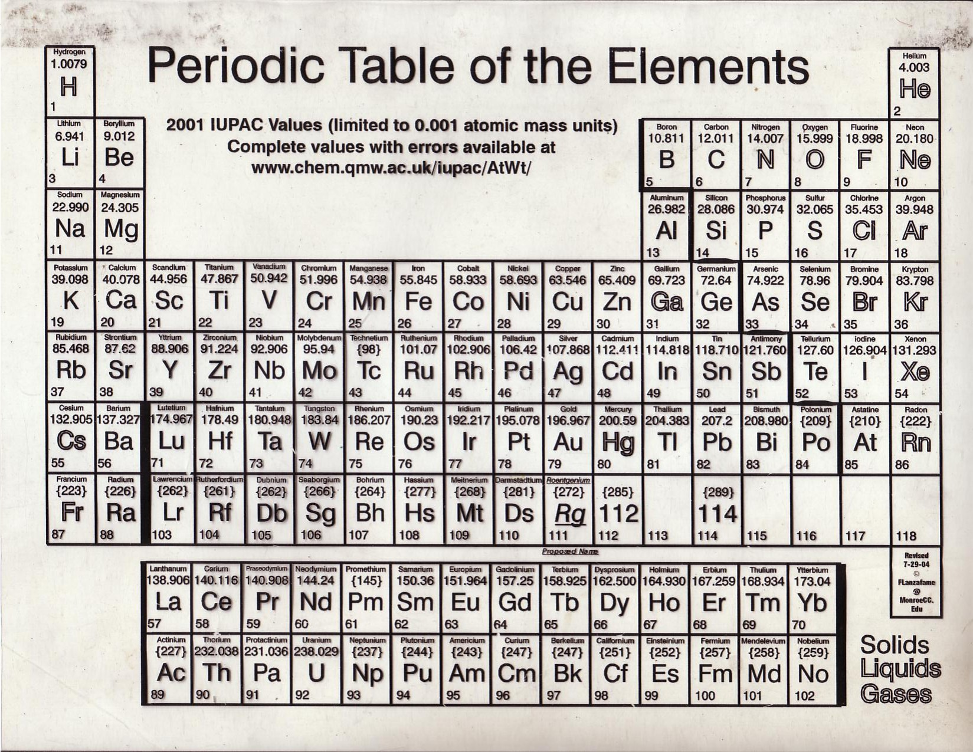

Slide 77
Mg = 12 electrons
1s gets 2
2s gets 2
2p gets 6
3s gets 2
1s²2s²2p⁶3s²

Slide 78
Clicker question
What is the ground state electron configuration of N?
A. 1s²2s⁵
B. 1s²2s²2p³
C. 1s²2s²2p⁵
D. 1s²2p⁵

Slide 79
Clicker question
What is the ground state electron configuration of As?
A. 1s²2s²2p⁶3s²3p⁸3d¹⁰4p³
B. 1s²2s²2p⁶3s²3p⁶4s²4p³
C. 1s²2s²2p⁶3s²3p⁶4s²3d¹⁰4p³
D. 1s²2s²2p⁶3s²3p⁶3d¹⁰4p⁵
E. I love you

Slide 81
Clicker question
What is the ground state electron configuration of Cr?
A. 1s²2s²2p⁶3s²3p⁸3d⁴
B. 1s²2s²2p⁶3s²3p⁶4s²3d⁴
C. 1s²2s²2p⁶3s²3p⁶4s¹3d⁵
D. 1s²2s²2p⁶3s²3p⁶3d⁶

Slide 82
Rules Governing Electrons
Pauli Exclusion Principle - No two electrons in an atom can have the same 4 quantum numbers
Lowest energy orbitals fill first
Hund’s rule – Electrons pair up as a last resort
An orbital being full or half-full is good! (lower in energy) – d orbitals

Slide 83
….4s²3d⁹
…4s¹3d¹⁰

Slide 85
If you are s²d⁴ you are more stable as s¹d⁵
If you are s²d⁹ you are more stable as s¹d¹⁰
[Note: If you look at the actual configurations as printed on some periodic tables, you’ll notice other exceptions. I’m not holding you responsible for those.]

Slide 86
p block
s block
d block
f block

Slide 87
Core vs. Valence Electrons
Core electrons – completed shells
Valence electrons – “outer” or incomplete shells
Only the valence electrons affect the chemistry of an atom.

Slide 88
What’s the valence configuration of…
Ca?
[Ar]4s²
Mo?
[Kr]5s¹4d⁵
Ga?
[Ar]4s²3d¹⁰4p¹ (3 valence electrons)

Slide 90
What about Fe³⁺?
Fe (atomic number 26)
[Ar]4s²3d⁶
Take away 3 electrons…
[Ar]4s²3d³
OR
[Ar]3d⁵

Slide 91
Rules Governing Electrons
Pauli Exclusion Principle - No two electrons in an atom can have the same 4 quantum numbers
Lowest energy orbitals fill first
Hund’s rule – Electrons pair up as a last resort
An orbital being full or half-full is good! (lower in energy)

Slide 92
Electron pairing affects magnetism
It is not apparent in the simple electron configuration.
Consider C again. Its configuration is 1s²2s²2p²
Since the 1s and 2s orbitals are full there’s no choice with the electrons, but the 2p is mostly empty.

Slide 93
Electron configurations
Another way to show the electron configurations is to actually show each orbital.
Electrons are represented by arrows pointing up (m_{s} = +1/2) or down (m_{s} = -1/2)

Slide 94
Carbon – 2 possibilities
___ ___ ___ ___ ___
1s 2s 2p
___ ___ ___ ___ ___
1s 2s 2p
This is where Hund’s rule comes into play.

Slide 95
Rules Governing Electrons
Pauli Exclusion Principle - No two electrons in an atom can have the same 4 quantum numbers
Lowest energy orbitals fill first
Hund’s rule – Electrons pair up as a last resort
An orbital being full or half-full is good! (lower in energy)

Slide 96
Carbon – only 1 possibility
___ ___ ___ ___ ___
1s 2s 2p
___ ___ ___ ___ ___
1s 2s 2p
Hund’s rule – Electrons pair up as a last resort

Slide 97
What difference does it make?
I’m glad you asked!
Paramagnetism – Only atoms with unpaired electrons are attracted to magnetic fields.

Slide 98
Carbon – 2 possibilities
___ ___ ___ ___ ___
1s 2s 2p
Paramagnetic
___ ___ ___ ___ ___
1s 2s 2p
Not paramagnetic

Slide 99
Photons as a source of energy
Did anyone own an Easy Bake oven?
Cooking with a light bulb!
It’s just another source of energy…but it must be absorbed!
Heat energy is automatically shared from colliding molecules. Light energy must be absorbed by the molecules.

Slide 100
Power (Watts) measures the rate of energy emitted.
How many photons do you get from a 100 Watt red (700 nm) bulb in 1 second?
1 W = 1 J/s
100 J/s*1 s = 100 J
(that’s why your electric bill charges you kW-hr – you pay by the joule!)

Slide 101
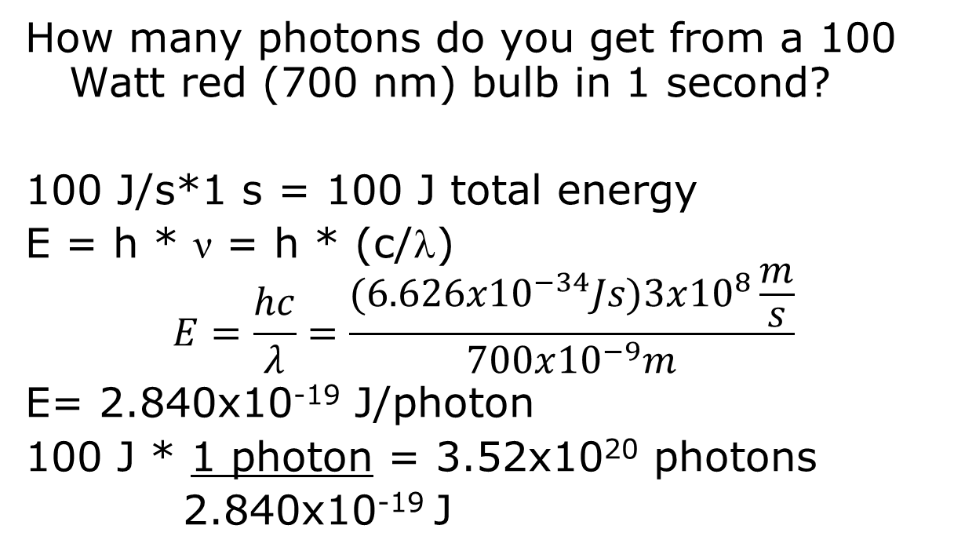
How many photons do you get from a 100 Watt red (700 nm) bulb in 1 second?
100 J/s*1 s = 100 J total energy
E = h * ν = h * (c/λ)
$$E=\frac{hc}{λ}=\frac{(6.626x{10}^{−34}Js)3x{10}^{8}\frac{m}{s}}{700x{10}^{−9}m}$$
E= 2.840x10⁻¹⁹ J/photon
100 J * 1 photon = 3.52x10²⁰ photons
2.840x10⁻¹⁹ J

Slide 102
Clicker
How many 700 nm photons does it take to generate 1.00 Joules of energy?
A. 2.16x10⁴⁸
B. 2.16x10³⁹
C. 3.5x10¹⁸
D. 2.84x10⁻¹⁹
E. 3.5x10²⁷

Slide 103
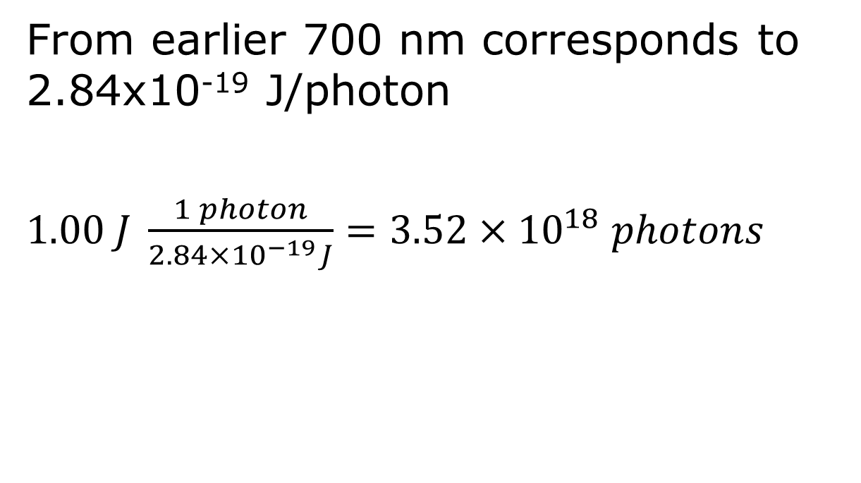
From earlier 700 nm corresponds to 2.84x10⁻¹⁹ J/photon
$1.00 J \frac{1 photon}{2.84×{10}^{−19}J}=3.52×{10}^{18} photons$

Slide 104
A little problem
I want to heat 100 g of water from 25ºC to the normal boiling point. How much energy do I need to add to the water?
A. 31.3 J
B. 31,350 J
C. 10, 450 J
D. None of the above
E. I don’t know, but I love this class.

Slide 105

$$q=mc∆T$$
$$q=100 g \left(4.18 \frac{J}{g℃}\right)\left(100℃−25℃\right)$$
$$q=31,350 J$$

Slide 106
How many 700 nm photons would I need to absorb to heat my water?
A. 4.6x10⁻⁴⁰ photons
B. 1.1x10¹⁴ photons
C. 1.1x10²³ photons
D. 8.9x10⁻¹⁵ photons
E. 4.6x10⁻⁴⁹ photons

Slide 107

$$31,350 J\frac{1 photon}{2.84×{10}^{−19}J}=1.1×{10}^{23}photons$$

Slide 108
Suppose I have a 100 W red (700 nm) light bulb. How long would it take to heat my water if the water is absorbing 35% of the light emitted by the bulb? [Assuming it all stays in the water.]
A. 1100 s
B. 1.1x10⁶ s
C. 896 s
D. 89 s
E. All frigging day

Slide 109
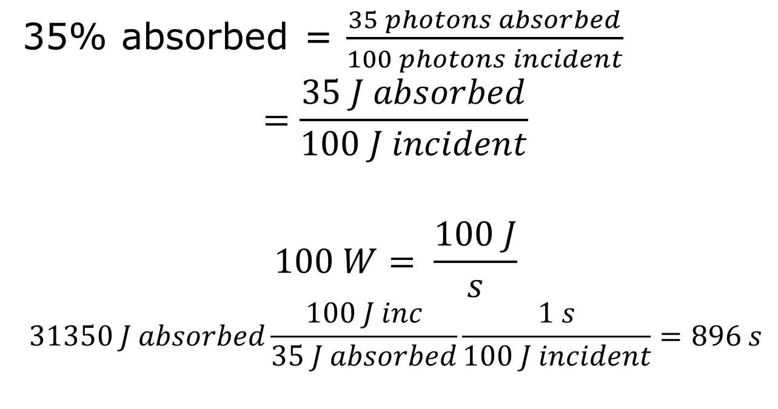
35% absorbed = $\frac{35 photons absorbed}{100 photons incident}$
$$=\frac{35 J absorbed}{100 J incident}$$
$$100 W= \frac{100 J}{s}$$
$$31350 J absorbed\frac{100 J inc}{35 J absorbed}\frac{1 s}{100 J incident}=896 s$$

