Slide 1
Numbers, Numbers, & More Numbers
Making sense of all the numbers

Slide 2
UNITS! UNITS! UNITS!
Joe’s 1st rule of Physical Sciences - watch the units.
The ability to convert units is fundamental, and a useful way to solve many simple problems.
Units also provide the context for numbers.

Slide 3
11
Good number at the craps table.
Bad number for an IQ.
Okay number for a shoe size.
They are all “elevens” but they are each very different things.

Slide 4
UNITS! UNITS! UNITS!
Numbers have no meaning without UNITS! UNITS! UNITS!
The unit provides the context to the number.
A number is just a number, but a number with an appropriate unit is a datum (singular of data) - a piece of information.

Slide 5
Data
11 pounds
11 dollars
11 points
These are better than just “elevens”, these are data, the 11 has some context – but it could have more!

Slide 6
Data
11 pounds of raisins vs. 11 pound baby vs. 11 pounds of sand
Our units are now even more specific, providing even greater context to the number, allowing better analysis of the meaning of the number.

Slide 7
Chemical Units
SI units - Systems Internationale - these are the standard units of the physical sciences (sometimes called the metric system).
Units are chosen to represent measurable physical properties.
Two types of units: “Pure” and “Derived”.

Slide 8
Pure Units
Represent indivisible physical quantities:
Mass – expressed in “kilograms” (kg)
Length – expressed in “meters” (m)
Time – expressed in “seconds” (s)
Charge – expressed in “Coulombs” (C)

Slide 9
Derived Units
Derived units are combinations of pure units that represent combinations of properties:
Speed – meters/second (m/s) – a combination of distance and time
Volume – m³ – combination of the length of each of 3 dimensions

Slide 10
SI units
The official standard units are all metric units. The nice thing about the standard system is that the units are all self-consistent: when you perform a calculation, if you use the standard unit for all of the variables, you will get a standard unit for the answer without having to expressly determine the cancellation of the units.

Slide 11
It’s all about the DATA folks!
The goal in any experimental science is to use measurement and observation as arguments in support of a thesis.
Data is NOT an end unto itself.
Data is part of a narrative. To be a good scientist, you need to learn to use data to craft an argument.

Slide 12
“Data” has a lot of subtlety
“four”
“4”
“4.0”
“4.00”
“4.00 pounds”
“4.00 pounds of carbon”
“4.00 pounds of carbon in the brain of Tyrannosaurus”
In our everyday speak, we use these interchangeably. But they aren’t!

Slide 13
The UNITS! UNITS! UNITS! mean everything
“4.00”
“4.00 pounds”
“4.00 pounds of carbon”
“4.00 pounds of carbon in the brain of Tyrannosaurus”
“4.00 pounds of carbon in the brain of Teddy the Tyrannosaur whom I bred in my basement”
These are not the same thing. “4.00” could be anything: 4 dollars in my pockets, 4 toes on my left foot, 4 ex-wives…
Specificity is important – it avoids ambiguity!

Slide 14
“Data” has a lot of subtlety
“four pounds of carbon in the brain of Tyrannosaurus”
“4 pounds of carbon in the brain of Tyrannosaurus”
“4.0 pounds of carbon in the brain of Tyrannosaurus ”
“4.00 pounds of carbon in the brain of Tyrannosaurus ”
Beyond the UNITS! UNITS! UNITS!, the numbers themselves include information.

Slide 15
4 is not 4.0 is not 4.00 is not 4.0000
A mathematician wouldn’t make a distinction.
Your grandma wouldn’t make a distinction – unless she’s a scientist.
A scientist makes a SIGNIFICANT distinction.

Slide 16
Significant Figures
Units represent measurable quantities.
Units contain information.
There are limits on the accuracy of any piece of information.
When writing a “data”, the number should contain information about the accuracy

Slide 17
Sig Figs
Suppose I measure the length of my desk using a ruler that is graduated in inches with no smaller divisions – what is the limit on my accuracy?
You might be tempted to say “1 inch”, but you can always estimate 1 additional decimal place. So the answer is 0.1 inches.
1
1
2
3
4

Slide 18
Sig Figs
1
1
2
3
4
The green block is about 40% of the way from 2 to 3, so it measures 2.4 inches!

Slide 19
Accuracy
So, the green block is 2.4 inches long. This is 2 “significant digits” – each of them is accurately known.
Another way of writing this is that the green block is 2.4 +/-0.05 inches long meaning that I know the block is not 2.3 in and not 2.5 in, but it could be 2.35 or 2.45 inches (both would be rounded to 2.4 inches).

Slide 20
Sig Figs
2.4 inches must always be written as 2.4 inches if it is data.
2.40 inches = 2.400 inches = 2.4 inches BUT NOT FOR DATA!
The number of digits written represent the number of digits measured and KNOWN!

Slide 21
Ambiguity
Suppose I told you I weigh 200 pounds. How many sig figs is that?
It is ambiguous – we need the zeroes to mark positions relative to the decimal place. Even if that measurement is 200 +/- 50 pounds, I can’t leave the zeroes out!

Slide 22
Scientific Notation
To avoid this ambiguity, numbers are usually written in scientific notation.
Scientific notation writes every number as
#.#### multiplied by some space marker.
For example 2.0 x 10² pounds would represent my weight to TWO sig figs.
The 10# markes the position, so I don’t need any extra zeroes lying around.
200 2.00

Slide 23
Examples of Scientific Notation
0.00038340 g = 3.8340 x 10⁻⁴ g
- trailing zeroes after decimal are always significant. Leading zeroes are never significant
200 lbs = 2 x 10² lbs = 2.0 x 10² lbs = 2.00 x 10² lbs
- place markers are ambiguous

Slide 24
Scientific Notation
Only sig figs are written. All digits that are written are significant.
1.200 x 10⁴ – 4 sig figs
1.0205 x 10⁻¹ – 5 sig figs
No ambiguity ever remains!

Slide 25
How many significant figures are there in the number 0.006410?
Preceding zeroes are NEVER significant.
Trailing zeroes are significant IF YOU DON’T NEED THEM.

Slide 26
SI units and Latin prefixes
Sometimes, SI units are written with a prefix indicating a different order of magnitude for the unit.
For example, length should always be measured in meters, but sometimes (for a planet) a meter is too small and sometimes (for a human cell) a meter is too large

Slide 27
Latin Prefixes
M = Mega = 1,000,000 = 10⁶
k = kilo = 1,000 = 10³
c = centi = 1/100 = 10⁻²
m = milli = 1/1000 = 10⁻³
μ = micro = 1/1,000,000 = 10⁻⁶

Slide 28
To date
Accuracy
Sig figs tell you how well you know the value of something
Scientific notation allows you to express it unambiguously.

Slide 29
Units! Units! Units!
What is it?
length, volume, weight, energy, charge…
How big is it?
inches? Feet? Yards? Miles? Parsecs?
nm, cm, m, km, Mm, Gm
What else could it be?
It’s a foot long, what does it weigh?
It’s a gallon big, what does it weigh?
Etc.

Slide 30
Prefixes & Units
So, if I measure a planet and determine it to be 167,535 meters in circumference, this can be written a number of ways.
167535 m
1.67535 x 10⁵ m
167.535 x 10³ m = 167.535 km

Slide 31
Other systems
The metric system isn’t the only system of measurement units. Any arbitrary system of units could be used, as long as the specific nature of each unit and its relationship to the physical property measured was defined.
The “English units” we use in the USA is an example of another system of units.

Slide 32
Converting Between Systems
If two different units both apply to the same physically measurable property – there must exist a conversion between them.

Slide 33
Converting Between Systems
If I am measuring length in “Joes” and Sandy is measuring length in “feet” and Johnny is measuring length in “meters”, since they are all lengths there must exist a reference between them.
I measure a stick and find it to be 3.6 “Joes” long. Sandy measures it and finds it to be 1 foot long, while Johnny measures it and finds it to be 0.3048 meters long.

Slide 34
Conversion factors
That means:
1 ft = 3.6 Joes
1 ft = 0.3048 m
This would apply to any measurement of any object

Slide 35
Dimensional Analysis
Also called the “Factor-label Method”.
Relies on the existence of conversion factors.
By simply converting units, it is possible to solve many simple and even mildly complex problems.

Slide 36
UNITS! UNITS! UNITS!
It’s always all about the units!

Slide 37
Conversion Factors
IT IS THE POWER OF ONE!

Slide 38
Conversion Factors
Dimensional analysis treats all numerical relationships as conversion factors of 1, since you can multiply any number by 1 without changing its value.

Slide 39
1 foot = 12 inches
This is really two different conversion factors – two different “ones”
$$\frac{1 foot}{12 inches}=1$$
$$\frac{12 inches}{1 foot}=1$$

Slide 40
One is Most Powerful
“One” is the multiplicative identity – you can multiply any number in the universe by 1 without changing its value.
Multiplying by 1 in the form of a ratio of numbers with units will NOT change its value but it WILL change its units!

Slide 41
The simplest Example
I am 73 inches tall, how many feet is that?
I know you can do this in like 10 seconds, but HOW do you do it?

Slide 42
The Path
The first thing you need to ask yourself in any problem is….?
What do I know?
The second thing you need to ask yourself in any problem is…?
What do I want to know? (Or, what do I want to find out?)

Slide 43
The Path
The solution in any problem is a question of finding the path from what you know to what you want to know.
In a dimensional analysis problem, that means finding the conversion factors that lead from what you know to what you want to know.

Slide 44
The simplest Example
I am 73 inches tall, how many feet is that?
$$73 inches \frac{???}{???}= ?feet$$
The thing I know - START
The thing I want - FINISH
THE PATH – how I get from START to FINISH

Slide 45
The Path
$$73 inches \frac{???}{???}= ?feet$$
The first step in ANY problem is always half-obvious!
Whatever I’m going to do next, I need to get rid of “inches”. [I don’t want it, it needs to change!]
$$73 inches \frac{???}{? inches}= ?feet$$
The path can have 1 step or a thousand steps. The 1 step solution is always obvious (although you may not know it). I change the unit I have into the unit I want.
$$73 inches \frac{?feet}{? inches}= ?feet$$

Slide 46
The Path
$$73 inches \frac{?feet}{? inches}= ?feet$$
In this case, I know the conversion: 1 foot = 12 inches
$$73 inches \frac{1feet}{12 inches}=6.08 feet≈6.1 feet$$
Only 2 significant figures! How do I know? Hang around for 10 minutes and I’ll tell you.

Slide 47
The Path
If I didn’t know the 1-step path, I need to find a longer path, but each step along the way is identical. I eliminate ONE unit and create a NEW UNIT.
$$=73 inches \frac{?mm}{? inches}\frac{?miles}{?mm}\frac{?yd}{?miles}\frac{?feet}{?yd}=?feet$$
It’s really just a whole series of multiplications by 1!

Slide 48
Too Simple?
As simple as that seems, the problems don’t get any more difficult! There is more than 1 step, many different conversion factors, but the steps in solving the problem remain the same.

Slide 49
Dimensional Analysis
Ask yourself what you know – with UNITS!
Ask yourself what you need to know – with UNITS!
Analyze the UNITS! change required.
Consider all the conversion factors you know (or have available) involving those UNITS!
Map the path.
Insert the conversion factors.
Run the numbers.
Celebrate victory!

Slide 50
Another Example
If there are 32 mg/mL of lead in a waste water sample, how many pound/gallons is this?
Do we recognize all the units?
mg = 10⁻³ g
mL = 10⁻³ Liters

Slide 51
Another Example
If there are 32 mg/mL of lead in a waste water sample, how many pound/gallons is this?
How would we solve this problem? What’s the first thing to do?

Slide 52

Dimensional Analysis
What do you know?
$$\frac{32 mg lead}{mL water}$$
What do you want to know?
$$\frac{lb lead}{gal water}$$

Slide 53
Dimensional Analysis
The path?
$$\frac{32 mg lead}{mL water}????=\frac{?lb lead}{gal water}$$
Do you know a single step path?
Probably not, but what do we know?

Slide 54
Dimensional Analysis
$$\frac{32 mg lead}{mL water}????=\frac{?lb lead}{gal water}$$
mg measures mass of lead, lb measures weight of lead (same thing at sea level)
mL measures volume of water, gal measures volume of water
It makes sense that identical types of quantities are most easily converted into each other.

Slide 55
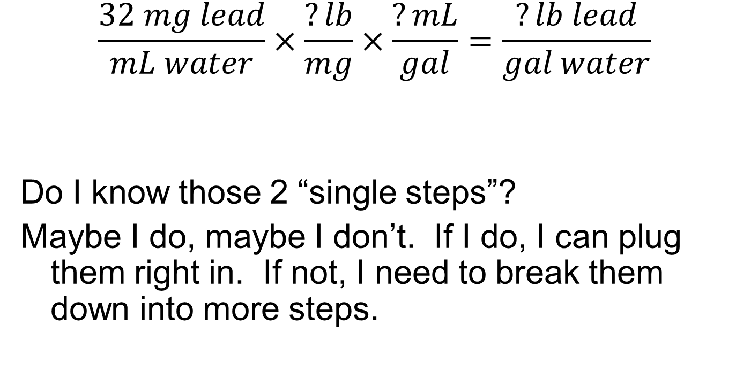
Two Step Path
$$\frac{32 mg lead}{mL water}×\frac{?lb}{mg}×\frac{?mL}{gal}=\frac{?lb lead}{gal water}$$
Do I know those 2 “single steps”?
Maybe I do, maybe I don’t. If I do, I can plug them right in. If not, I need to break them down into more steps.

Slide 56
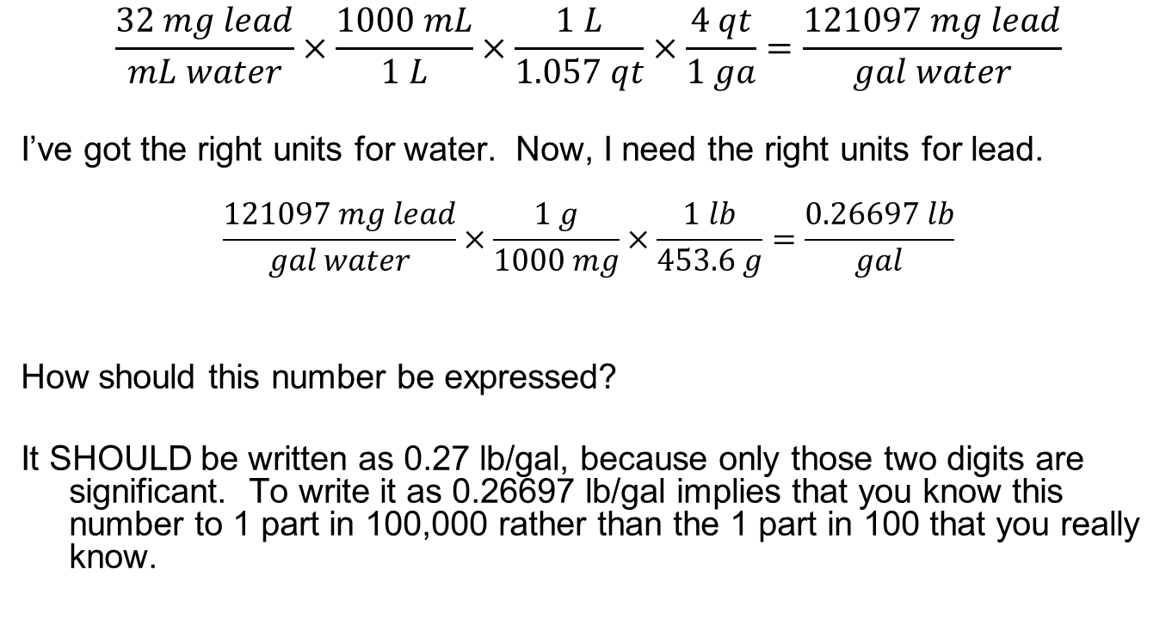
One possible path
$$\frac{32 mg lead}{mL water}×\frac{1000 mL}{1 L}×\frac{1 L}{1.057 qt}×\frac{4 qt}{1 ga}=\frac{121097 mg lead}{gal water}$$
I’ve got the right units for water. Now, I need the right units for lead.
$$\frac{121097 mg lead}{gal water}×\frac{1 g}{1000 mg}×\frac{1 lb}{453.6 g}=\frac{0.26697 lb}{gal}$$
How should this number be expressed?
It SHOULD be written as 0.27 lb/gal, because only those two digits are significant. To write it as 0.26697 lb/gal implies that you know this number to 1 part in 100,000 rather than the 1 part in 100 that you really know.

Slide 57
Sig Figs in a Calculated Answer
Significant Figures represent the accuracy of a measurement – what if the answer isn’t measured but calculated?
The calculated value must come from know values. These known values have accuracy of their own. Accuracy = sig figs
You can determine the accuracy (sig figs) of a calculated value based on the accuracy of the values used to do the calculation.

Slide 58
Calculating Sig Figs
2 different rules exist:
Multiplication/Division - the answer has the same number of sig figs as the digit with the least number of sig figs
Ex. 1.0 x 12.005 = 12
Addition/Subtraction - the answer has the same last decimal place as all digits have in common
Ex 1.1 + 2.222 + 13.333 = 16.7 (16.655 rounded)

Slide 59
Helpful Hints
When adding numbers in scientific notation, be sure the decimal points are in the proper place
You can only add numbers that have the SAME UNITS!

Slide 60
Sample Problem
$$6.24×{10}^{−3}∗1.2406×{10}^{4}∗6=464.48064≈5×{10}^{2}$$
only 1 sig fig because of the “6”
I write the answer in scientific notation so I don’t need zeroes as place markers (500)

Slide 61
Sample Problem
$$1.27×{10}^{2}+1.6×{10}^{3}+6.579×{10}^{5}=659627$$
How many sig figs? I don’t know!
Line ‘em up relative to the decimal point:
 |  |  | 1 | 2 | 7.
 |  | 1 | 6 | ? | ?.
6 | 5 | 7 | 9 | ? | ?.
6 | 5 | 9 | 6 | 2-ish | 7-ish

Slide 62
Sample Problem
(6.24 x 10⁻³ * 1.2406 x 10⁴) + 1.27 x 10² =
This problem involves both addition & multiplication!?!?!?
Simply apply each rule separately (obeying normal orders of operation) - BUT DON’T ROUND UNTIL THE END or you will introduce rounding errors.

Slide 63
(6.24 x 10⁻³ * 1.2406 x 10⁴) + 1.27 x 10² =
First the multiplication (order of operations):
$$6.24×{10}^{−3}∗1.2406×{10}^{4}=7.741344×{10}^{1}$$
But it’s only 3 sig figs (multiplication rule):
$$\left({7.74}_{1344}×{10}^{1}\right)+1.27×{10}^{2}=204.41$$
How many sig figs? Line ‘em up!
So the “ones’ place” is the last significant position.
So I write it as “204” or “2.04x10²”.
 | 7 | 7. | 4 | 1 | 3
1 | 2 | 7. | ? | ? | ?
2 | 0 | 4. | 4ish | 1ish | 3ish

Slide 64
Units and Math
You can multiply together any two numbers you want:
My height is 73 inches, my weight is 100 kg
73 inches * 100 kg = 7.3x10³ kg-inches
When you multiply, the units combine.

Slide 65
Addition/Subtraction and Units
You CAN’T add any two numbers, because the units don’t mix:
73 inches + 100 kg = 173 ????
To add two numbers, they MUST have the same units!

Slide 66
I have 48 cents in my pocket and $32 in my wallet. How much money do I have.
I can’t just add them together:
48 cents + 32 dollars = 80 ???
But I can if I give them the same units:
48 cents * 1 dollar = 0.48 dollars
100 cents
32 dollars + 0.48 dollars = 32.48 dollars (or $32.48)

Slide 67
Same type – different units
All of the conversions we’ve done so far have been simply changing the unit of measure without changing the type of measurement.
Inches to feet. Inches measures length. Feet measures length.
mL to L to quarts to gallons. All measure volume.
That’s great but kind of boring. I mean, I don’t get any taller if I use inches instead of feet. I don’t know anything new.

Slide 68
Different unit. Different type.
OOOOO….NOW WE’RE TALKING!
Here’s some real chemistry. If I can change a unit of mass into a unit of length, I’ve learned something new! But I need to have some physical relationship between length and mass for that to work.

Slide 69
The most important chemical conversion!
$$poop\frac{???}{???}=gold$$
Sadly, there’s no known relationship between poop and gold…at least not yet!

Slide 70
What is Density?
Density is the mass to volume ratio of a substance.
It allows you to compare the relative “heaviness” of two materials. A larger density material means that a sample of the same size (volume) will weigh more.

Slide 71
Ratios are Conversion Factors
Density is the ratio of mass to volume.
So, if you want to convert mass to volume or volume to mass – it’s the DENSITY!

Slide 72
$Density of steel=\frac{3 g steel}{mL steel}$
It means 1 mL of steel has a mass of 3 g:
1 mL steel = 3 g steel

Slide 73

Equalities are ratios – Conversion factors
1 mL steel = 3 g steel
$$\frac{1 mL steel}{3 g steel}=1$$
$$\frac{3 g steel}{1 mL steel}=1$$

Slide 74
Conversion Factors
Powers of 1

Slide 75
Sample problem
The density of aluminum is 2.7 g/mL. If I have a block of aluminum that is 1 meter on each side, then what is the mass of the block?
Where do we start?
We know the volume (length*width*height):
1 m x 1 m x 1 m = 1 m³
Where do we want to go?
Grams (or kilograms or cg or some unit of mass!)

Slide 76
Algebraically…
D = mass
Volume
But this is really just another conversion factor!

Slide 77
1 m³ * ???? = ? g
How do we go from m³ to g?
m³ is volume. g is mass. As soon as both are involved, there’s a density somewhere!

Slide 78
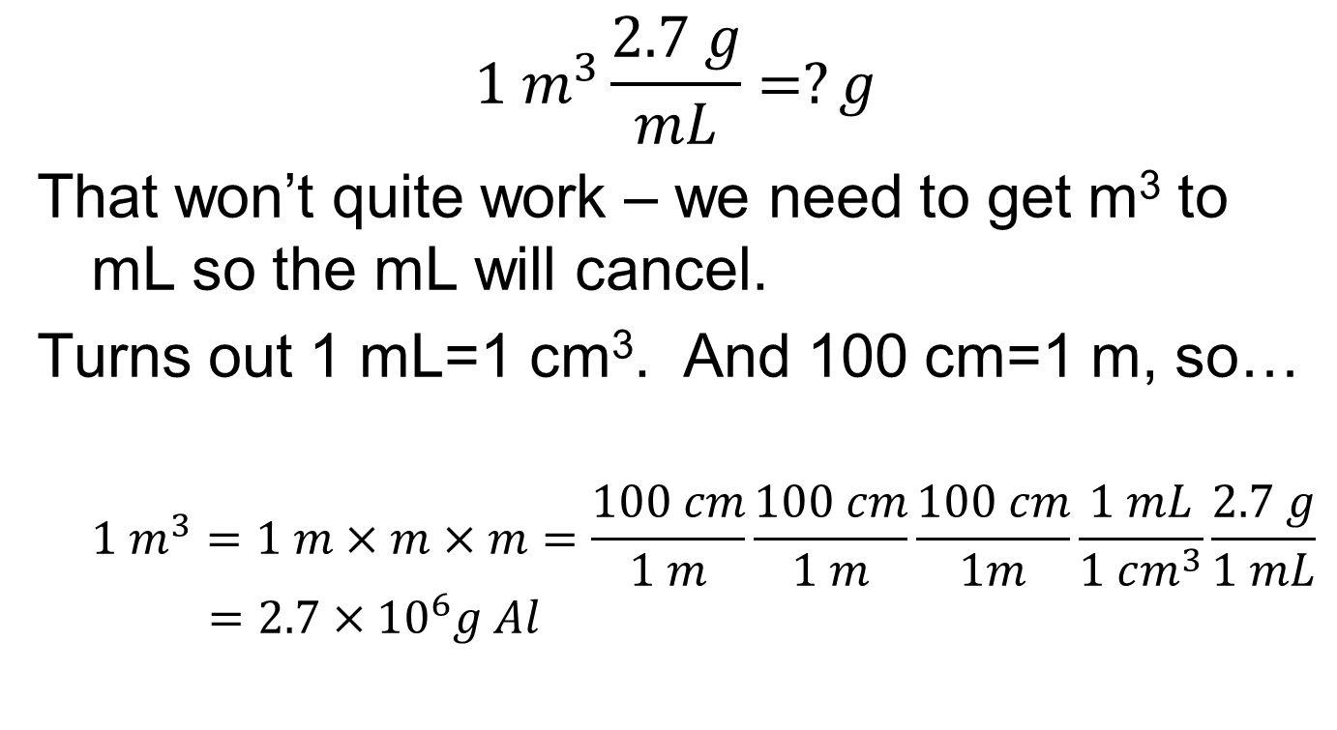
$$1 m^{3}\frac{2.7 g}{mL}=?g$$
That won’t quite work – we need to get m³ to mL so the mL will cancel.
Turns out 1 mL=1 cm³. And 100 cm=1 m, so…
$$1 m^{3}=1 m×m×m=\frac{100 cm}{1 m}\frac{100 cm}{1 m}\frac{100 cm}{1m}\frac{1 mL}{1 cm^{3}}\frac{2.7 g}{1 mL}=2.7×{10}^{6}g Al$$

