Slide 1
Thermochemistry
Energy, heat:
Uses and implications

Slide 2
Energy
Energy is actually like pornography: easy to recognize but hard to define.
Energy is sometimes defined as the capacity to do work.
Work is the result of a force acting over a distance.
Energy, however, takes many forms.

Slide 3
Some Types of Energy
Light
Gravitational
Potential
Kinetic/mechanical
Chemical
Electrical
Magnetic
Heat – waste energy

Slide 4
It’s not what you say, it’s what you do…
Often easier to see the effects of energy than the energy itself…
One of the easiest things to understand (especially during a Rochester winter) is “heat”.

Slide 5
Heat
Heat is actually waste energy from an engineering standpoint. It is energy that doesn’t go into making the car move, or bonding the atoms together.
Heat simply raises the temperature of materials.
On the molecular level, it is energy that makes the molecules move around faster.

Slide 6
Kinetic Theory of Temperature
Within this model, “temperature” is actually a measure of the median kinetic energy of the molecules.
Median K.E. T
# of molecules
Energy of molecules

Slide 7
When my water evaporated…
The temperature of the water stayed the same
The temperature of water stayed the same within the “uncertainty” of the measurement.
The temperature of the water went up.
The temperature of the water went down.
I have no frigging idea, the water fairies are looking better by the second.

Slide 8
So…after my temperature “went down”…did
The evaporation stop?
The evaporation slow down?
The evaporation keep on trucking…?
Water fairies
Earth fairies

Slide 9
Less water on my nightstand..
Is this because…
Water fairies stole it
The cat got it
The temperature in the room was briefly 100 degrees C
Some of the water molecules had enough energy to become gas molecules
I have no idea, I’m still asleep.

Slide 10
Absolute vs. Relative Temperature
Kinetic Energy is energy of motion. The faster a given object travels, the more KE it has.
High Temp
Low temp
Median K.E. T
# of molecules
Energy of molecules

Slide 11
Absolute vs. Relative Temperature
Fahrenheit, Celsius, Kelvin
All different temperature scales.
You could define your own. Find two temperatures (body temperature, melting point of sugar), divide up the difference between them into arbitrary units and you’re done!

Slide 12
Absolute vs. Relative Temperature
Fahrenheit, Celsius were made just that way – picking two arbitrary temperatures and dividing the difference between them into arbitrary units.
These are “relative” temperature scales.
Relative scales work fine: higher temperature is “hotter”, lower temperature is “colder”

Slide 13
Absolute vs. Relative Temperature
But if Temperature is really to be defined as the KE of the molecules, 0 degrees should be the temperature at which ALL MOLECULES STOP MOVING!
A temperature scale with the correct “0” is called an “absolute” temperature scale. Kelvin is an absolute temperature scale!

Slide 14
Energy is measured in Joules (J) which is a derived unit:
J = kg m²
s²

Slide 15
How does a hot pack work?
When you break the seal, you mix water and a salt.
The process of dissolving the salt results in the release of heat.

Slide 16
How does a cold pack work?
When you break the seal, you mix water and a salt together.
The process of dissolving the salt requires heat from the surroundings. Absorbing the heat cools the surroundings.

Slide 17
Molecular Dynamics
How different are these?
NaCl _{(s)}
NaCl _{(aq)}

Slide 18
Molecular Dynamics
How different are these?
NaCl _{(s)} – solid salt
NaCl _{(aq)} - salt dissolved in water

Slide 19
Molecular Dynamics
Sometimes, they are doing something very dynamic but we still tend to think of them as static.
NaCl _{(s)} NaCl _{(aq)}
When you see that reaction written, do you see it as a simple statement or a dynamic process?

Slide 20
Molecular Dynamics
NaCl _{(s)}  NaCl _{(aq)}
It’s actually a very dynamic process. All of the Na⁺ and Cl⁻ ions are ripped apart and surrounded by water molecules. There is energy associated with any such process: energy of attraction of ions, energy of attraction for the water and ions, etc.

Slide 21
Dynamic Picture
Na⁺
Na⁺
H H
O
Na⁺
H H
O
H H
O
Cl⁻
Cl⁻
Cl⁻
H H
O
H H
O
H H
O
Na⁺
H H
O
Na⁺
H H
O
Na⁺
Cl⁻
H H
O
Na⁺
Cl⁻
Na⁺
Cl⁻
Cl⁻
Na⁺
Cl⁻
Na⁺
Cl⁻
Cl⁻

Slide 22
Dynamic Picture
Na⁺
Na⁺
H H
O
Na⁺
H H
O
H H
O
Cl⁻
Cl⁻
Cl⁻
H H
O
H H
O
H H
O
Cl⁻
Na⁺
H H
O
H H
O
Na⁺
H H
O
Na⁺
Cl⁻
Na⁺
H H
O
Na⁺
Cl⁻
Na⁺
Cl⁻
Na⁺
Cl⁻
Na⁺
Cl⁻
Cl⁻
Na⁺
Cl⁻
Na⁺
Cl⁻
Na⁺
Cl⁻
Na⁺
Cl⁻
Cl⁻

Slide 23
When I stick the waters in there…
Do I have to put more energy in
Do I get energy out
Is there no energy implications whatsoever

Slide 24
Why do I get energy out?
I don’t know, you just do…
My high school chem teacher told me so…
The electrostatic attraction is pleasing
There is a natural H to Na repulsion
There is a natural H to Na attraction

Slide 25
What is step 2?
The Na and Cl get moved far enough apart to allow a water in
The water was ice and is melted
The water was liquid and was made a gas
I have no clue, stop wasting time with effing clicker questions
I really need to go the bathroom but I’m afraid to leave my clicker behind.

Slide 26
I want to rip out a chloride ion…
I need to put energy in
I get energy out
I don’t need to do anything with energy
Still asleep
Your mother.

Slide 27
Dynamic Picture
NaCl _{(s)}  NaCl _{(aq)}
To actually go from solid to aqueous requires individually separating each ion and then connecting each ion to the solvent network. It is the sum of billions and billions of little separations (a MOLE of separations).
There is actually a change in energy involved: the energy required to separate those billions and billions of molecules.

Slide 28
H_{2 (g)} + O_{2 (g)}  H₂O _{(g)}
How does this reaction occur? What do you need to do on the molecular level to make this reaction occur.
You need to break the H-H bond and the O=O bond, and make two O-H bonds!

Slide 29
H_{2 (g)} + O_{2 (g)}  H₂O _{(g)}
H-H H H

O=O O
There is also an energy change involved in the reaction.

Slide 30
Making and Breaking Bonds
Making a bond always releases energy.
Breaking a bond always requires energy.
Whether the entire reaction requires energy or releases energy depends on whether you get more/less energy out of the bonds you make than you put into the bonds you break.

Slide 31
The System vs. The Surroundings
Energy accounting requires certain rules to maintain consistency and get appropriate units.
The System – what you are studying.
The Surroundings – the rest of the universe.

Slide 32
Kinds of systems
There are different kinds of systems, defined by how they are related to the universe:
Open system – directly connected to the universe, mass and heat can go back and forth between system/universe.
Closed system – no mass can be transferred, but heat can be.
Isolated system – no mass or heat can be transferred.

Slide 33
Types of System
An “open system” would be this room.
A “closed system” would be an unopened bottle of wine.
An “isolated system” would be a sealed perfect thermos – your soup stays hot for an eternity!

Slide 34
Approximations to the Ideal
Ideally, we would always have an isolated system to study. It is much simpler if everything we are studying is trapped.
In practice, we only have nearly isolated systems.
For example, a thermos. (Sorry, but it won’t keep your soup warm for an eternity.)
As long as it limits heat loss or the duration of the experiment, it is practically isolated.

Slide 35
Calorimetry
Determining “heat” by measuring temperature.
Adding heat to something raises its temperature. That temperature rise is quantitatively related to the amount of heat added.

Slide 36
Boiling water
Is it easier to boil a cup of water or boil a swimming pool?
The bigger amount (mass) of water requires more energy to get the same temperature change!

Slide 37
Is it easier to boil a cup of water or boil a swimming pool
Cup of water
Swimming Pool
They’re the same
I wouldn’t do either one.
Why are we clicking on this?

Slide 38
Specific Heat
Have you ever put a ceramic pan on the stove and a metal pan on the same stove? Is there a difference?
The ceramic pan usually heats up more slowly (and cools down more slowly) than the metal pan.
Adding the same amount of heat to different materials causes a different temperature change!

Slide 39
Specific Heat
The amount of heat added to a fixed amount (mass) of a substance to change the temperature 1º is called the “specific heat of the substance”

Slide 40
The relation of Heat to Temperature
Putting it all together:
q = m c ΔT
q = heat
m = mass of the object
c = specific heat of the object
Δ T = change in temperature

Slide 41
Calorimetry problem
I want to heat 1 gallon of water from 20 ºC to 30ºC. How much heat must I add?
q = m c ΔT
1 gal * 3.7854 L * 1000 mL * 1 g = 3785.4 g
1 gal 1 L 1mL
c = 4.18 J/g ºC FOR WATER
Δ T = T_{f} – T_{i} = 30 ºC – 20 ºC = 10 ºC
q = (3785.4 g) (4.18 J/g ºC) (10 ºC) = +158, 230 J
= 158.230 kJ

Slide 42
Calorimetry Problem #2
I have 50.0 mL of pure water in a perfectly insulated thermos that is at room temperature (25 º C). I put a 5.0 g aluminum slug into a dry test tube and then put it in boiling water at sea level for several minutes until the aluminum slug, test tube and water have all reached equilibrium. I then instantaneously dump the hot slug into the perfectly insulated thermos without splashing. What is the temperature of the water and slug when they reach equilibrium with each other BUT NOT THE ROOM?

Slide 43
Solution to Question #2
q_{water} = - q_{Al}
q_{water} + q_{Al} =0
q_{water} = m_{water} c_{water} Δ T_{water}
q_{Al} = m_{Al} c_{Al} Δ T_{Al}
m_{water} c_{water} Δ T_{water} = - m_{Al} c_{Al} Δ T_{Al}

Slide 44
Solution to Question #2
50.0 mL water * 1.0 g water = 50.0 g water
1.0 mL water
From the table in the book:
c_{water} = 4.18 J/g ºC
c_{Al} = 0.90 J/g ºC
m_{water} c_{water} ΔT_{water} = - m_{Al} c_{Al} ΔT_{Al}
50.0 g * 4.18 J/g ºC (T_{f,water-}25) =
- 5.0 g * 0.90 J/g ºC * (T_{f},_{Al} – 100)
T_{f,water} = T_{f,Al}

Slide 45
Solution to Question #2
50.0 g * 4.18 J/g ºC (T_{f}-25) =
- 5.0 g * 0.90 J/g ºC * (T_{f} – 100)
209 (T_{f}-25) = -4.5(T_{f} – 100)
209 T_{f} – 5225 = -4.5T_{f} + 450
209 T_{f} + 4.5 T_{f} = 450 + 5225
213 T_{f} = 5675
T_{f} = 26.58 ºC

Slide 46
C=4.18 J/gC (water) c=0.90 J/gC (Al)
I take 50 mL of water at 25ºC and add to it a test tube of 25.0 mL of boiling water which has a 5.0 g Al slug in it. What is the final Temperature?
A. 27
B. 57
C. 24
D. 161
E. 42.54

Slide 47
Question
Burning 1 g of gasoline releases 3100 Joules of energy. How much gasoline (grams) would I need to burn to boil 1 L of water that is initially at room temperature (298 K)?

Slide 48
$$\frac{3100 J}{g burned}$$
Burning 1 g of gasoline releases 3100 Joules of energy
UNITS! UNITS! UNITS
$$\frac{3100 J}{g burned}$$

Slide 49
$$\frac{3100 J}{g burned}$$
How much gasoline (grams) would I need to burn to boil 1 L of water that is initially at room temperature (298 K)?
How much heat does it take?
If I’m changing the T of water, it’s:
Q=mc∆T

Slide 50
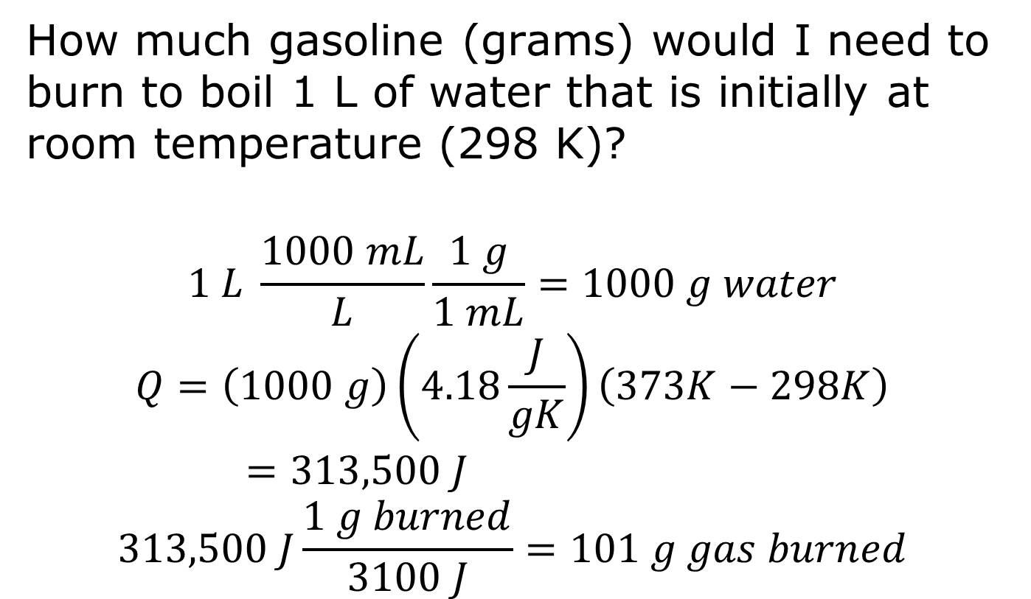
$$\frac{3100 J}{g burned}$$
How much gasoline (grams) would I need to burn to boil 1 L of water that is initially at room temperature (298 K)?
$$1 L \frac{1000 mL}{L}\frac{1 g}{1 mL}=1000 g water$$
$$Q=\left(1000 g\right)\left(4.18\frac{J}{gK}\right)\left(373K−298K\right)=313,500 J$$
$$313,500 J\frac{1 g burned}{3100 J}=101 g gas burned$$

Slide 51
Another little question
I burn 100 g of ethanol (C₂H₅OH) in a bomb calorimeter which contains 1 L of water at 298.0 K. After combustion of the ethanol, the temperature of the water in the bomb has climbed to 304.6 K. What is the energy released per mol of ethanol (assume negligible heat absorption by the bomb)?

Slide 52
What’s a bomb calorimeter?
Dang…I need the blackboard – I’ll draw this one out tomorrow.
But the bomb is a bomb-proof container that holds a combustion reaction. The container is submerged in a water bath which acts as a heat reservoir, kind of like this…

Slide 54
Another little question
I burn 100 g of ethanol (C₂H₅OH) in a bomb calorimeter which contains 1 L of water at 298.0 K. After combustion of the ethanol, the temperature of the water in the bomb has climbed to 304.6 K. What is the energy released per mol of ethanol (assume negligible heat absorption by the bomb)?

Slide 55
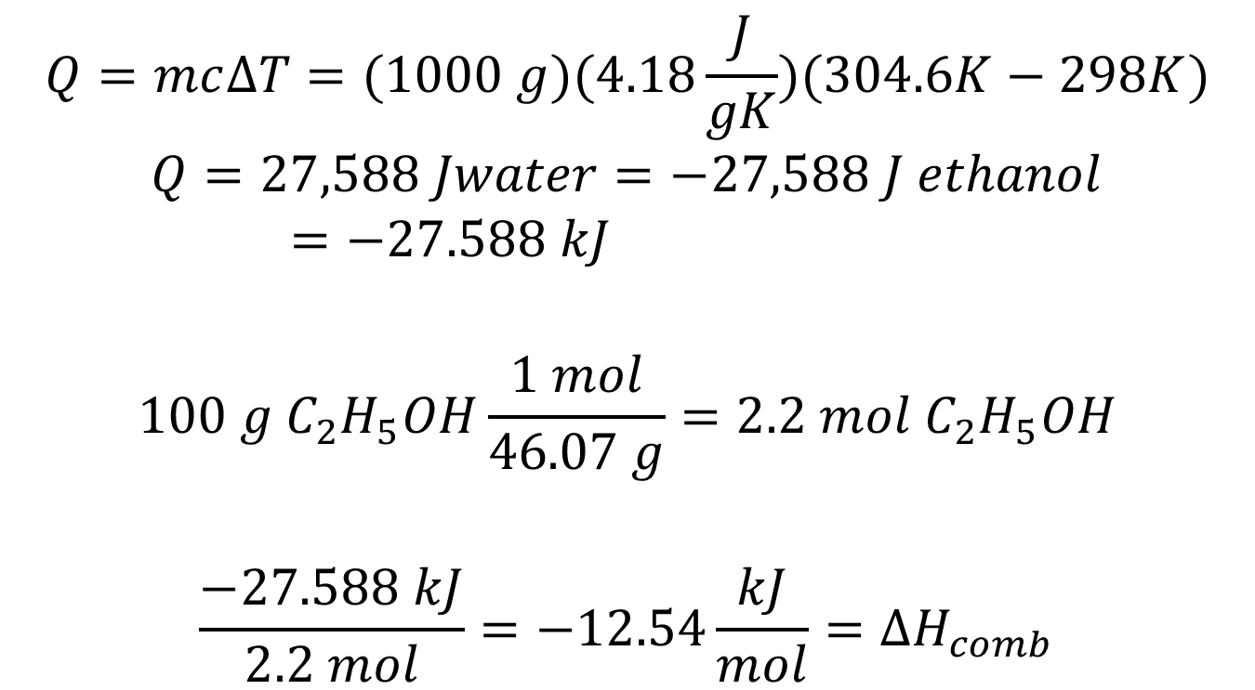
If T changed…then…
$$Q=mc∆T=(1000 g)(4.18\frac{J}{gK})(304.6K−298K)$$
$$Q=27,588 Jwater=−27,588 J ethanol=−27.588 kJ$$
$$100 g C_{2}H_{5}OH\frac{1 mol}{46.07 g}=2.2 mol C_{2}H_{5}OH$$
$$\frac{−27.588 kJ}{2.2 mol}=−12.54\frac{kJ}{mol}=∆H_{comb}$$

