Slide 1
Of Atoms, Molecules & Ions I Sing
The Foundations of Chemistry

Slide 2
Atomic Structure
We defined chemistry as the study of the physical and chemical properties of materials.
The study of material properties does not require an understanding of underlying atomic and molecular structure – but it can be helpful.

Slide 3
What things matter?
“Things” that have mass and take up space are called “matter”.
“Thingness”, the property of being a material, is determined by the presence of mass and occupation of space.
It is these two properties that define an object as being a material entity (as opposed to a spiritual entity, an abstract concept, or a non-entity).

Slide 4
Construction of Matter
Matter itself consists of many different types of objects.
Atoms are “physically indivisible” matter.
Molecules are collections of atoms that are joined together.
Mixtures are collections of different molecules that are intertwined with each other.

Slide 5
MATTER
CAN YOU PHYSICALLY SEPARATE?
NO
YES
PURE
MIXTURE
Can you
chemically
Separate?
Is it “uniform”
Throughout?
NO
YES
NO
YES
ATOM
(ELEMENT)
MOLECULE
(COMPOUND)
HETEROGENEOUS
HOMOGENEOUS

Slide 6
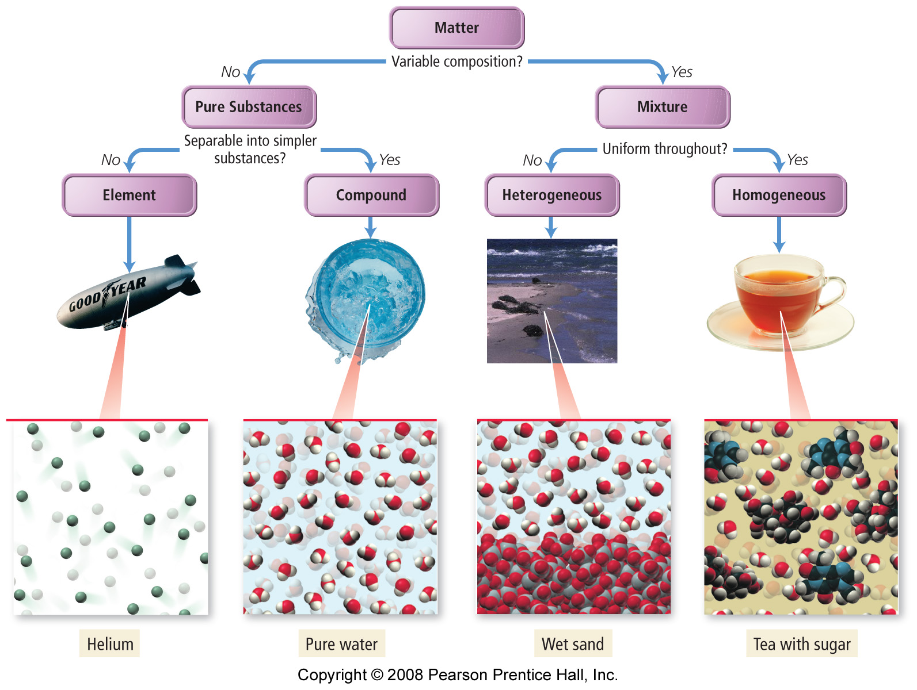

Slide 7
The Atomic Theory of Matter
At its lowest level, matter is made up of atoms. The current theory is most directly traceable to John Dalton in the early 1800s.

Slide 8
Conservation of Mass
It all starts with Lavoisier who showed that mass is conserved: he burned things in sealed containers and found that the total mass of the container was the same before and after the burning.
This showed that in a chemical reaction, the materials might change form, but the total mass remains the same.

Slide 9
Law of Definite Proportions
Joseph Proust made a series of mixtures of different elements and discovered that the ratio of the masses that reacted was always the same.
For example if mixing hydrogen and oxygen to get water, he found that if you started with 16.0 g of oxygen, you needed 2.0 g of hydrogen but if you started with 8.0 g of oxygen, you only needed 1.0 g of hydrogen. Always an 8:1 oxygen:hydrogen mass ratio!

Slide 10
Law of Multiple Proportions
John Dalton extended the definite proportions to “multiple proportions”: when 2 atoms (A and B) form different possible compounds, the mass of B combining with 1 g of A is always a whole number.
In other words, 1 g of hydrogen will react with 8 g oxygen to make water (8:1 ratio) 1 g of hydrogen will react with 16 g oxygen to make hydrogen peroxide (16:1 ratio)

Slide 11
Question
Gasoline burns in the presence of oxygen to form carbon dioxide and water. If 21 kg of gasoline requires 84 kg of oxygen to completely combust, what mass of carbon dioxide and water would be created?
63 kg
42 kg
84 kg
105 kg
21 kg

Slide 12
Question
Gasoline burns in the presence of oxygen to form carbon dioxide and water. 21 kg of gasoline requires 84 kg of oxygen to completely combust. If my gas tank has 30 kg of gas, how much oxygen would I need to completely burn it?
105 kg
120 kg
51 kg
7.5 kg
21 kg

Slide 13
Putting it all together:
Combining Lavoisier’s observation (conservation of mass) with Proust’s (definite proportions) and Dalton’s (multiple proportions) created Dalton’s Theory of Atomic Structure…

Slide 14
Dalton’s Atomic Theory
Each element is composed of atoms – which are incredibly small.
All atoms of a given element are identical to one another in mass and other properties, and different from all other atoms.
That atoms were indivisible, and were not created or destroyed in chemical reactions.
When atoms of different elements form compounds, the ratio of one type of atom to another is fixed.

Slide 15
Refining the model
Dalton’s model is useful for explaining how atoms form molecules.
We now know that atoms are divisible, but not by normal chemical means.
At extremely high energies (nuclear reactor), it is possible to split atoms into constituent particles.

Slide 16
Finding an Electron…
J.J. Thomson was playing with cathode ray tubes (precursor to your glass tubed television).
He discovered a stream of particles were actually moving from the cathode (negatively charged plate) to the anode (positively charged plate)

Slide 17
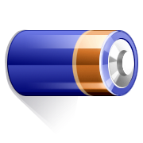
-
+

Slide 18
Rutherford found the rest
He fired alpha particles (charged Helium atoms) at a gold foil. What he found surprised him – most went straight through, a few deflected, but some bounced straight back!


Slide 19
Rutherford’s conclusion
Most of a gold foil (and other matter by extension) is made up of empty space, but there are some really hard little parts in between)

Slide 20
The Bohr Model
e-
Nucleus
n
p
p
n
e-
p
n
e-
n

Slide 21
The Bohr Model
The Bohr Model was “planetary”:
The nucleus (like the sun) lay at the center of the atom.
Electrons (like planets) were orbiting in circular orbits around the nucleus.
Most of the mass was the result o the protons and neutrons. Electrons are light (about 1/2000th of a proton)
Electrons are negatively charged while protons are postively charged (equal in magnitude to each other).
e-
Nucleus
p
n
p
n
e-
p
n
n
e-

Slide 22
The Bohr Model
We know now that the Bohr model isn’t completely accurate. Is there anything surprising about it?
-What keeps the protons from flying apart?
-What keeps the electrons from collapsing inward?
e-
Nucleus
p
n
p
n
e-
p
n
n
e-

Slide 23
The Bohr Model
Electrostatic forces aren’t the only forces in nature.
There exists a “strong force” and a “weak force” that counter the electrostatic forces at very short distances.
Despite its shortcomings, the Bohr Model remains instructive.
e-
Nucleus
p
n
p
n
e-
p
n
n
e-

Slide 24
The Bohr Model
Key Points:
The mass is a result of the total # of protons and neutrons.
The charge is a result of the net number of protons – electrons
The number of protons determines the identity of the atom
The electrons are responsible for the chemistry of the atom

Slide 25
Mass Number
The mass number is the total number of neutrons and protons.
The mass number is related to the atomic mass of an atom, but it isn’t directly connected.

Slide 26
Atomic Mass
Atomic mass has units of “atomic mass units” (amu). An “amu” is an arbitrary unit of mass, it is relative to carbon-12 having a mass of 12 amu.
Typically, the atomic mass is a little less than the mass number (for relativistic reasons). So a mass number of 24 will usually have an atomic mass of 23.99 amu.

Slide 27
Atomic Number
The atomic number is the number of protons the atom possesses.
All atoms of a particular type MUST have the same number of protons. It is the proton number that determines the identity of the atom. Carbon is atomic number 6 because all carbon atoms have 6 protons. If you find an atom by the side of the road and it has 6 protons, then you know it MUST be carbon.

Slide 29
Isotopes
All carbon atoms must have 6 protons, but they can have different numbers of neutrons. Adding neutrons will change the mass number.
An isotope is a type of atom with a particular mass number. An atom, like carbon, can have multiple isotopes.

Slide 30
Isotopes of Carbon
All carbon has 6 protons.
But carbon has 3 different isotopes: one with 6 neutrons, one with 7 neutrons, and one with 8 neutrons.
6 p + 6 n = mass number 12
6 p + 7 n = mass number 13
6 p + 8 n = mass number 14

Slide 31
Specifying isotopes
6 p + 6 n = mass number 12
6 p + 7 n = mass number 13
6 p + 8 n = mass number 14
These 3 isotopes are called carbon-12, carbon-13 and carbon-14.

Slide 32
Shorthand notation for isotopes
¹²C
¹³C
¹⁴C
Specifying the atom using its atomic symbol along with the mass number as a superscript gives a concise symbol for each of the isotopes.

Slide 33
Shorthand notation for isotopes
¹²₆C
¹³₆C
¹⁴₆C
While it is somewhat redundant, the atomic number is sometimes also included as a subscript.

Slide 34
Ions
An ion is an atom (or compound) that has an unequal number of protons and electrons. A cation is a positively charged ion (more protons than electrons) and an anion is a negatively charged ion (more electrons than protons).

Slide 35
Ion Notation
¹²₆C
¹³₆C⁺¹
¹⁴₆C⁺²
The charge is indicated as a superscript on the atomic symbol. If the isotopes aren’t relevant, you can just use the symbol and the charge:
C
C⁺¹
C⁺²

Slide 36
The Periodic Table is Your Friend
Knowing your way around the periodic table is the key to being a chemist. It contains a great deal of information.

Slide 37
Clicker Question #1
Consider the following atom: ¹³⁹₅₆Ba²⁺
The indicated atom has:
56 neutrons, 56 protons, 56 electrons
56 protons, 83 neutrons, 58 electrons
56 protons, 56 neutrons, 54 electrons
56 neutrons, 83 protons, 56 electrons
56 protons, 83 neutrons, 54 electrons

Slide 38
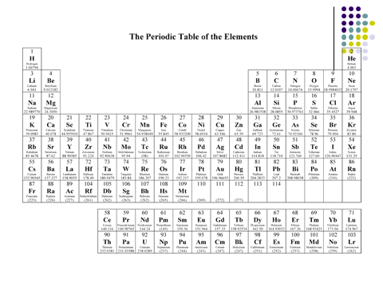

Slide 39
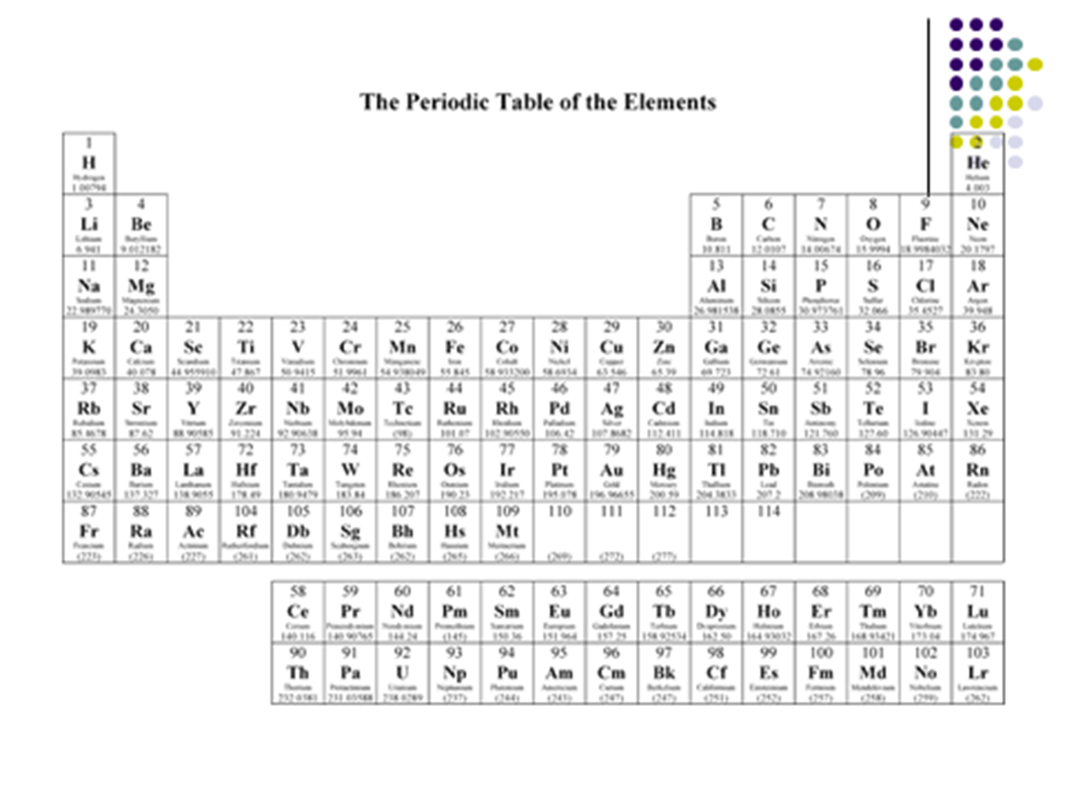
Metals vs. Non-metals

Slide 40
Metalloids or Semi-metals

Slide 41
Alkali Metals

Slide 42
Alkali Earth Metals

Slide 43
Noble Gases

Slide 44
Halogens

Slide 45
Chalcogenides

Slide 46
Mass Number vs. Atomic Weight
If carbon has a mass number of 12, 13 or 14 (depending on the isotope), why is the atomic mass in the periodic table 12.011?
It is a weighted average of all of the isotopes.

Slide 47
What’s a weighted average?
It’s like calculating your GPA:
Principles of Chemistry – A – 4 credits
Chemistry Lab – C – 1 credit
The average grade is a B or 3.0.
The weighted average is 3.6 – the class counts for much more than the lab.

Slide 48
Neon
Neon has 3 different isotopes
²⁰Ne – mass = 19.9924 amu
²¹Ne – mass = 20.9938 amu
²²Ne – mass = 21.9914 amu
But they aren’t equally common.

Slide 49
Natural Abundance
All isotopes occur with a certain “natural abundance” – the % of a sample of that element that has that isotope mass.

Slide 50
Neon – natural abundances
²⁰Ne – mass = 19.9924 amu – 90.48% NA
²¹Ne – mass = 20.9938 amu – 0.27% NA
²²Ne – mass = 21.9914 amu – 9.25% NA
The natural abundances are significantly different for the different isotopes and this must be accounted for in the “average atomic mass” of a sample of neon.

Slide 51
Neon – atomic mass
²⁰Ne – mass = 19.9924 amu – 90.48% NA
²¹Ne – mass = 20.9938 amu – 0.27% NA
²²Ne – mass = 21.9914 amu – 9.25% NA
19.9924 * 0.9048 + 20.9938 * 0.0027 + 21.9914 * 0.0925 = 20.180 amu

Slide 53
Neon – alternate calculation
²⁰Ne – mass = 19.9924 amu – 90.48% NA
²¹Ne – mass = 20.9938 amu – 0.27% NA
²²Ne – mass = 21.9914 amu – 9.25% NA
(19.9924 * 90.48 + 20.9938 * 0.27 + 21.9914 * 9.25) 100
= 20.180 amu

Slide 54
Molecules from atoms
Molecules are made by combining 2 or more atoms. It makes no difference whether they are the same atom or different atoms.

Slide 55
Diatomic molecules
Some of the elements actually exist in nature ONLY as diatomic molecules (di-atomic = two atoms).
For example H₂, O₂, N₂, F₂, Br₂, Cl₂, I₂
These are considered to be the natural form of these elements.
Halogens, HON!

Slide 56
Diatomic molecules
You can form a myriad of diatomic molecules from different atoms joined together.
MgO, FeO, CO, NO, HCl are examples

Slide 57
Molecular Mass
A molecule has a molecular mass just like an atom has an atomic mass.
Both are frequently called “molar mass” and have units of g/mol (which is why they are called “molar mass” which is the mass, in g, of a mole of substance)

Slide 58
Molar Mass
To determine the molar mass of a molecule, you simply add together the atomic masses of the atoms that make it up.
So, for MgO:
Molar Mass of MgO = Molar mass of Mg + Molar Mass of O

Slide 60
A mole of Mg atoms has a mass of 24.31 g. How many moles of Mg atoms in 500 g?
1 mol of Mg atoms = 24.31 g
(from the Periodic Table)
$\frac{24.31 g Mg}{1 mol Mg}$ or $\frac{1 mol Mg}{24.31 g Mg}$

Slide 61
Mass of MgO = 24.305 amu + 15.999 amu
Mass of MgO = 40.304 amu

Slide 62
amu and moles
amu – “atomic mass unit” is arbitrary.
Before they could “weigh” atoms, there was no other way. They determined the mass relative to Carbon-12 and just left it at that.
Obviously, grams would be a better unit of mass than amu, since you could use a scale!

Slide 63
Enter Avogadro’s number
Eventually, they were able to determine the absolute mass instead of the relative mass. Turns out that 1 amu = 1.66053873x10⁻²⁷ kg.
But that is an unsightly number and who ever uses a single atom!
Enter the “mole”

Slide 64
A mole is just a “dozen”
Some things are measured in groups:
A dozen donuts (12)
A dozen eggs (12)
A ream of paper (500)
A gross of widgets (144)
…A mole of atoms.

Slide 65
It’s just convenience
A mole is just the number of atoms (molecules) required to turn an amu into a gram!!!
If ¹²C has a mass of 12 amu, one MOLE of ¹²C has a mass of 12 grams!
The better way to look at the mass in the periodic table is as g/mol rather than amu.

Slide 67
6.02214150x10²³ anythings per mole
How many ¹²C atoms in a mole of ¹²C?
6.02214150x10²³
How many ping pong balls in a mole of ping pong balls?
6.02214150x10²³

Slide 68
Avogadro’s number
Just another conversion factor:
6.022x10²³ things
mole

Slide 69
Clicker question
I have 182,000 pennies that I’ve collected. How many moles of pennies is that?
1.096x10²⁹
6.022x10²³
3.0223x10⁻¹⁹
6.022x10⁻²³

Slide 70
182,000 pennies * 1 mole =
6.022x10²³ pennies
3.022x10⁻¹⁹ moles of pennies

Slide 71
Clicker question
The federal deficit year to date is $1.3 x10¹². How many moles of dollars is that?
1.3x10⁻³⁶
7.8x10²³
4.6x10¹¹
7.8x10³⁵
2.2x10⁻¹²

Slide 72
How many atoms are in 500.0 g of Mg?
A. $500.0 g Mg\frac{1 mol Mg}{6.022x{10}^{23}Mg atoms}=8.3x{10}^{−22}Mg atoms$
B. $500.0 g Mg\frac{6.022x{10}^{23}Mg atoms}{mol}=3.011x{10}^{26}Mg atoms$
C. $500.0 g Mg\frac{1 mol }{24.305 g Mg}=20.57 mol Mg$
D. $500.0 g Mg\frac{1 mol }{24.305 g Mg}\frac{6.022x{10}^{23}atoms}{mol}=1.24x{10}^{25} mol Mg$
E. Your mother is a critic

