Slide 1
Solution Equilibria
Of Buffers, Ions and Solubility Products I sing!!!!

Slide 2
K IS K IS K IS K IS K
If you truly grasp the nature of equilibrium reactions and can set up and solve ICE charts – there is nothing new here.
Different type of reaction, same mechanics.

Slide 3
Common Ion Effect
We’ve already seen a version of the common Ion Effect pop up in our discussions of very weak acids (or bases) and in polyprotic acids.
This has also implicitly arisen as an issue when discussing LeChatelier’s Principle.

Slide 4
An Old Friend – A Familiar Problem
What is the pH of a 0.100 M HOAc solution?
What’s the 1st thing we need?

Slide 5
A Balanced Equation
HOAc + H₂O ↔ OAc⁻ + H₃O⁺
And next we need….???

Slide 6
An ICE Chart & a K
HOAc + H₂O ↔ OAc⁻ + H₃O⁺
K_{a} = [OAc-][H₃O⁺] = 1.8x10⁻⁵
[HOAc]

Slide 7
An ICE Chart
HOAc + H₂O ↔ OAc⁻ + H₃O⁺
I 0.100 M - 0 0
C -x -x +x +x
E 0.100-x - x x
Now, back to the K!!

Slide 8
An ICE Chart & a K
HOAc + H₂O ↔ OAc⁻ + H₃O⁺
K_{a} = [x][x] = 1.8x10⁻⁵
[0.100-x]
How do we solve it?

Slide 9
An ICE Chart & a K
HOAc + H₂O ↔ OAc⁻ + H₃O⁺
K_{a} = [x][x] = 1.8x10⁻⁵
[0.100-x]
How do we solve it?
Always try our simplifying assumption

Slide 10
HOAc + H₂O ↔ OAc⁻ + H₃O⁺
K_{a} = [x][x] = 1.8x10⁻⁵
[0.100-x]
X<<0.100
K_{a} = [x][x] = 1.8x10⁻⁵
[0.100]
X² = 1.8x10⁻⁶
x = 1.34x10⁻³ M

Slide 11
pH = - log [H₃O⁺ ]
pH = - log (1.34x10⁻³ M)
pH = 2.87

Slide 12
New Problem
What is the pH of a solution that is 0.100 M HOAc AND 0.100 M NaOAc?
What’s the first thing you need?

Slide 13
What is the pH of a solution that is 0.100 M HOAc AND 0.100 M NaOAc?
HOAc + NaOAc ↔
HOAc + H₂O ↔
NaOAc + H₂O ↔
H₂O + H₂O↔
OAc⁻ + HOAc ↔

Slide 14
A Balanced Equation
But what’s going on here?
Is this a familiar reaction or something completely new?

Slide 15
Critical Judgment
HOAc + H₂O ↔ OAc⁻ + H₃O⁺
How would you know this?
HOAc and NaOAc have only a couple possible products if they were to react….

Slide 16
Critical Judgment
HOAc + H₂O ↔ OAc⁻ + H₃O⁺
HOAc is an “ionic-ish” compound.
NaOAc is an ionic compound
HOAc → H⁺ + OAc⁻
NaOAc → Na⁺ + OAc⁻

Slide 17
Critical Judgment
HOAc → H⁺ + OAc⁻
NaOAc → Na⁺ + OAc⁻
If new compounds were to form, it would need to be from the interaction of the cations with the anions and vice-versa
The only possible products are:
HOAc and NaOAc
They cannot react with each other!

Slide 18
Critical Judgment
It is also possible that an acid/base neutralization reaction could happen since HOAc is an acid and OAc⁻ is a base:
HOAc + OAc⁻ → HOAc + OAc⁻
The only possible products are:
HOAc and OAc⁻ ⁻ which is what you started with!
They cannot react with each other!

Slide 19
So – is there no reaction…
Well, there is actually one other thing in the beaker:
HOAc
HOAc
OAc⁻
OAc⁻
HOAc
OAc⁻

Slide 20
So – is there no reaction…
Well, there is actually one other thing in the beaker:
HOAc
H₂O
H₂O
H₂O
HOAc
OAc⁻
OAc⁻
HOAc
OAc⁻

Slide 21
It’s our old friend!
HOAc + H₂O ↔ OAc⁻ + H₃O⁺
Or…
OAc⁻ + H₂O ↔ HOAc + OH⁻
In either case it is the SAME reaction:
K_{a} or K_{b}
It just happens that you have one of the reactants AND one of the products!

Slide 22
Returning to the Problem
HOAc + H₂O ↔ OAc⁻ + H₃O⁺
Next on the list of things we need is…

Slide 23
Returning to the Problem
HOAc + H₂O ↔ OAc⁻ + H₃O⁺
Next on the list of things we need is…
The Equilibrium Constant Expression
And maybe an ICE chart

Slide 24
The Equilibrium Constant Expression
HOAc + H₂O ↔ OAc⁻ + H₃O⁺
K_{a} = [OAc-][H₃O+] = 1.8x10⁻⁵
[HOAc]
The value is from the table in the book.

Slide 25
ICE ICE, BABY, ICE ICE
HOAc + H₂O ↔ OAc⁻ + H₃O⁺
I
C
E
What goes where?

Slide 26
In case you’ve forgotten the problem…
What is the pH of a solution that is 0.100 M HOAc AND 0.100 M NaOAc?
What’s with the NaOAc?

Slide 27
In case you’ve forgotten the problem…
What is the pH of a solution that is 0.100 M HOAc AND 0.100 M NaOAc?
What’s with the NaOAc?
It’s just a source of OAc- in this reaction – Na is a spectator ion. We could just as easily have used KOAc, or even Fe(OAc)₃

Slide 28
Why NaOAc?

Slide 29
Why NaOAc?
You see Na salts used a lot.
Same 3 reasons as before:
Cheap.
Very soluble.
Mostly inert.
(K salts also work, things like Fe, Ca etc not so much.)

Slide 30
ICE ICE, BABY, ICE ICE
HOAc + H₂O ↔ OAc⁻ + H₃O⁺
I 0.100 M - 0.100 M 0
C -x - +x +x
E 0.100-x - 0.100+x x
Does it now start to feel like we’re on familiar ground?

Slide 31
The Equilibrium Constant Expression
HOAc + H₂O ↔ OAc⁻ + H₃O⁺
K_{a} = [OAc-][H₃O+] = 1.8x10⁻⁵
[HOAc]
K_{a} = [0.100+x][x] = 1.8x10⁻⁵
[0.100-x]
Can we make our assumption?

Slide 32
The Equilibrium Constant Expression
HOAc + H₂O ↔ OAc⁻ + H₃O⁺
K_{a} = [OAc-][H₃O+] = 1.8x10⁻⁵
[HOAc]
K_{a} = [0.100+x][x] = 1.8x10⁻⁵
[0.100-x]
Can we make our assumption?
Always worth a try! x<<0.100

Slide 33
The Equilibrium Constant Expression
K_{a} = [0.100][x] = 1.8x10⁻⁵
[0.100]
x = 1.8x10⁻⁵
Looks like a pretty good assumption.

Slide 34
ICE ICE, BABY, ICE ICE
HOAc + H₂O ↔ OAc⁻ + H₃O⁺
I 0.100 M - 0.100 M 0
C -1.8x10⁻⁵ - +1.8x10⁻⁵ +1.8x10⁻⁵
E 0.100 - 0.100 1.8x10⁻⁵

Slide 35
Calculating the pH
pH = - log[H₃O+]
pH = -log (1.8x10⁻⁵)
pH = 4.74

Slide 36
How does this compare to our HOAc without the NaOAc?
0.100 M HOAc
pH = 2.87
0.100 M HOAc & 0.100 M NaOAc
pH = 4.74
Does this make sense?

Slide 37
How does this compare to our HOAc without the NaOAc?
0.100 M HOAc
pH = 2.87
0.100 M HOAc & 0.100 M NaOAc
pH = 4.74
Does this make sense?
Of course! It’s French!

Slide 38
Le Chatelier’s Principle!
A system under “stress” responds to alleviate that stress.
By introducing a second source of OAc-, we force the K_{a} reaction of HOAc to shift to alleviate that stress.
It shifts back toward the reactants to try and use up some of the extra OAc- and keep K constant!

Slide 39
Le Chatelier’s Principle!
All the “Common Ion Effect” is is LeChatelier’s Principle where the “stress” is a “common ion”!
This problem is also an excellent example of something else…

Slide 40
Le Chatelier’s Principle!
All the “Common Ion Effect” is is LeChatelier’s Principle where the “stress” is a “common ion”!
This problem is also an excellent example of something else…
It’s a Buffer!

Slide 41
What’s a Buffer?

Slide 42
What’s a Buffer?
A “buffer” is just an acid (or a base) and its conjugate base (or acid).
What’s a buffer good for?

Slide 43
What’s a Buffer?
A “buffer” is just an acid (or a base) and its conjugate base (or acid).
What’s a buffer good for?
A buffer resists changes in its pH!
How?

Slide 44
What’s a Buffer?
A “buffer” is just an acid (or a base) and its conjugate base (or acid).
What’s a buffer good for?
A buffer resists changes in its pH!
How?
Le Chatelier’s Principle, Common Ion Effect, 2 elephants on the playground…

Slide 45
Two elephants on the playground
Remember “equilibrium” is all about balancing the see-saw!

Slide 46
0.100 M HOAc in water
0.099 M HOAc
1.34x10⁻³ M H₃O⁺
1.34x10⁻³ M OAc-

Slide 47
HOAc in water – add a little acid
What happens?
+1x10-3M acid
0.099 M HOAc
1.34x10⁻³ M H₃O⁺
1.34x10⁻³ M OAc-

Slide 48
It’s all about K – it must be maintained
Ka = [OAc-][H3O+] = 1.8x10⁻⁵ Ka = [0.00134][0.00134] = 1.8x10⁻⁵
[HOAc] [0.099]
+1x10-3M acid
0.099 M HOAc
1.34x10⁻³ M H₃O⁺
1.34x10⁻³ M OAc-

Slide 49
It’s all about K – it must be maintained
Ka == [0.00134][0.00134 + 0.001] ‡ 1.8x10-5
[0.099]
+1x10-3M acid
0.099 M HOAc
1.34x10⁻³ M H₃O⁺
1.34x10⁻³ M OAc-
The reaction will have to shift back toward the reactants a little to balance

Slide 50
0.100 M HOAc in water + the other Fat elephant
A small addition of acid (or base) isn’t going to move the
Fat Kids very much!
0.100 M HOAc
1.8x10⁻⁵ M H₃O⁺
0.100 M OAc-

Slide 51
0.100 M HOAc in water + the other Fat elephant
A small addition of acid (or base) isn’t going to move the
Fat Kids very much!
0.001 M H+
0.100 M HOAc
1.8x10⁻⁵ M H₃O⁺
0.100 M OAc-

Slide 52
Buffers are NOTHING NEW
K is K is K is K
A buffer is just an acid (or base) with a conjugate base (or acid) thrown in.
It’s just an ICE chart with different initial conditions.

Slide 53
Chemical Shorthand
Since the ICE chart for a buffer looks pretty much the same every time, doesn’t it seem like there should be a way around having to set up and solve the ICE chart repeatedly?
Well, in fact, there is a chemical shorthand…

Slide 54
Henderson-Hasselbach
pH= pK_{a} + log [base]
[acid]
This is actually just the ICE chart.
Recall the equilibrium expression we just used:
K_{a} = [OAc-][H₃O+]
[HOAc]
Could I write it more generally for any acid?

Slide 55
Acid + H₂O ↔ Conj Base + H₃O⁺
K_{a} = [conj base][H₃O+]
[acid]
Now, all I need to do is take the –log of both sides!!!

Slide 56
A little algebra
- log K_{a} = - log [conj base][H₃O+]
[acid]
Remember log A*B = log A + log B
- log K_{a} = - log [conj base] - log [H₃O+]
[acid]

Slide 57
A little algebra
- log K_{a} = - log [base] - log [H₃O+]
[acid]
What is “- log [H₃O⁺]”?
pH, of course!
What is “- log K_{a}”?
pK_{a}, of course!
pK_{a} = - log [base] + pH
[acid]

Slide 58
Rearranging a little
pK_{a} = - log [base] + pH
[acid]
pK_{a} + log [base] = pH
[acid]
Voila!!! The Henderson-Hasselbach equation!!!
You can also write it as:
pOH = pK_{b} + log [acid]
[base]

Slide 59
Returning to my original buffer…
If I mix 0.100 M HOAc and 0.100 M NaOAc, what’s the pH?
Let’s revisit our solution but use Henderson-Hasselbach:

Slide 60

ICE ICE, BABY, ICE ICE
HOAc + H₂O ↔ OAc⁻ + H₃O⁺
I 0.100 M - 0.100 M 0
C -x - +x +x
E 0.100-x - 0.100+x x
$$pH = pKa +\log\left(\frac{\left[base\right]}{\left[acid\right]}\right)$$

Slide 61

ICE ICE, BABY, ICE ICE
$$pH = pKa +\log\left(\frac{\left[base\right]}{\left[acid\right]}\right)$$
$$pKa = −log⁡(1.8×{10}^{−5}) = 4.74$$
$$pH =4.74 +\log\left(\frac{\left[base\right]}{\left[acid\right]}\right)$$

Slide 62
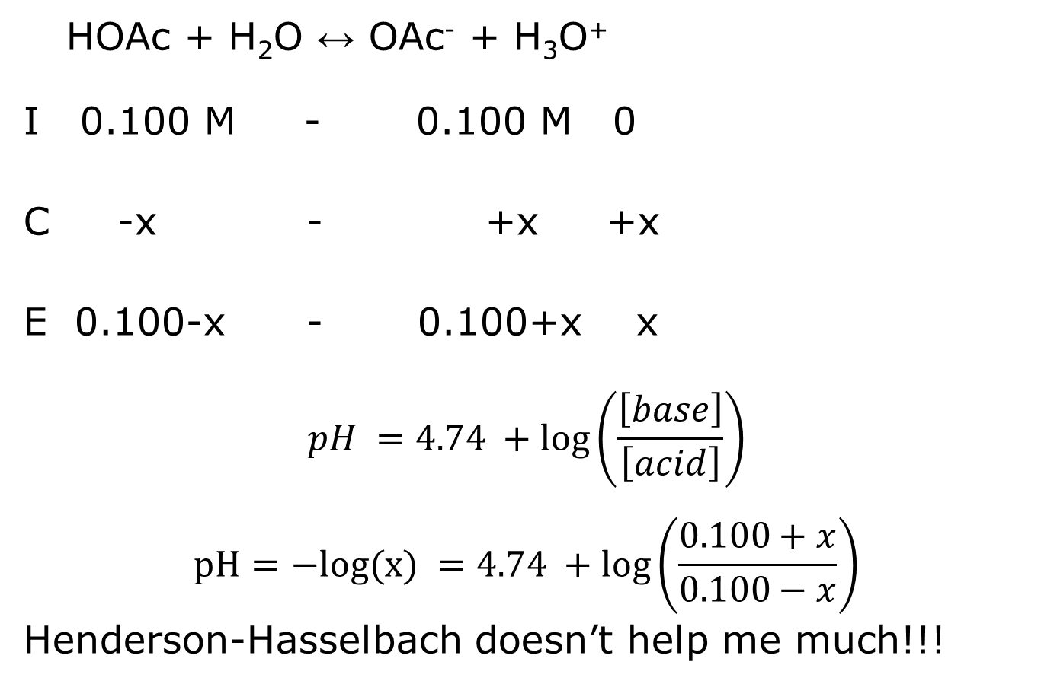
ICE ICE, BABY, ICE ICE
HOAc + H₂O ↔ OAc⁻ + H₃O⁺
I 0.100 M - 0.100 M 0
C -x - +x +x
E 0.100-x - 0.100+x x
$$pH =4.74 +\log\left(\frac{\left[base\right]}{\left[acid\right]}\right)$$
$$pH=−log(x) =4.74 +\log\left(\frac{0.100+x}{0.100−x}\right)$$
Henderson-Hasselbach doesn’t help me much!!!

Slide 63
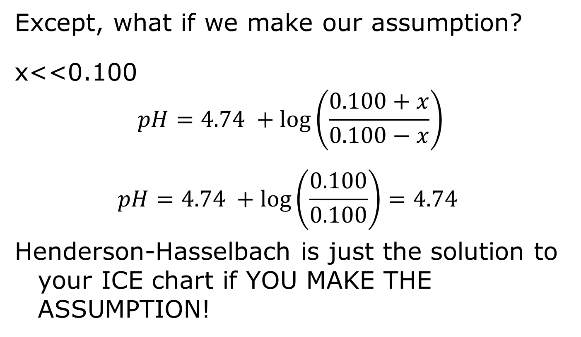
The Equilibrium Constant Expression
Except, what if we make our assumption?
x<<0.100
$$pH=4.74 +\log\left(\frac{0.100+x}{0.100−x}\right)$$
$$pH=4.74 +\log\left(\frac{0.100}{0.100}\right)=4.74$$
Henderson-Hasselbach is just the solution to your ICE chart if YOU MAKE THE ASSUMPTION!

Slide 64
ICE ICE, BABY, ICE ICE
HOAc + H₂O ↔ OAc⁻ + H₃O⁺
I INITIAL - INITIAL 0
C -SMALL - +SMALL +x
E INITIAL - INITIAL x
So, I get to use my INITIAL concentrations in H-H if I assume x is small.

Slide 65
H-H makes buffers easy!
What is the pH of a solution made by mixing 500 mL of 3.0 M NH₃ and 500 mL of 3.0 M NH₄Cl?
1st thing you need is…
NH₄Cl = NH₄⁺ + Cl⁻

Slide 66
Balanced Equation!
NH₃ + H₂O ↔ NH₄⁺ + OH⁻
Do I need to do an ICE chart?
Not with H-H!

Slide 67
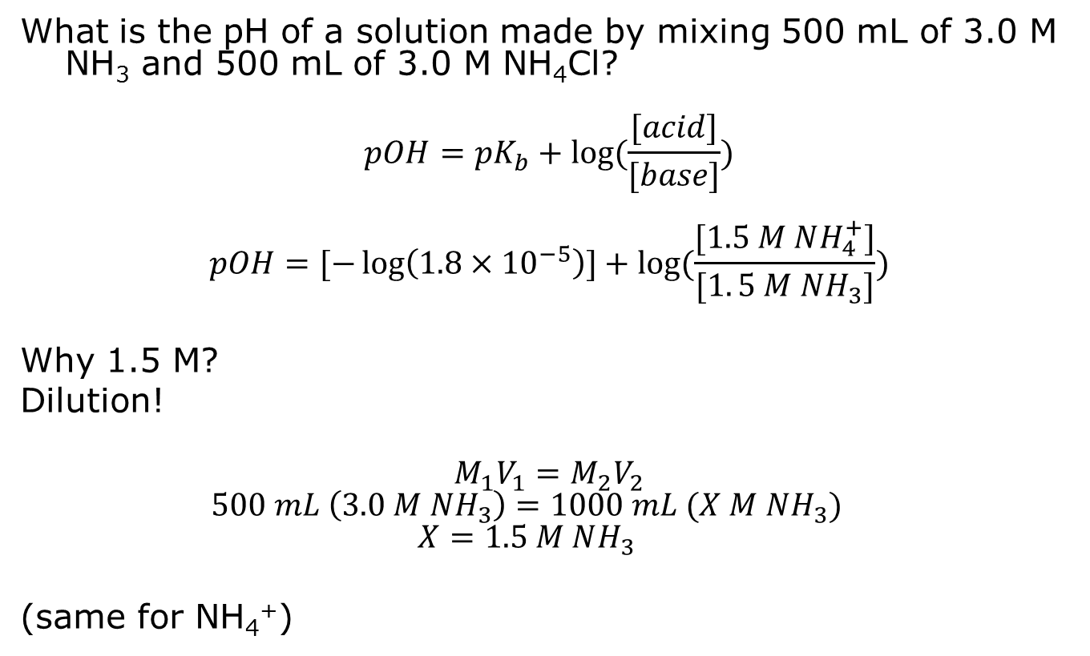
H-H makes buffers easy!
What is the pH of a solution made by mixing 500 mL of 3.0 M NH₃ and 500 mL of 3.0 M NH₄Cl?
$$pOH=pK_{b}+log⁡(\frac{[acid]}{[base]})$$
$$pOH=[−\log\left(1.8×{10}^{−5}\right)]+log⁡(\frac{[1.5 M NH_{4}^{+}]}{[1. 5 M NH_{3}]})$$
Why 1.5 M?
Dilution!
$$M_{1}V_{1}=M_{2}V_{2}$$
$$500 mL \left(3.0 M NH_{3}\right)=1000 mL (X M NH_{3})$$
$$X=1.5 M NH_{3}$$
(same for NH₄⁺)

Slide 68
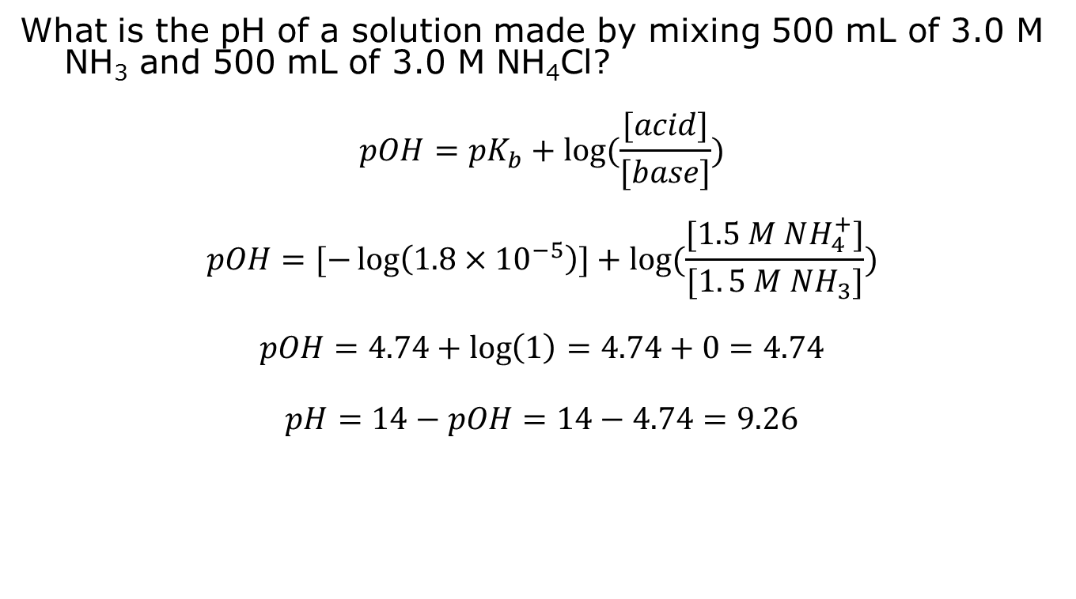
H-H makes buffers easy!
What is the pH of a solution made by mixing 500 mL of 3.0 M NH₃ and 500 mL of 3.0 M NH₄Cl?
$$pOH=pK_{b}+log⁡(\frac{[acid]}{[base]})$$
$$pOH=[−\log\left(1.8×{10}^{−5}\right)]+log⁡(\frac{[1.5 M NH_{4}^{+}]}{[1. 5 M NH_{3}]})$$
$$pOH=4.74+\log\left(1\right)=4.74+0=4.74$$
$$pH=14−pOH=14−4.74=9.26$$

Slide 69
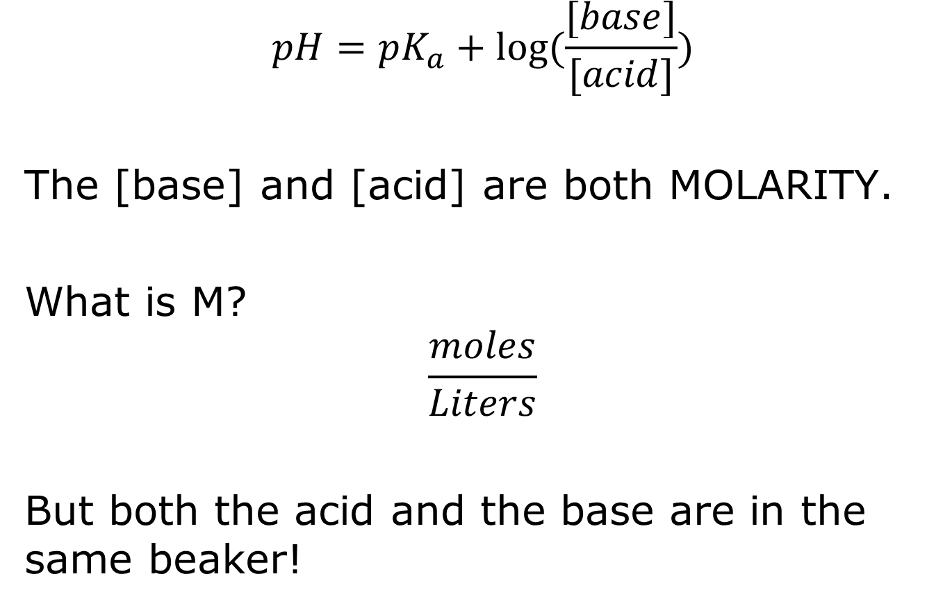
Another little trick..
$$pH=pK_{a}+log⁡(\frac{[base]}{[acid]})$$
The [base] and [acid] are both MOLARITY.
What is M?
$$\frac{moles}{Liters}$$
But both the acid and the base are in the same beaker!

Slide 70
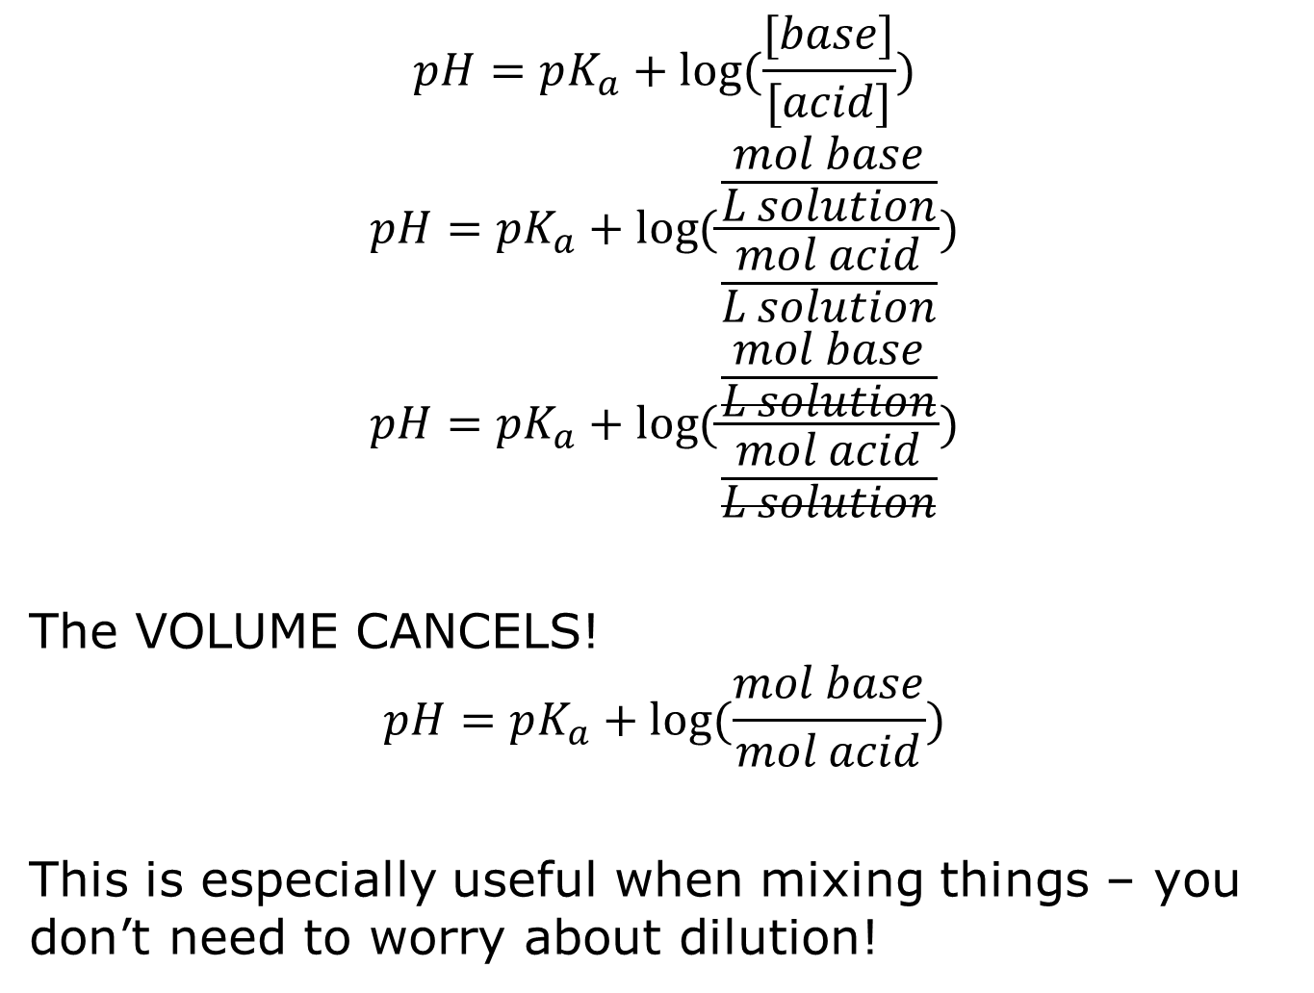
$$pH=pK_{a}+log⁡(\frac{[base]}{[acid]})$$
$$pH=pK_{a}+log⁡(\frac{\frac{mol base}{L solution}}{\frac{mol acid}{L solution}})$$
$$pH=pK_{a}+log⁡(\frac{\frac{mol base}{L solution}}{\frac{mol acid}{L solution}})$$
The VOLUME CANCELS!
$$pH=pK_{a}+log⁡(\frac{mol base}{mol acid})$$
This is especially useful when mixing things – you don’t need to worry about dilution!

Slide 71
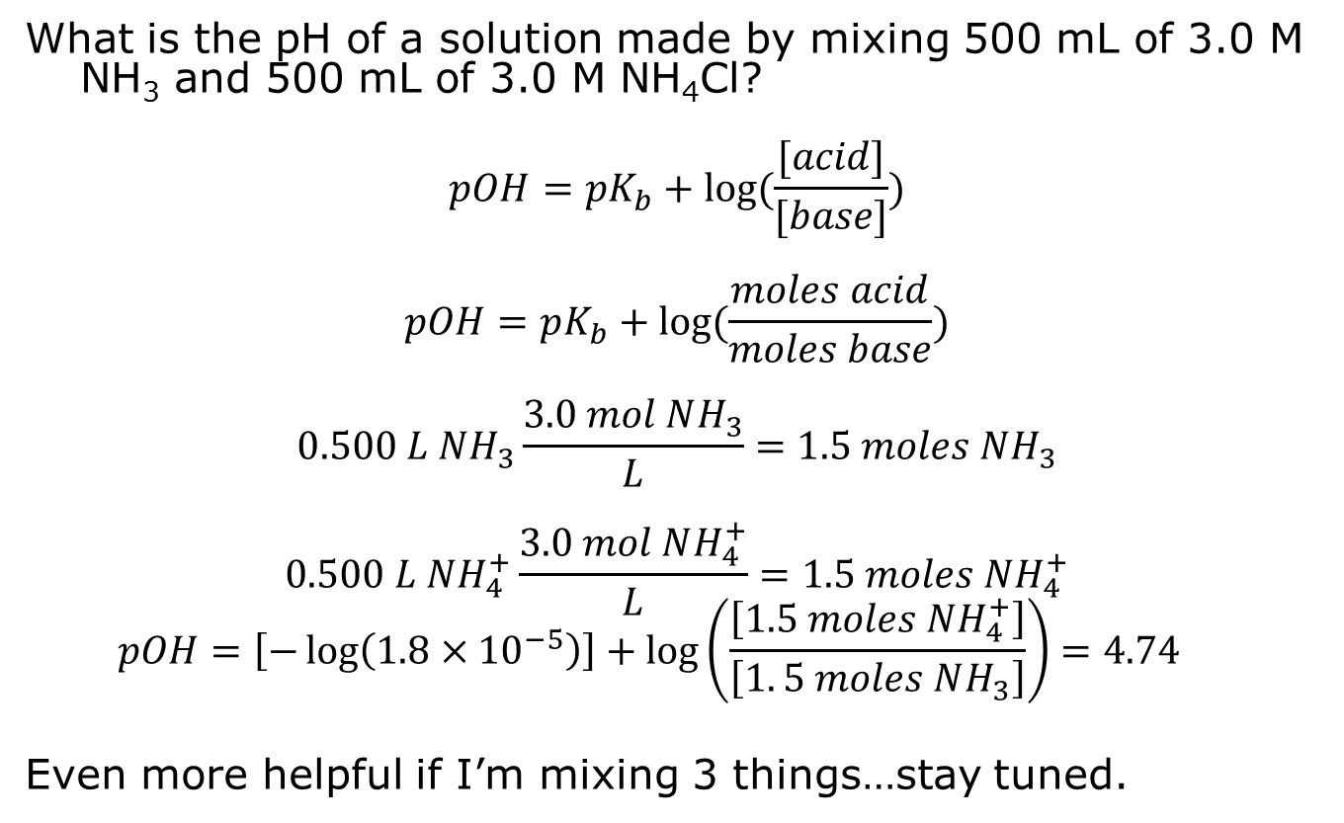
Revisiting the previous problem:
What is the pH of a solution made by mixing 500 mL of 3.0 M NH₃ and 500 mL of 3.0 M NH₄Cl?
$$pOH=pK_{b}+log⁡(\frac{[acid]}{[base]})$$
$$pOH=pK_{b}+log⁡(\frac{moles acid}{moles base})$$
$$0.500 L NH_{3}\frac{3.0 mol NH_{3}}{L}=1.5 moles NH_{3}$$
$$0.500 L NH_{4}^{+}\frac{3.0 mol NH_{4}^{+}}{L}=1.5 moles NH_{4}^{+}$$
$$pOH=\left[−\log\left(1.8×{10}^{−5}\right)\right]+\log\left(\frac{\left[1.5 moles NH_{4}^{+}\right]}{\left[1. 5 moles NH_{3}\right]}\right)=4.74$$
Even more helpful if I’m mixing 3 things…stay tuned.

Slide 72
Quick Comprehension test!

Slide 73
What is the pH of a solution that is 0.500 M HOAc and 0.250 M NaCl?
What is NaCl?
It’s a salt!
Is this a buffer?
NO! The salt does NOT contain the conjugate base of HOAc.

Slide 74
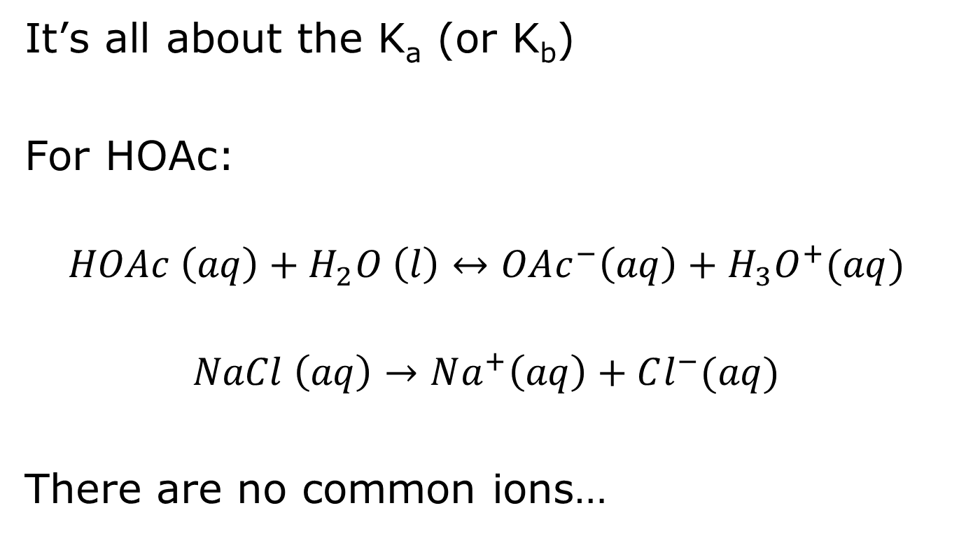
Consider the reaction:
It’s all about the K_{a} (or K_{b})
For HOAc:
$$HOAc \left(aq\right)+H_{2}O \left(l\right)↔OAc^{−}\left(aq\right)+H_{3}O^{+}(aq)$$
$$NaCl \left(aq\right)→Na^{+}\left(aq\right)+Cl^{−}(aq)$$
There are no common ions…

Slide 75
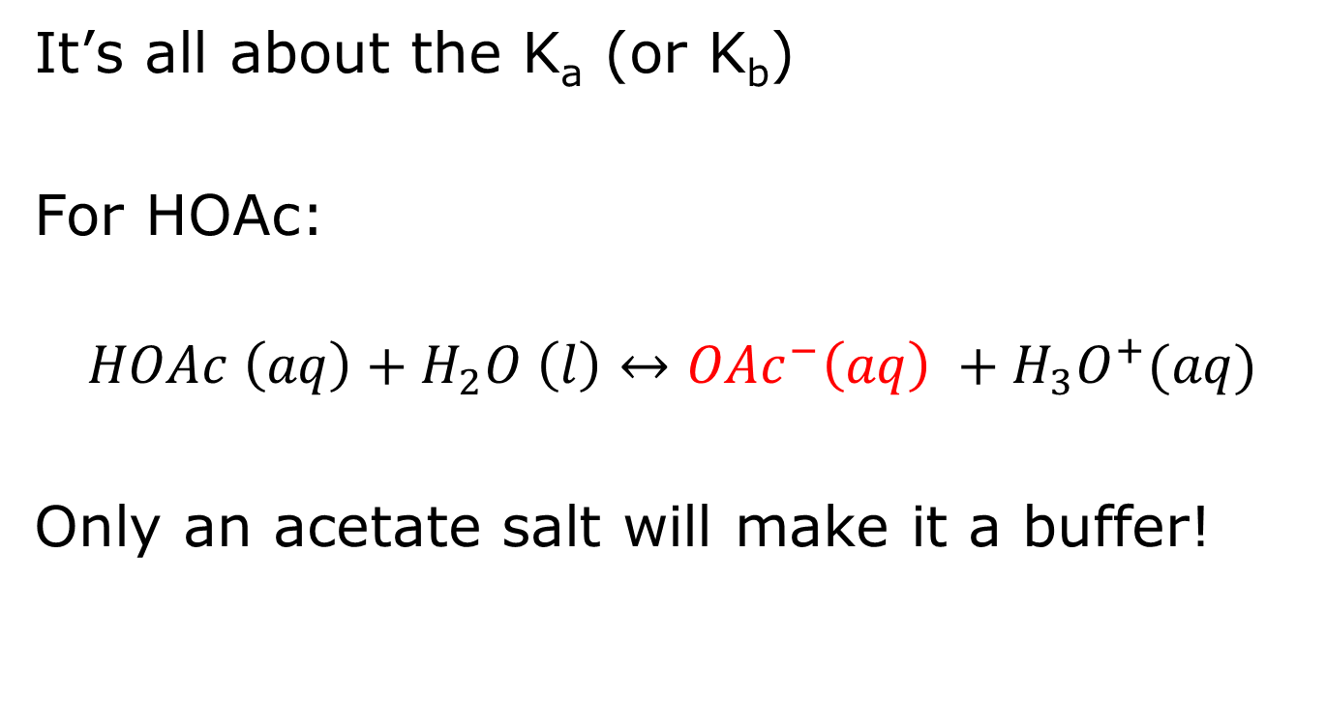
Consider the reaction:
It’s all about the K_{a} (or K_{b})
For HOAc:
$$HOAc \left(aq\right)+H_{2}O \left(l\right)↔OAc^{−}\left(aq\right) +H_{3}O^{+}(aq)$$
Only an acetate salt will make it a buffer!

Slide 76
What is the pH of a solution that is initially 0.100 M NH₃ and 0.050 M HCl?
K_{b} (NH₃) = 1.8x10⁻⁵
K_{a} (HCl) = FB
What is NH₃?
It’s a base!
What is HCl?
It’s an acid! (A strong acid, in fact!)
What do acids and bases do?
Neutralize each other!

Slide 77
Now, we sort of have TWO reactions (or maybe 4… ☺)
I have MULTIPLE acids and bases…
What are they?
NH₃ is a base…
HCl is an acid…
And…
H₂O is both an acid and a base!

Slide 78
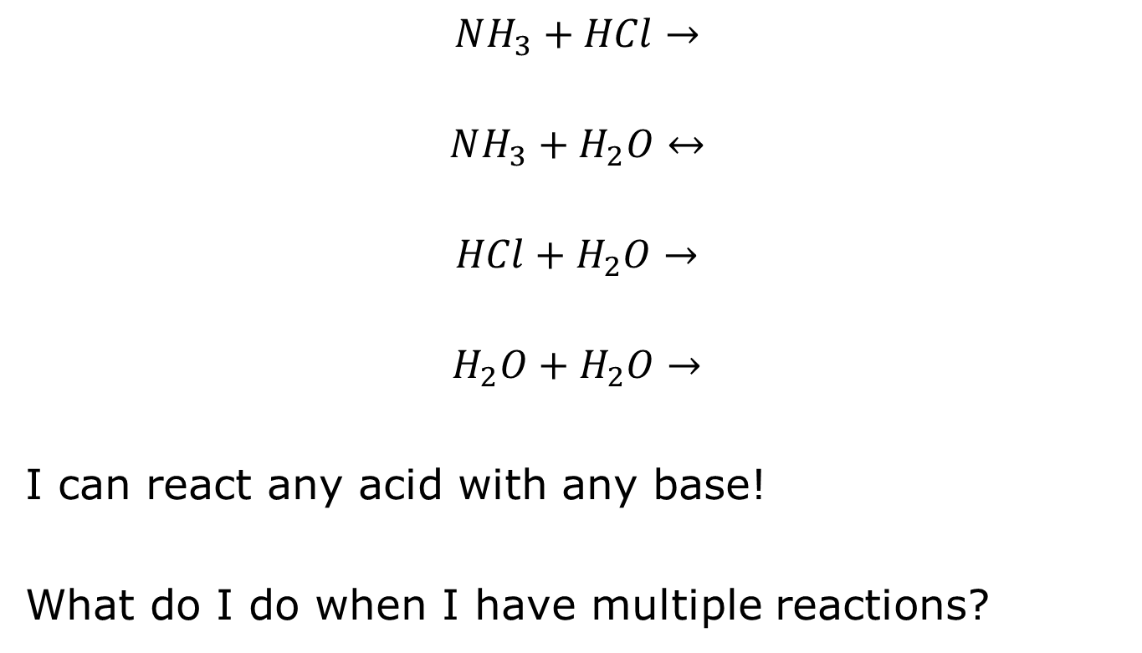
My TWO (or 4) reactions!
$$NH_{3}+HCl→$$
$$NH_{3}+H_{2}O↔$$
$$HCl+H_{2}O→$$
$$H_{2}O+H_{2}O→$$
I can react any acid with any base!
What do I do when I have multiple reactions?

Slide 79
I do each of them, one at a time, from biggest K to smallest K!

Slide 80
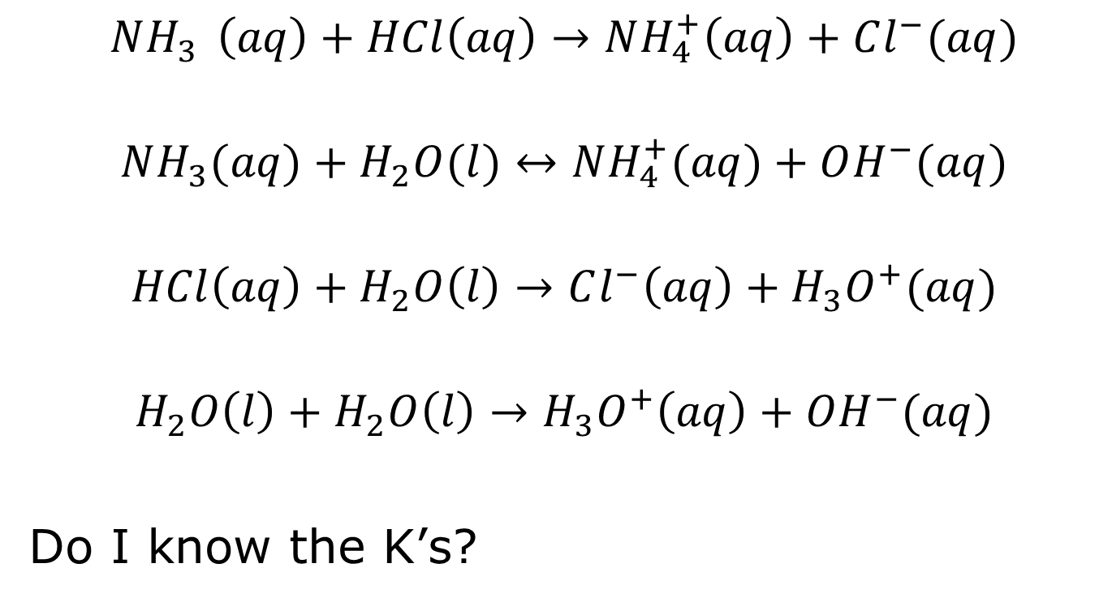
My TWO (or 4) reactions!
$$NH_{3 } \left(aq\right)+HCl\left(aq\right)→NH_{4}^{+}\left(aq\right)+Cl^{−}(aq)$$
$$NH_{3}(aq)+H_{2}O(l)↔NH_{4}^{+}(aq)+OH^{−}(aq)$$
$$HCl\left(aq\right)+H_{2}O\left(l\right)→Cl^{−}\left(aq\right)+H_{3}O^{+}(aq)$$
$$H_{2}O\left(l\right)+H_{2}O\left(l\right)→H_{3}O^{+}\left(aq\right)+OH^{−}(aq)$$
Do I know the K’s?

Slide 81
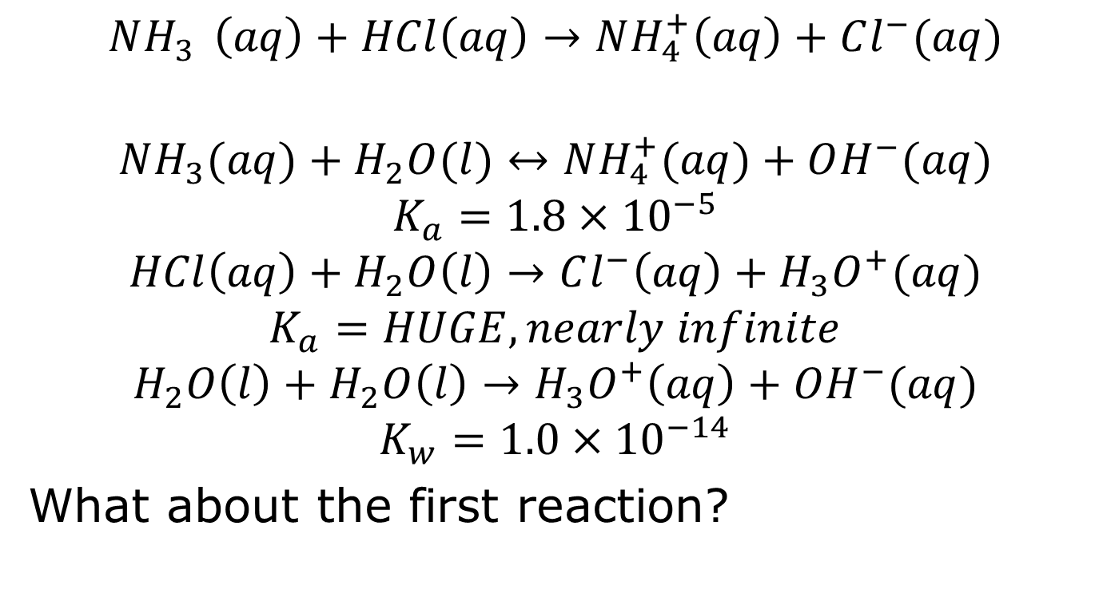
My TWO (or 4) reactions!
$$NH_{3 } \left(aq\right)+HCl\left(aq\right)→NH_{4}^{+}\left(aq\right)+Cl^{−}(aq)$$
$$NH_{3}(aq)+H_{2}O(l)↔NH_{4}^{+}(aq)+OH^{−}(aq)$$
$$K_{a}=1.8×{10}^{−5}$$
$$HCl\left(aq\right)+H_{2}O\left(l\right)→Cl^{−}\left(aq\right)+H_{3}O^{+}(aq)$$
$$K_{a}=HUGE, nearly infinite$$
$$H_{2}O\left(l\right)+H_{2}O\left(l\right)→H_{3}O^{+}\left(aq\right)+OH^{−}(aq)$$
$$K_{w}=1.0×{10}^{−14}$$
What about the first reaction?

Slide 82
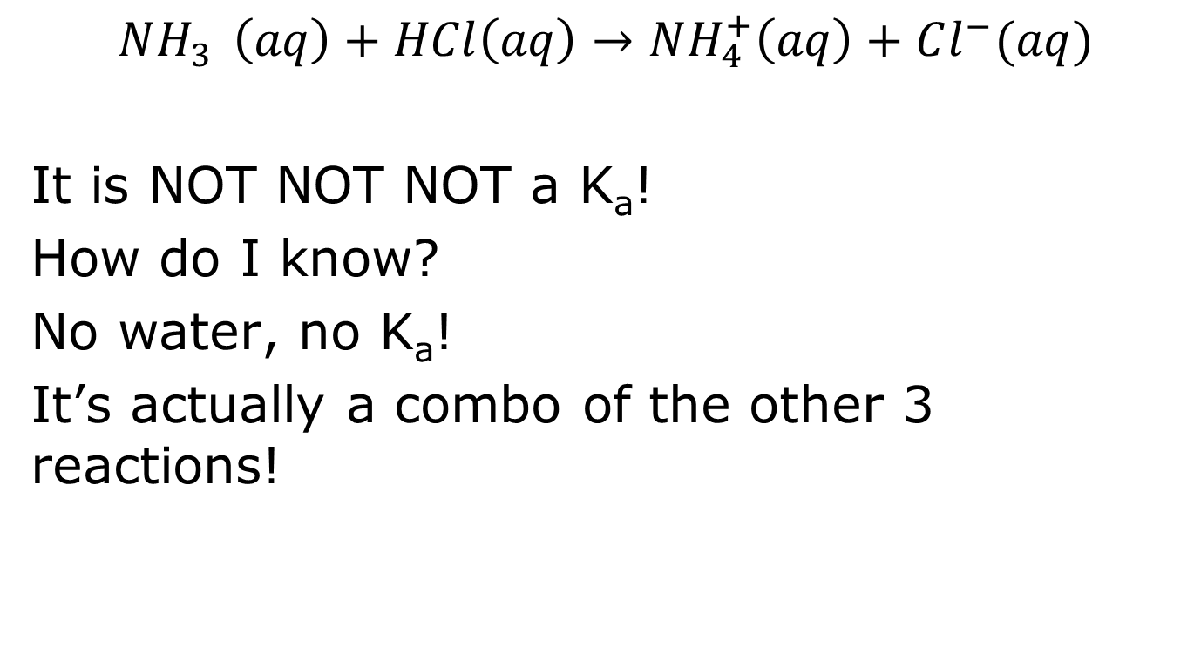
What about the first reaction?
$$NH_{3 } \left(aq\right)+HCl\left(aq\right)→NH_{4}^{+}\left(aq\right)+Cl^{−}(aq)$$
It is NOT NOT NOT a K_{a}!
How do I know?
No water, no K_{a}!
It’s actually a combo of the other 3 reactions!

Slide 83
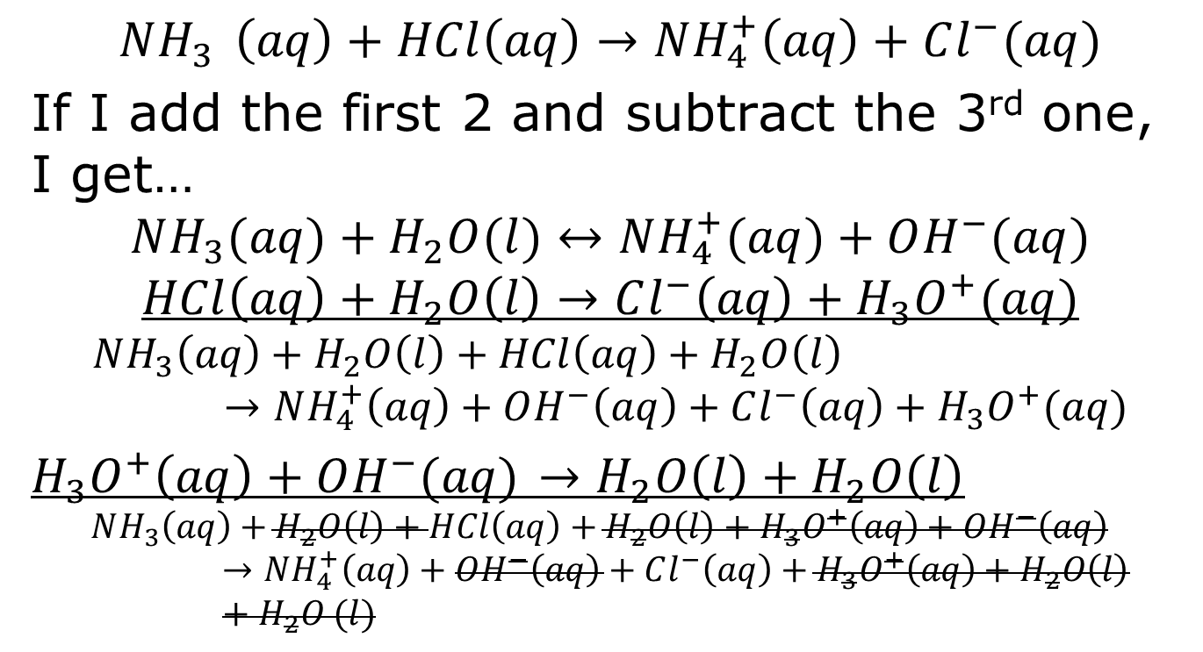
What about the first reaction?
$$NH_{3 } \left(aq\right)+HCl\left(aq\right)→NH_{4}^{+}\left(aq\right)+Cl^{−}(aq)$$
If I add the first 2 and subtract the 3rd one, I get…
$$NH_{3}(aq)+H_{2}O(l)↔NH_{4}^{+}(aq)+OH^{−}(aq)$$
$$HCl\left(aq\right)+H_{2}O\left(l\right)→Cl^{−}\left(aq\right)+H_{3}O^{+}(aq)$$
$$NH_{3}\left(aq\right)+H_{2}O\left(l\right)+HCl\left(aq\right)+H_{2}O\left(l\right)→NH_{4}^{+}\left(aq\right)+OH^{−}\left(aq\right)+Cl^{−}\left(aq\right)+H_{3}O^{+}(aq)$$
$H_{3}O^{+}\left(aq\right)+OH^{−}(aq)$ $→H_{2}O\left(l\right)+H_{2}O\left(l\right)$
$$NH_{3}\left(aq\right)+H_{2}O\left(l\right)+HCl\left(aq\right)+H_{2}O\left(l\right)+H_{3}O^{+}\left(aq\right)+OH^{−}\left(aq\right)→NH_{4}^{+}\left(aq\right)+OH^{−}\left(aq\right)+Cl^{−}\left(aq\right)+H_{3}O^{+}\left(aq\right)+H_{2}O\left(l\right)+H_{2}O (l)$$

Slide 84
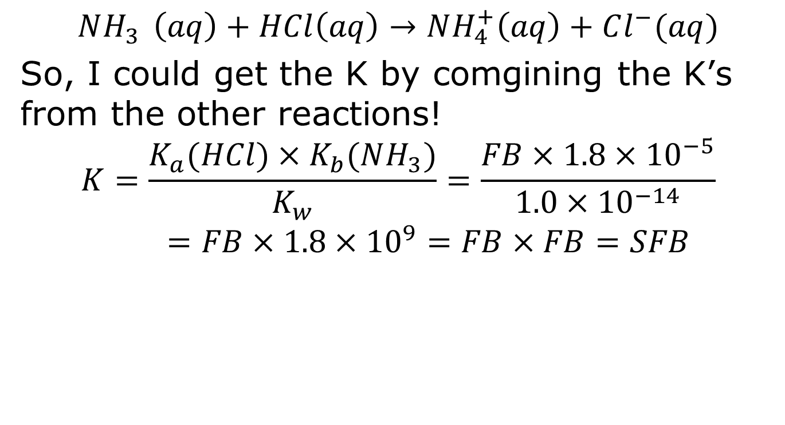
What about the first reaction?
$$NH_{3 } \left(aq\right)+HCl\left(aq\right)→NH_{4}^{+}\left(aq\right)+Cl^{−}(aq)$$
So, I could get the K by comgining the K’s from the other reactions!
$$K=\frac{K_{a}(HCl)×K_{b}(NH_{3})}{K_{w}}=\frac{FB×1.8×{10}^{−5}}{1.0×{10}^{−14}}=FB×1.8×{10}^{9}=FB×FB=SFB$$

Slide 85
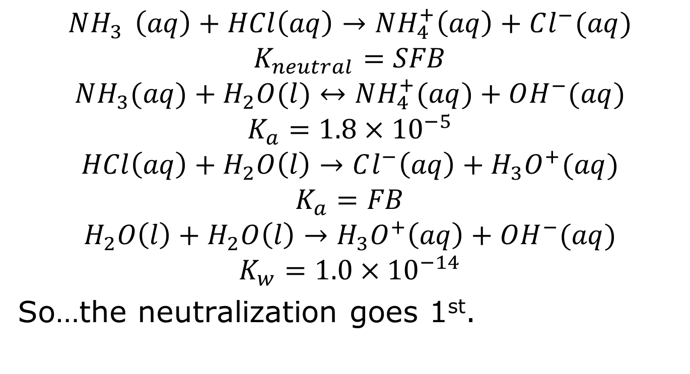
My TWO (or 4) reactions!
$$NH_{3 } \left(aq\right)+HCl\left(aq\right)→NH_{4}^{+}\left(aq\right)+Cl^{−}(aq)$$
$$K_{neutral}=SFB$$
$$NH_{3}(aq)+H_{2}O(l)↔NH_{4}^{+}(aq)+OH^{−}(aq)$$
$$K_{a}=1.8×{10}^{−5}$$
$$HCl\left(aq\right)+H_{2}O\left(l\right)→Cl^{−}\left(aq\right)+H_{3}O^{+}(aq)$$
$$K_{a}=FB$$
$$H_{2}O\left(l\right)+H_{2}O\left(l\right)→H_{3}O^{+}\left(aq\right)+OH^{−}(aq)$$
$$K_{w}=1.0×{10}^{−14}$$
So…the neutralization goes 1st.

Slide 86
NOT an equilibrium! It’s SFB!
What is the pH of a solution that is initially 0.100 M NH₃ and 0.050 M HCl?
 | NH₃ (aq) | + HCl (aq) | → | NH₄⁺ (aq) | + Cl⁻ (aq)
I | 0.100 M | 0.050 M |  | 0 | 0
C | -x | -x |  | +x | +x
End
HCl is the limiting reactant…so…

Slide 87
NOT an equilibrium! It’s SFB!
What is the pH of a solution that is initially 0.100 M NH₃ and 0.050 M HCl?
 | NH₃ (aq) | + HCl (aq) | → | NH₄⁺ (aq) | + Cl⁻ (aq)
I | 0.100 M | 0.050 M |  | 0 | 0
C | -x | -x |  | +x | +x
End | 0.050 M | ZERO |  | 0.050 M | 0.050 M
This is what I have after the 1st reaction…on to the 2nd!

Slide 88
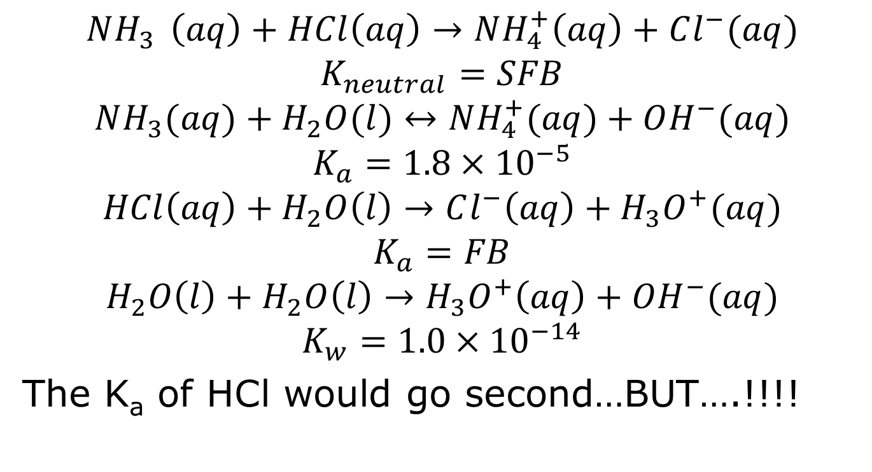
My TWO (or 4) reactions!
$$NH_{3 } \left(aq\right)+HCl\left(aq\right)→NH_{4}^{+}\left(aq\right)+Cl^{−}(aq)$$
$$K_{neutral}=SFB$$
$$NH_{3}(aq)+H_{2}O(l)↔NH_{4}^{+}(aq)+OH^{−}(aq)$$
$$K_{a}=1.8×{10}^{−5}$$
$$HCl\left(aq\right)+H_{2}O\left(l\right)→Cl^{−}\left(aq\right)+H_{3}O^{+}(aq)$$
$$K_{a}=FB$$
$$H_{2}O\left(l\right)+H_{2}O\left(l\right)→H_{3}O^{+}\left(aq\right)+OH^{−}(aq)$$
$$K_{w}=1.0×{10}^{−14}$$
The K_{a} of HCl would go second…BUT….!!!!

Slide 89
I’m out of HCl!
2nd reaction always starts where the 1st ends…so this is what’s in the beaker…along with water.
 | NH₃ (aq) | + HCl (aq) | → | NH₄⁺ (aq) | + Cl⁻ (aq)
I | 0.100 M | 0.050 M |  | 0 | 0
C | -x | -x |  | +x | +x
End | 0.050 M | ZERO |  | 0.050 M | 0.050 M
So, on to the 3rd…

Slide 90
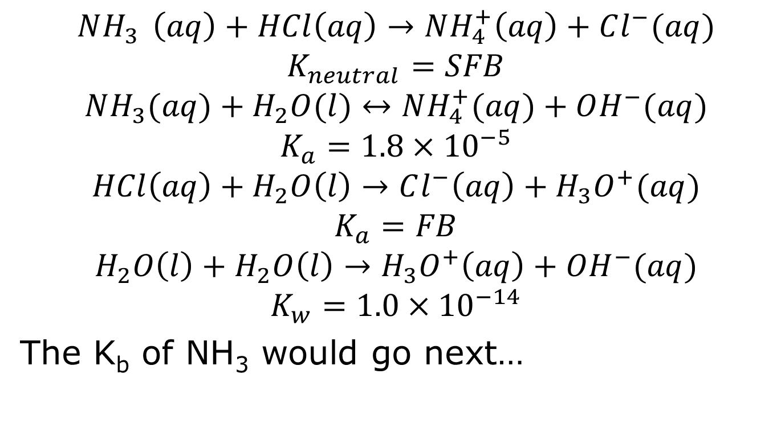
My TWO (or 4) reactions!
$$NH_{3 } \left(aq\right)+HCl\left(aq\right)→NH_{4}^{+}\left(aq\right)+Cl^{−}(aq)$$
$$K_{neutral}=SFB$$
$$NH_{3}(aq)+H_{2}O(l)↔NH_{4}^{+}(aq)+OH^{−}(aq)$$
$$K_{a}=1.8×{10}^{−5}$$
$$HCl\left(aq\right)+H_{2}O\left(l\right)→Cl^{−}\left(aq\right)+H_{3}O^{+}(aq)$$
$$K_{a}=FB$$
$$H_{2}O\left(l\right)+H_{2}O\left(l\right)→H_{3}O^{+}\left(aq\right)+OH^{−}(aq)$$
$$K_{w}=1.0×{10}^{−14}$$
The K_{b} of NH₃ would go next…

Slide 91
I’m out of HCl!
3rd reaction always starts where the 2nd ends…so this is what’s in the beaker…along with water.
 | NH₃ (aq) | + HCl (aq) | → | NH₄⁺ (aq) | + Cl⁻ (aq)
I | 0.100 M | 0.050 M |  | 0 | 0
C | -x | -x |  | +x | +x
End | 0.050 M | ZERO |  | 0.050 M | 0.050 M
Hey, look, it’s a buffer!!!
 | NH₃ (aq) | + H₂O (l) | → | NH₄⁺ (aq) | + OH⁻ (aq)
I | 0.050 M | LOTS |  | 0.050 M | 0
C | -x | -x |  | +x | +x
End | 0.050 M-x | LOTS |  | 0.050 M+x | x

Slide 92
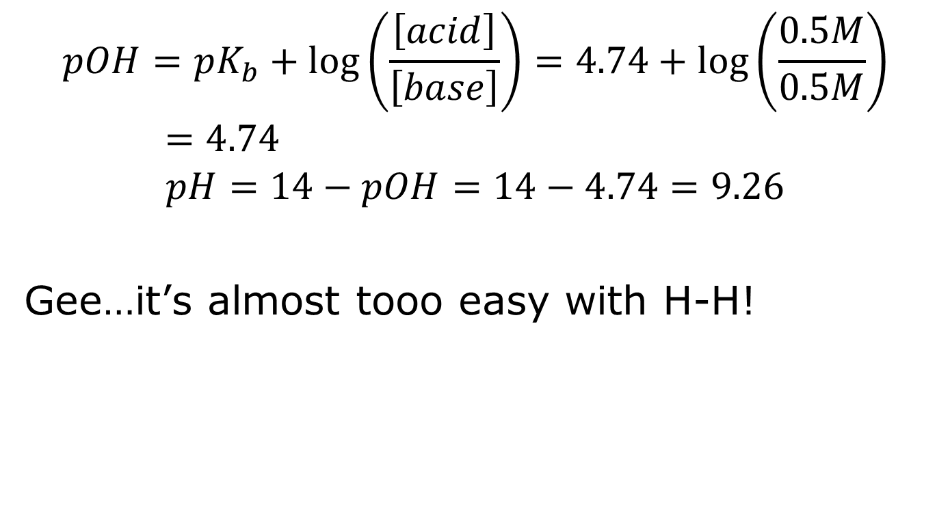
Let’s H-H!
$$pOH=pK_{b}+\log\left(\frac{\left[acid\right]}{\left[base\right]}\right)=4.74+\log\left(\frac{0.5M}{0.5M}\right)=4.74$$
$$pH=14−pOH=14−4.74=9.26$$
Gee…it’s almost tooo easy with H-H!

Slide 93
This is a general rule:
If you neutralize a weak base (or weak acid) with a strong acid (or strong base) you get a buffer…
…unless there is more of the strong acid (or strong base) than weak base (or weak acid).

Slide 94
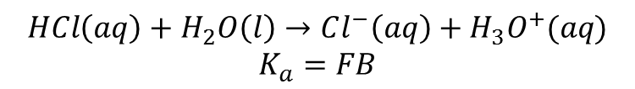

Imagine I switch it..
 | NH₃ (aq) | + HCl (aq) | → | NH₄⁺ (aq) | + Cl⁻ (aq)
I | 0.050 M | 0.100 M |  | 0 | 0
C | -x | -x |  | +x | +x
End | ZERO | 0.050 M |  | 0.050 M | 0.050 M
Now, I have HCl and the conjugate acid (NH₄⁺), so it is just a strong acid!
$$HCl\left(aq\right)+H_{2}O\left(l\right)→Cl^{−}\left(aq\right)+H_{3}O^{+}(aq)$$
$$K_{a}=FB$$
$$pH=−\log\left(0.050 M H_{3}O^{+}\right)=1.30$$

Slide 95
That’s why I said 2 (4) reactions
While there are technically 4 reactions that can happen, we usually only have 2 we need to worry about. And, at most, only 1 is an actual equilibrium.

Slide 96
A new question
A solution is made by mixing 500 mL of 3.0 M NH₃ and 500 mL of 3.0 M NH₄Cl. What is the pH of the solution after addition of 10 mL of 1.0 M HCl?
What kind of problem is this?

Slide 97
IT’S A BUFFER!
So, H-H still rules!
But what’s with the HCl?
HCl is an acid, so what’s it going to do?
Neutralize some base, that’s what!

Slide 98
HCl is the acid, what’s the base?
NH₃!!! (It’s not the only base, but it’s the BEST base!)
NH₃ + HCl → NH₄⁺ + Cl⁻
So every mole of acid eliminates a mole of NH₃ and creates one of NH₄⁺

Slide 99
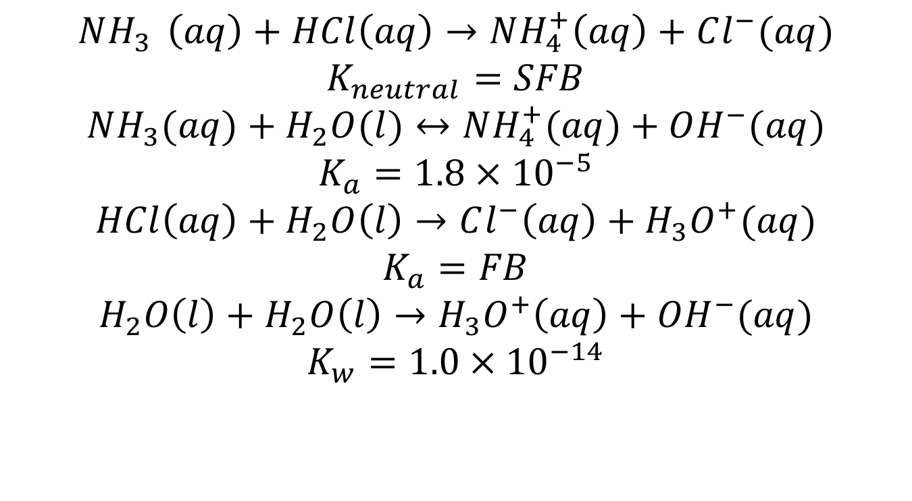
Again, it is really a choice of multiple acids/bases
$$NH_{3 } \left(aq\right)+HCl\left(aq\right)→NH_{4}^{+}\left(aq\right)+Cl^{−}(aq)$$
$$K_{neutral}=SFB$$
$$NH_{3}(aq)+H_{2}O(l)↔NH_{4}^{+}(aq)+OH^{−}(aq)$$
$$K_{a}=1.8×{10}^{−5}$$
$$HCl\left(aq\right)+H_{2}O\left(l\right)→Cl^{−}\left(aq\right)+H_{3}O^{+}(aq)$$
$$K_{a}=FB$$
$$H_{2}O\left(l\right)+H_{2}O\left(l\right)→H_{3}O^{+}\left(aq\right)+OH^{−}(aq)$$
$$K_{w}=1.0×{10}^{−14}$$

Slide 100
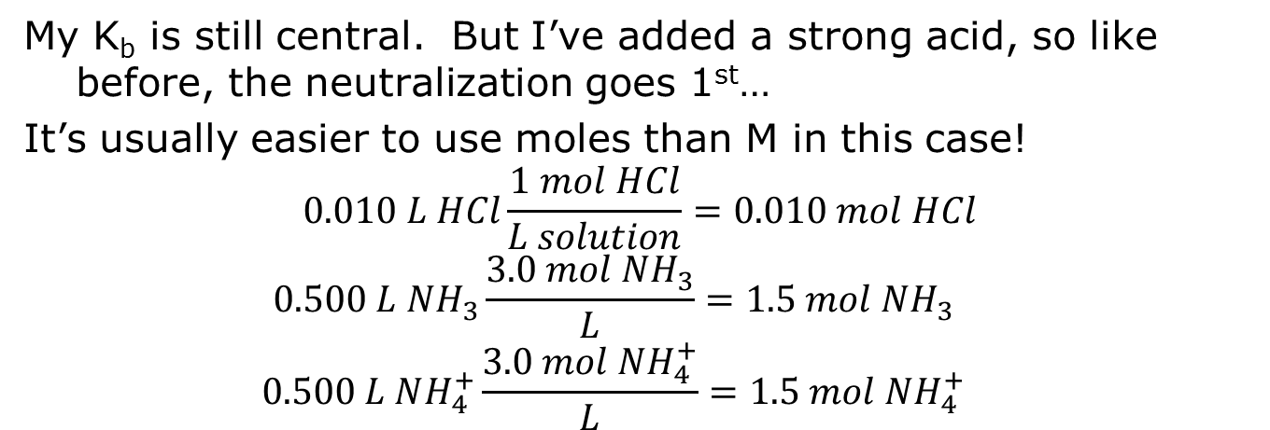
ICE charts make light work
My K_{b} is still central. But I’ve added a strong acid, so like before, the neutralization goes 1st…
It’s usually easier to use moles than M in this case!
$$0.010 L HCl\frac{1 mol HCl}{L solution}=0.010 mol HCl$$
$$0.500 L NH_{3}\frac{3.0 mol NH_{3}}{L}=1.5 mol NH_{3}$$
$$0.500 L NH_{4}^{+}\frac{3.0 mol NH_{4}^{+}}{L}=1.5 mol NH_{4}^{+}$$
 | NH₃ (aq) | + HCl (aq) | → | NH₄⁺ (aq) | + Cl⁻ (aq)
I | 1.50 mol | 0.0100 mol |  | 1.50 | 0
C | -x | -x |  | +x | +x
End | 1.49 mol | ZERO |  | 1.510 mol | 0.010 mol

Slide 101
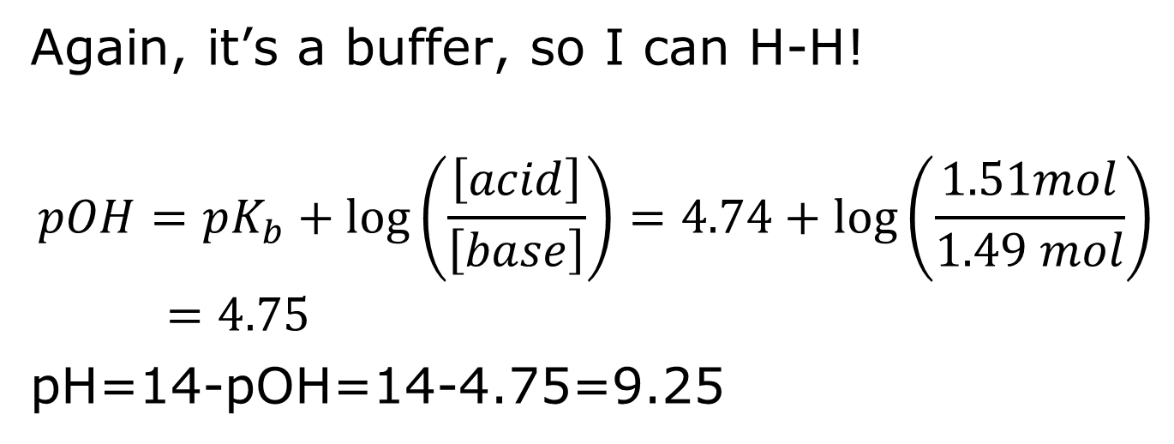
And the K_{b} follows
 | NH₃ (aq) | + H₂O (l) | → | NH₄⁺ (aq) | + OH⁻ (aq)
I | 1.49 mol | LOTS |  | 1.51 mol | 0
C | -x | -x |  | +x | +x
End | 1.49mol-x | LOTS |  | 1.51mol+ x | x
Again, it’s a buffer, so I can H-H!
$$pOH=pK_{b}+\log\left(\frac{\left[acid\right]}{\left[base\right]}\right)=4.74+\log\left(\frac{1.51mol}{1.49 mol}\right)=4.75$$
pH=14-pOH=14-4.75=9.25

Slide 102
ICE charts make light work – DOUBLE ICE charts are 2x the fun!
Adding 10 mL of 1.0 M HCl is adding 0.01 moles acid!
1.0 mol HCl * 0.010 L HCl solution = 0.010 moles
L HCl sol
NH₃ + H₂O ↔ NH₄⁺ + OH⁻
I 1.5 mol 1.5 mol
C -0.01 mol + 0.01 mol
I 1.49 mol 1.51 mol
C
LE
You don’t need to finish the chart, of course, because you’ve got H-H!!
NH₃ + HCl = NH₄⁺ + Cl⁻

Slide 103

$$pOH=pK_{b}+\log\left(\frac{\left[acid\right]}{\left[base\right]}\right)=4.74+\log\left(\frac{1.51mol}{1.49 mol}\right)=4.75$$
pH=14-pOH=14-4.75=9.25
You might recall that the pH of the buffer was 9.26 before addition of the HCl. A very small change.

Slide 104
A solution is made by mixing 500 mL of 3.0 M NH₃ and 500 mL of 3.0 M NH₄Cl. What is the pH of the solution after addition of 10 mL of 1.0 M NaOH?
NaOH = Na⁺ + OH⁻

Slide 105
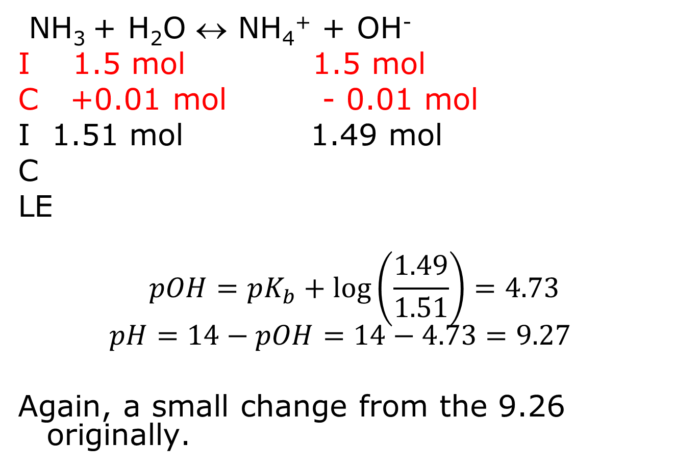
OH⁻ + NH₄⁺ = NH₃ + H₂O
NH₃ + H₂O ↔ NH₄⁺ + OH⁻
I 1.5 mol 1.5 mol
C +0.01 mol - 0.01 mol
I 1.51 mol 1.49 mol
C
LE
$$pOH=pK_{b}+\log\left(\frac{1.49}{1.51}\right)=4.73$$
$$pH=14−pOH=14−4.73=9.27$$
Again, a small change from the 9.26 originally.

Slide 106
Compare that to a non-buffer
Suppose I just had 1 L of 1.5 M NH₃ that I add 10 mL of 1.0 M HCl – then what would the pH change be?

Slide 107
NH₃ + H₂O ↔ NH₄⁺ + OH-
I 1.5 M - 0 0
C -x x x
E 1.5-x x x
1.8x10⁻⁵ = x² = x²
1.5-x 1.5
X = 5.196x10⁻³
pOH = -log (5.196x10⁻³) = 2.28
pH = 14 – 2.28 = 11.72

Slide 108
NH₃ + H₂O ↔ NH₄⁺ + OH-
I 1.485 M - 0 0
C -0.0099 +0.0099 0
I 1.4751 .0099 0
C -x +x +x
E 1.4751-x .0099+ x x
1.8x10⁻⁵ = x(0.0099 +x) = x (0.0099)
1.4751-x 1.4751
X = 2.68x10⁻³
pOH = -log (2.68x10⁻³) = 2.57
pH = 14 – 2.57 = 11.43 (vs. 11.72 for the original)

Slide 109
Similar problem…
I have 500 mL of a solution that is 0.123 M NH₃ and 0.325 M NH₄Cl. I add 10.0 mL of 0.567 M HCl. What is the pH of the buffer after the addition of the HCl?
I’m going to use moles to avoid dilution. Since it is a buffer, H-H doesn’t require Molarities:

Slide 110
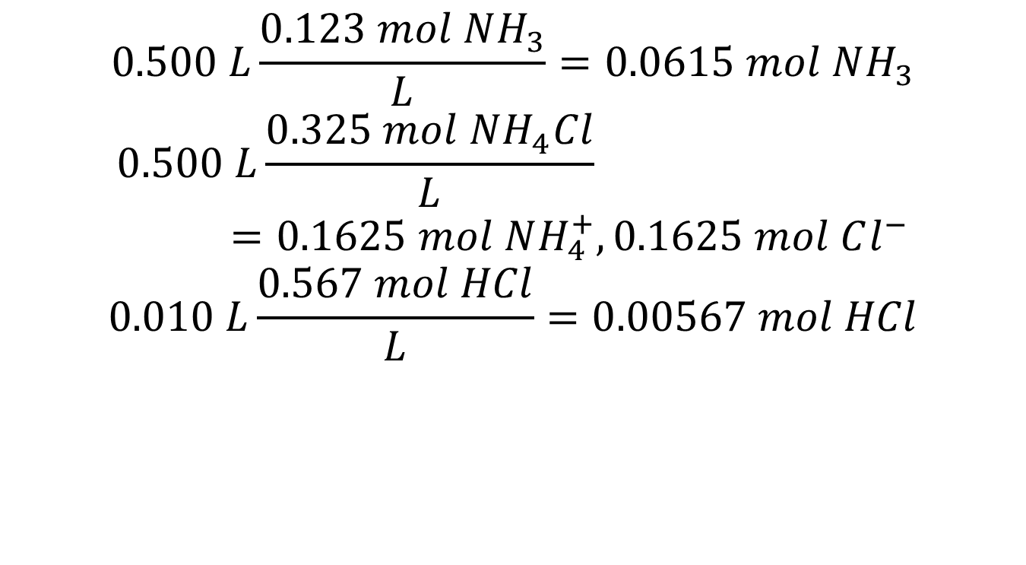
Notice the volume goes with the M
$$0.500 L\frac{0.123 mol NH_{3}}{L}=0.0615 mol NH_{3}$$
$$0.500 L\frac{0.325 mol NH_{4}^{}Cl}{L}=0.1625 mol NH_{4}^{+}, 0.1625 mol Cl^{−}$$
$$0.010 L\frac{0.567 mol HCl}{L}=0.00567 mol HCl$$

Slide 111
I could ICICLE..
 | NH₃ (aq) + | H₂O (l) | → | NH₄⁺ (aq) + | H₃O⁺ (aq)
I
C
I
C
LE
The double ICE chart does confuse some people.
This is especially true because there are really two different reactions represented in this ICE chart.
So, if it confuses you…

Slide 112
You can treat it as 2 separate ICE charts: Neutralization followed by K_{b}
 | NH₃ (aq) + | HCl (aq) | → | NH₄⁺ (aq) + | Cl⁻ (aq)
I | 0.0615 mol | 0.00567 mol |  | 0.1625 mol | 0.1625 mol
C | -0.00567 | -0.00567 |  | +0.00567 | +0.00567
E | 0.05583 mol | O |  | 0.16817 mol | 0.16817 mol
 | NH₃ (aq) + | H₂O (l) | → | NH₄⁺ (aq) + | H₃O⁺ (aq)
I | 0.05583 mol | - |  | 0.16817 mol | 0
C | -x |  |  | +x | +x
E | 0.05583-x |  |  | 0.16817+x | x
As long as they are separable, one ends before the other begins.

Slide 113
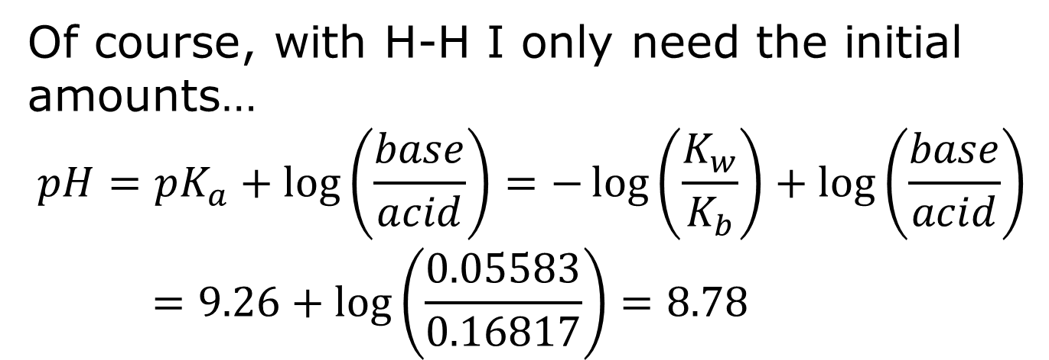
You can treat it as 2 separate ICE charts: Neutralization followed by K_{b}
 | NH₃ (aq) + | H₂O (l) | → | NH₄⁺ (aq) + | H₃O⁺ (aq)
I | 0.05583 mol | - |  | 0.16817 mol | 0
C
E
Of course, with H-H I only need the initial amounts…
$$pH=pK_{a}+\log\left(\frac{base}{acid}\right)=−\log\left(\frac{K_{w}}{K_{b}}\right)+\log\left(\frac{base}{acid}\right)=9.26+\log\left(\frac{0.05583}{0.16817}\right)=8.78$$

Slide 114
Buffer capacity
+/- 1 pH unit
(Rule of thumb)
pH=4.00 buffer
pH stays between 3 and 5, it is still considered “buffered”

Slide 115
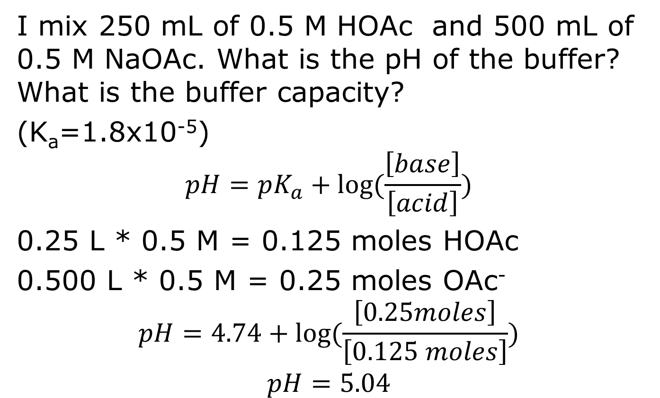
Calculating buffer capacity
I mix 250 mL of 0.5 M HOAc and 500 mL of 0.5 M NaOAc. What is the pH of the buffer? What is the buffer capacity?
(K_{a}=1.8x10⁻⁵)
$$pH=pK_{a}+log⁡(\frac{\left[base\right]}{\left[acid\right]})$$
0.25 L * 0.5 M = 0.125 moles HOAc
0.500 L * 0.5 M = 0.25 moles OAc⁻
$$pH=4.74+log⁡(\frac{\left[0.25moles\right]}{\left[0.125 moles\right]})$$
$$pH=5.04$$

Slide 116
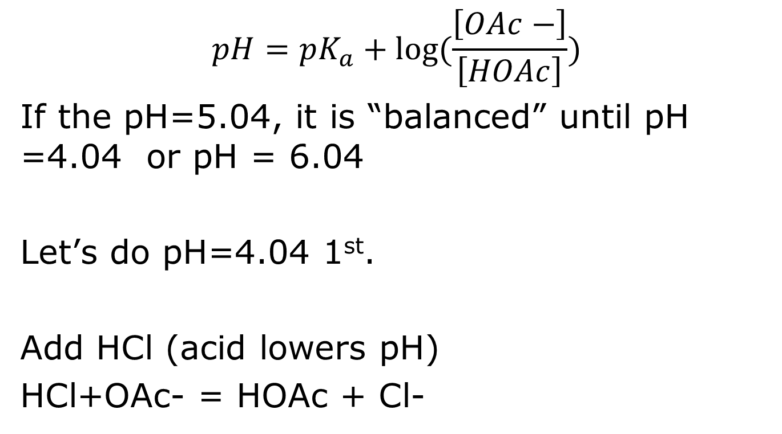
HOAc + H₂O= OAc⁻ + H₃O⁺
$$pH=pK_{a}+log⁡(\frac{\left[OAc−\right]}{\left[HOAc\right]})$$
If the pH=5.04, it is “balanced” until pH =4.04 or pH = 6.04
Let’s do pH=4.04 1st.
Add HCl (acid lowers pH)
HCl+OAc- = HOAc + Cl-

Slide 117
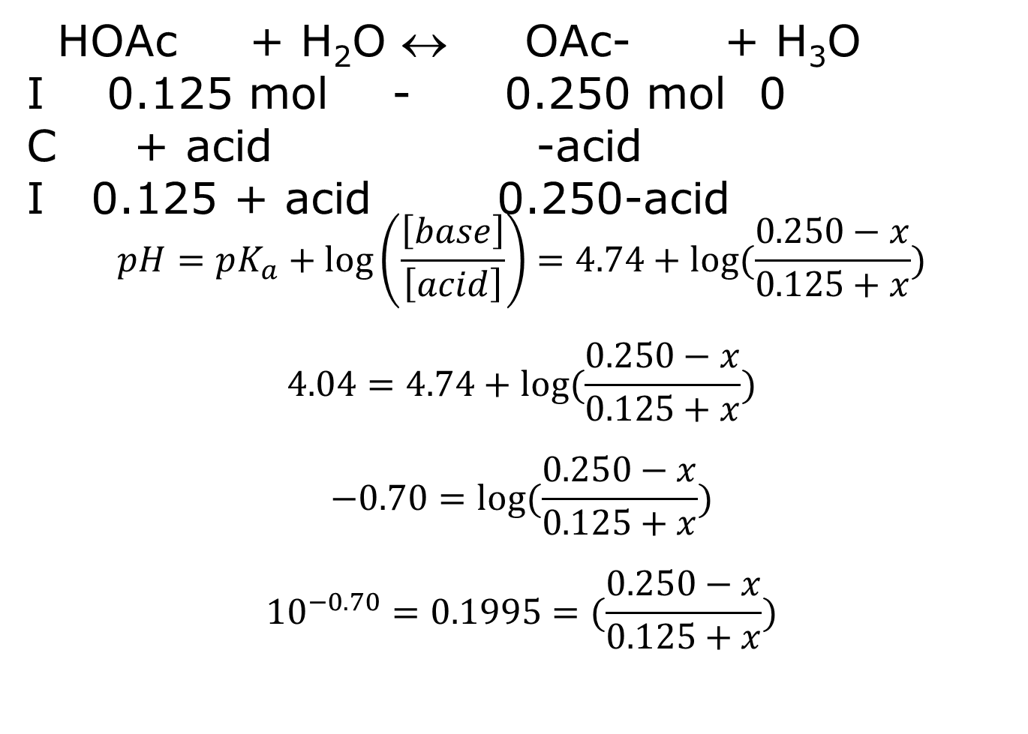
HOAc + H₂O ↔ OAc- + H₃O
I 0.125 mol - 0.250 mol 0
C + acid -acid
I 0.125 + acid 0.250-acid
$$pH=pK_{a}+\log\left(\frac{\left[base\right]}{\left[acid\right]}\right)=4.74+log⁡(\frac{0.250−x}{0.125+x})$$
$$4.04=4.74+log⁡(\frac{0.250−x}{0.125+x})$$
$$−0.70=log⁡(\frac{0.250−x}{0.125+x})$$
$${10}^{−0.70}=0.1995=⁡(\frac{0.250−x}{0.125+x})$$

Slide 118
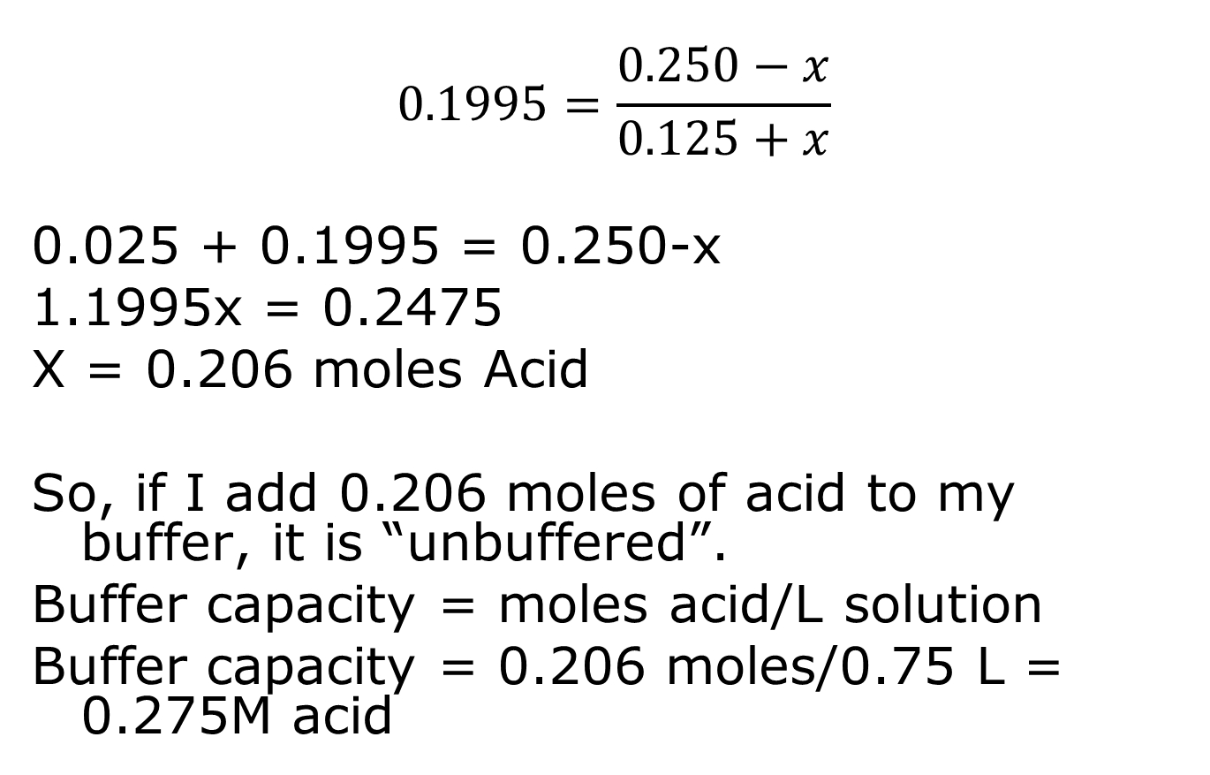
$$0.1995=\frac{0.250−x}{0.125+x}$$
0.025 + 0.1995 = 0.250-x
1.1995x = 0.2475
X = 0.206 moles Acid
So, if I add 0.206 moles of acid to my buffer, it is “unbuffered”.
Buffer capacity = moles acid/L solution
Buffer capacity = 0.206 moles/0.75 L = 0.275M acid

Slide 119
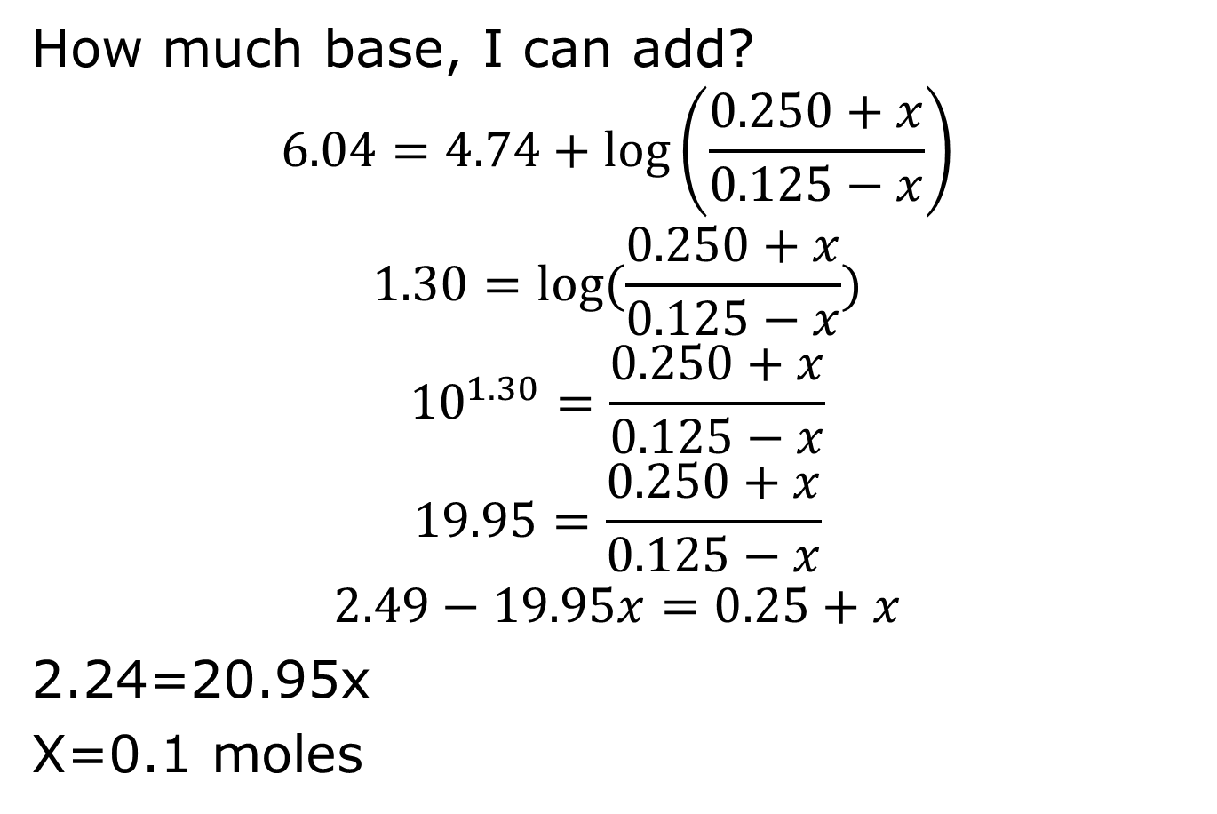
How much base, I can add?
$$6.04=4.74+\log\left(\frac{0.250+x}{0.125−x}\right)$$
$$1.30=log⁡(\frac{0.250+x}{0.125−x})$$
$${10}^{1.30}=\frac{0.250+x}{0.125−x}$$
$$19.95=\frac{0.250+x}{0.125−x}$$
$$2.49−19.95x=0.25+x$$
2.24=20.95x
X=0.1 moles

Slide 120

Buffer capacity
$Buffer capacity= \frac{0.1 mol base absorbed}{0.75 L}=$0.133 M

Slide 121
What is the pH of 0.123 M HClO?

Slide 122
What is the pH of a solution that is 0.123 M HClO and 0.123 M HOAc?

Slide 123
What is the pH of a solution that is 0.100 M NH₃ and 0.250 M NH₄Cl?

Slide 124
What is the pH of a solution that is 0.100 M NH₃ and 0.250 M NaOAc?

Slide 125
I have 0.100 M NH₃ and 0.500 M HCl. I want to make 1 L of a buffer that is pH 10.00. How do I do it?

Slide 126
Ka and Kb table
H₃C₆H₅O₇ K_{a1} = 7.4x10⁻⁴ K_{a2}=1.7x10⁻⁵ K_{a3}=4.0x10⁻⁷
HC₃H₅O₃ K_{a1} = 1.4x10⁻⁴
H₂C₂O₄ K_{a1} = 6.0x10⁻² K_{a2}=6.1x10⁻⁵
HClO K_{a1} = 2.9x10⁻⁸
HONH₂ K_{b}=1.1x10⁻⁸
C₅H₅N K_{b}=1.7x10⁻⁹

