Slide 1
RedOx Chemistry
OK, I balanced the frigging equation, so what?

Slide 2
An example of an Electrochemical Reaction
Oxidation half-reaction: Fe²⁺ → Fe³⁺ + 1 e⁻
Reduction half-reaction: Sn⁴⁺ + 2 e- → Sn²⁺
Net: 2 Fe²⁺ + Sn⁴⁺ → 2 Fe³⁺ + Sn²⁺
So frigging what?
Well a couple things:

Slide 3
Looking back at our first example..
2 Fe²⁺ + Sn⁴⁺ → 2 Fe³⁺ + Sn²⁺
A couple frigging things:
It is a different set of compounds. If I mix Fe²⁺ and Sn⁴⁺ and IF the reaction above happens, the stuff in my beaker is different.
Electrons move…think lightning and kites.

Slide 4
WTFDYMBI?
What do you mean by “IF”?
2 Fe²⁺ + Sn⁴⁺ → 2 Fe³⁺ + Sn²⁺
2 Fe³⁺ + Sn²⁺ → 2 Fe²⁺ + Sn⁴⁺
2 Fe²⁺ + Sn⁴⁺ ↔ 2 Fe³⁺ + Sn²⁺
Is this just another case of equilibrium…?

Slide 5
Not Usually
Only one of the reactions will happen. That’s why your rusty car never de-rusts!
Why is that? Well, I thought you’d never ask?

Slide 6
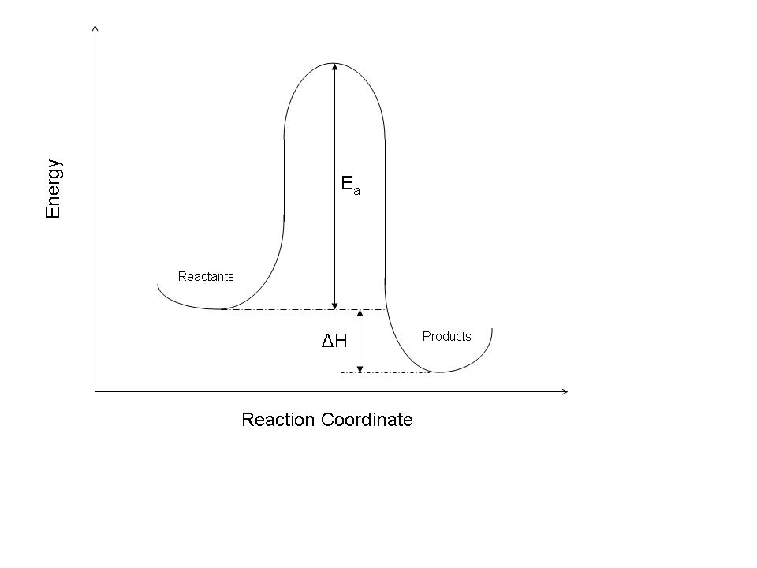
Typical Reaction Energy Diagram

Slide 7
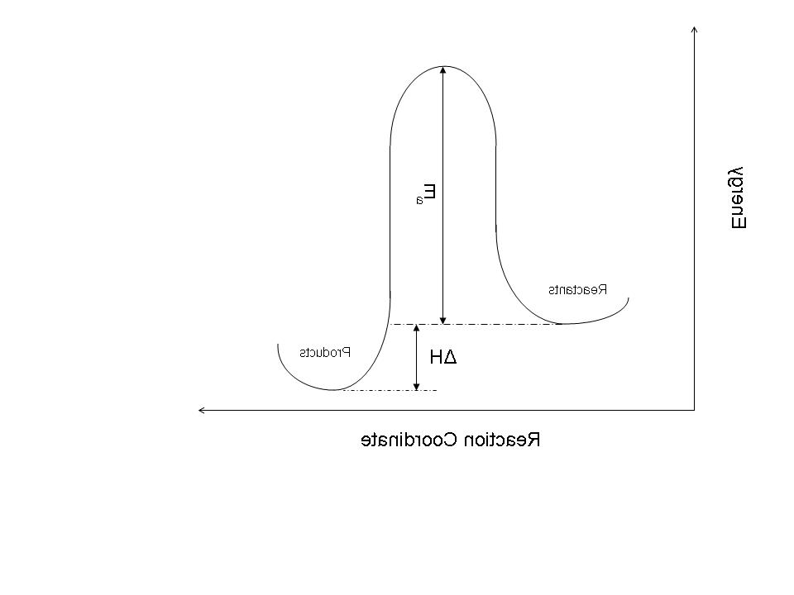
What if you just flip it around?

Slide 8
So what?
We’ve seen the reaction diagrams before, what does it mean?
Reactions can only do 4 things:
Not happen at all – boring!
Proceed as written
Proceed in reverse
Sit at equilibrium
How do you decide what they do?
Yes, that’s right, ΔG!

Slide 9
WTFIDG?
Well, we don’t know what ΔG is yet, but I’ll tell you this: it is related to the second frigging thing – electrons are moving around.

Slide 10
WTFDYMBI?
What do you mean by “IF”?
2 Fe²⁺ + Sn⁴⁺ → 2 Fe³⁺ + Sn²⁺
2 Fe³⁺ + Sn²⁺ → 2 Fe²⁺ + Sn⁴⁺
2 Fe²⁺ + Sn⁴⁺ ↔ 2 Fe³⁺ + Sn²⁺
Is this just another case of equilibrium…?

Slide 11
If electrons are going to move…
Either you need to push them…or they just fall down the hill!
ElectroMotiveForce (emf) is the push.
You know it more by the name of its unit: volts!

Slide 12
EMF is really the push behind the electrons. The voltage is the potential difference between reactants and products (like altitude).
You can’t fall uphill!
Reactants
Voltage
Products

Slide 13
The Cell Potential
The voltage difference is called the “cell potential” and it depends on a number of factors (the usual suspects: temperature, concentration, pressure etc.).
The starting point is STANDARD cell potentials (E⁰) – which can be found in the Table in Appendix C

Slide 14
Ox: Fe²⁺ → Fe³⁺ + 1 e⁻ E⁰_{red} = 0.77 V
Fe³⁺ + 1 e⁻→Fe²⁺
Red : Sn⁴⁺ + 2 e- → Sn²⁺ E⁰_{red} = 0.15 V
Net: 2 Fe²⁺ + Sn⁴⁺ → 2 Fe³⁺ + Sn²⁺
So, I got the number from the table, what do I do with them?

Slide 15
They aren’t all red!
Ox: Fe²⁺ → Fe³⁺ + 1 e⁻ E⁰_{red} = 0.77 V
Ox: Fe²⁺ → Fe³⁺ + 1 e⁻ E⁰_{ox} = - 0.77 V
Red : Sn⁴⁺ + 2 e- → Sn²⁺ E⁰_{red} = 0.15 V
Net: 2 Fe²⁺ + Sn⁴⁺ → 2 Fe³⁺ + Sn²⁺

Slide 16
What about the Stoichimetry?
Ox: Fe²⁺ → Fe³⁺ + 1 e⁻ E⁰_{red} = 0.77 V
Ox: Fe²⁺ → Fe³⁺ + 1 e⁻ E⁰_{ox} = - 0.77 V
Ox: 2(Fe²⁺ → Fe³⁺ + 1 e⁻ ) E⁰_{ox} = 2(- 0.77 V)?
Red : Sn⁴⁺ + 2 e- → Sn²⁺ E⁰_{red} = 0.15 V
Net: 2 Fe²⁺ + Sn⁴⁺ → 2 Fe³⁺ + Sn²⁺

Slide 17
Ignore the Stoichiometry (clutch chest and fake heart attack)
Ox: Fe²⁺ → Fe³⁺ + 1 e⁻ E⁰_{red} = 0.77 V
Ox: Fe²⁺ → Fe³⁺ + 1 e⁻ E⁰_{ox} = - 0.77 V
Ox: 2(Fe²⁺ → Fe³⁺ + 1 e⁻ ) E⁰_{ox} = 2(- 0.77 V)?
Red : Sn⁴⁺ + 2 e-  Sn²⁺ E⁰_{red} = 0.15 V
Net: 2 Fe²⁺ + Sn⁴⁺  2 Fe³⁺ + Sn²⁺

Slide 18
Why no stoichiometry?
It’s literally like an altitude. Two hills 100 foot tall aren’t the same as 1 hill 200 feet tall.
You have more electrons falling down, but they all fall down the same distance.
Reactants
Voltage
Products

Slide 19
So what does it all mean?
Ox: Fe²⁺ → Fe³⁺ + 1 e⁻ E⁰_{ox} = - 0.77 V
Red : Sn⁴⁺ + 2 e- → Sn²⁺ E⁰_{red} = 0.15 V
Net: 2 Fe²⁺ + Sn⁴⁺ → 2 Fe³⁺ + Sn²⁺
E⁰_{cell} = E⁰_{red} ⁺ E⁰_{ox}
E⁰_{cell} = 0.15 V ⁺ -0.77 V = -0.62 V
The cell potential is negative – that means the reaction is NOT spontaneous.

Slide 20
Looking back at our first example..
2 Fe²⁺ + Sn⁴⁺ → 2 Fe³⁺ + Sn²⁺
E⁰_{cell} = -0.62 V
2 Fe³⁺ + Sn²⁺ → 2 Fe²⁺ + Sn⁴⁺
E⁰_{cell} = +0.62 V
Mixing Fe²⁺ and Sn⁴⁺ results in nothing happening.
Mixing Fe³⁺ and Sn²⁺ results in electrons moving.

Slide 21
Another example:
What is the cell potential of:
2I⁻ _{(aq)}+ Br_{2 (aq)} → I_{2 (s)} + 2 Br⁻ _{(aq)}

Slide 22
Split into ½ reactions
2I⁻ _{(aq)} → I_{2 (s)} + 2 e- E⁰_{ox} = - E⁰_{red} = - 0.54 V
Br_{2 (aq)}+ 2 e- → 2 Br⁻ _{(aq)} E⁰_{red} = 1.09
E⁰_{cell} = 1.09 V -0.54 V =+0.55 V
So this reaction is spontaneous and there is an exchange of electrons that fall off a 0.55 V cliff.

Slide 23
What happens after electrons fall…
…they get married and raise quarks!
…nothing unless you catch them!
Think hydroelectric power or just an old mill wheel…if you catch the falling water, you can make it turn a wheel to do useful work.
Catch the falling electrons and use them to do useful work

Slide 24
Electrochemical cells
You know them as “batteries”, although that is only one example.

Slide 25
To make a battery…
…I need to separate the half-cells!
Why can’t I mix them together?
They short-circuit!
If I put everything in a single beaker, they just react and I’m done. I need to separate the reactants from the products so I can “catch” the electrons!

Slide 26
Why no stoichiometry?
If I make the falling electrons pass through my electric device, I can use the energy they release as they fall to do something useful.
Reactants
Voltage
Products

Slide 27
I need to be separate…
…but not too separate.
They need to be chemically isolated but electrically connected.

Slide 28
Galvanic cell – battery – electrochemical cell….
e⁻
e⁻
e⁻
e⁻
e⁻
e⁻
NO₃⁻

Slide 29
Galvanic cell – battery – electrochemical cell….
e⁻
e⁻
e⁻
e⁻
e⁻
e⁻
Cu²⁺
Fe
Cu
NO₃⁻
Fe²⁺
Which way does it go?

Slide 30
Whole bunch of possible reactions
Cu²⁺ + 2 e⁻ = Cu E_{red} = 0.34 V
Fe²⁺ + 2 e⁻ = Fe E_{red} = -0.45 V
Fe³⁺ + 1 e- = Fe²⁺ E_{red} = 0.77 V
Cu²⁺ + 1 e⁻ = Cu⁺ E_{red} = 0.16 V

Slide 31
Whole bunch of possible reactions
Cu²⁺ + 2 e⁻ = Cu E_{red} = 0.34 V (could be either)
Fe²⁺ + 2 e⁻ = Fe E_{red} = -0.45 V (could be either)
Fe³⁺ + 1 e- = Fe²⁺ E_{red} = 0.77 V (could only do ox)
Cu²⁺ + 1 e⁻ = Cu⁺ E_{red} = 0.16 V (could only do red)

Slide 32
E is like delta G is related to “K”…biggest positive voltage wins
Cu²⁺ + 2 e⁻ = Cu E_{red} = 0.34 V (could be either)
Fe²⁺ + 2 e⁻ = Fe E_{red} = -0.45 V (could be either)
Fe²⁺ = 1 e- + Fe²⁺ E_{ox} = -0.77 V (could only do ox)
Cu²⁺ + 1 e⁻ = Cu⁺ E_{red} = 0.16 V (could only do red)

Slide 33
E is like delta G is related to “K”…biggest positive voltage wins
Cu²⁺ + 2 e⁻ = Cu E_{red} = 0.34 V (could be either)
Fe²⁺ + 2 e⁻ = Fe E_{red} = -0.45 V (could be either)
Cu²⁺ + 1 e⁻ = Cu⁺ E_{red} = 0.16 V (smaller than the Cu²⁺ to Cu reaction )

Slide 34
E is like delta G is related to “K”…biggest positive voltage wins
Cu²⁺ + 2 e⁻ = Cu E_{red} = 0.34 V (could be either)
Fe²⁺ + 2 e⁻ = Fe E_{red} = -0.45 V (could be either)
Iron must be oxidized or the E_{cell} would be negative and non-spontaneous.

Slide 35
Galvanic cell – battery – electrochemical cell….
e⁻
e⁻
e⁻
e⁻
e⁻
e⁻
Cu²⁺
Fe
Cu
NO₃⁻
Fe²⁺
Which way does it go?

Slide 36
Galvanic cell – battery – electrochemical cell….
e⁻
e⁻
e⁻
e⁻
e⁻
e⁻
Cu²⁺
Fe
Pt
NO₃⁻
Fe²⁺
Inert reference electrode

Slide 37
Shorthand notation
2I⁻ _{(aq)}+ Br_{2 (aq)} → I_{2 (s)} + 2 Br⁻ _{(aq)}
2I⁻ _{(aq)} → I_{2 (s)} + 2 e- E⁰_{ox} = - E⁰_{red} = - 0.54 V
Br_{2 (aq)}+ 2 e- → 2 Br⁻ _{(aq)} E⁰_{red} = 1.09
I could write it as a chemical reaction, but an electrochemical cell can also be written in shorthand as:
Ox reactant|ox product||red reactant|reduction product
I⁻(1 M,aq) |I₂(s)||Br₂(1 M,aq)|Br⁻(1 M,aq)
I⁻ |I₂||Br₂|Br⁻

Slide 38
Caveat
I⁻(1M,aq) |I₂(s)||Br₂(1M,aq)|Br⁻(1M,aq)
Of course the I⁻ and the Br⁻ might have a counterion present
KI(1M, aq) |I₂(s)||Br₂(1M,aq)|KBr(1M,aq)

Slide 39
Energy
We normally measure energy in “Joules”.
Electron energy is sometimes measured in “electron volts” which kind of implies the connection between cell potentials and energy.
Cell potential is like a cliff. What has more energy, a 1 pound rock falling off a 50 foot cliff or a 10 pound rock?

Slide 40
Mass is to cliffs as _______ is to volts.
The 10 pound rock has more kinetic energy (mgh becomes ½ mv²)
In an electron potential field, the equivalent concept to mass is the charge.
Charge is measured in “Coulomb”s (“C”) and each electron has a charge of 1.602x10⁻¹⁹ C

Slide 41
A Joule is…
…a “Coulomb Volt”.
Take the charge (# of electrons x each charge) and multiply it by the voltage.
Energy is, therefore, determined by the cell potential AND the number of electrons falling through it.

Slide 42
Joules = # electrons (1.602x10⁻¹⁹ C/e-) * Voltage
1 mol e⁻ = 96485 C
Faraday’s Constant = 96485 C/mol

