Slide 1
What’s in your beaker?

Slide 2
What’s a titration?
A titration is a chemical reaction conducted with a controlled addition of one of the reactants. By carefully monitoring the amount of the reactant added, we can figure out how much of the other reactant must have been there.

Slide 3
Titration example
50.00 mL of an unknown acid is titrated with 0.1234 M NaOH. It required 22.67 mL of titrant to reach the endpoint. What was the pH of the original acid solution?
Like all chemistry problems, we begin with…

Slide 4
A BALANCED EQUATION!
NaOH + H⁺ → Na⁺ + H₂O
NaOH + H₃O⁺ → Na⁺ + 2 H₂O
OH⁻ + H⁺ → H₂O
Either way, the point is:
1 mol NaOH = 1 mol H⁺

Slide 5
Titration example
50.00 mL of an unknown acid is titrated with 0.1234 M NaOH. It required 22.67 mL of titrant to reach the endpoint. What was the pH of the original acid solution?
0.1234 M NaOH * 22.67 mL NaOH = ? M H⁺ * 50.00 mL H⁺
5.595x10⁻² M H⁺
pH = - log (5.595x10⁻² M) = 1.25

Slide 6
How does a titration actually occur?
You add one reactant (NaOH in this case) drop by drop until the other reactant (H⁺ in this case) is completely reacted (neutralized).
How do you know the reaction is over?
Some kind of indicator: another chemical compound, pH.

Slide 7
H⁺ + OH⁻ → H₂O
As I make water, by adding OH⁻ to H⁺ (or H⁺ to OH⁻), the pH changes.

Slide 8
OH-
OH-
OH-
OH-
OH-
H+
H+
H+
pH is low
H+
H+

Slide 9
B
OH-
OH-
OH-
OH-
H+
pH is getting higher
A
H-OH
H+
H+
H+

Slide 10
B
OH-
OH-
OH-
H-OH
pH is even higher
A
H-OH
H+
H+
H+

Slide 11
B
OH-
OH-
OH-
H-OH
pH is even higher
A
H-OH
H-OH
H+
H+

Slide 12
B
OH-
OH-
OH-
H-OH
pH is near 7
A
H-OH
H-OH
H-OH
H+

Slide 13
B
OH-
OH-
OH-
H-OH
pH is 7 (sometimes)
A
H-OH
H-OH
H-OH
H-OH

Slide 14
B
OH-
OH-
OH-
H-OH
pH is over 7
A
H-OH
H-OH
H-OH
H-OH

Slide 15
pH vs. mL Base added
pH
7
mL OH- added

Slide 16
Could we calculate the pH all along the way?
Sure, why not? It’s all a question of what’s in the beaker!

Slide 17


Potentiometric Titrations
A potentiometric titration
combines a titration with
a pH measurement.
A graph of pH vs. titrant
volume is called a
titration curve.
The equivalence point
(stoichiometric point)
occurs when moles of
base (B or A-) = moles of
H+ donated by the acid
(HA or BH+).

Slide 18



Strong Acid - Strong Base Titrations
Analyte is strong base Analyte is strong acid
Titrant is a strong acid Titrant is a strong base

Slide 19
50.00 mL of 0.100 M HCl is titrated with 0.100 M NaOH. Calculate the pH at 10.0 mL increments from 0.00 mL titrant added until 100.0 mL of titrant.
We begin with…

Slide 20
A Balanced Equation!
HCl + NaOH → NaCl + H₂O
At 0.00 mL added, what’s in the beaker?
50.00 mL of 0.100 M HCl
– nothing but HCl and H₂O

Slide 21
pH of 50.00 mL of 0.100 M HCl
What do we know about HCl?
It’s a strong acid!
What do we know about strong acids?
They completely dissociate.
0.100 M HCl = 0.100 M H⁺
pH = - log (0.100 M H⁺) = 1.0

Slide 22
Add 10.0 mL of 0.100 M NaOH
HCl + NaOH → NaCl + H₂O
Start 0.005 mol 0 0 LOTS
Add .001 mol
What does NaOH do?
Neutralizes HCl.
How much HCl?
0.001 mol HCl

Slide 23
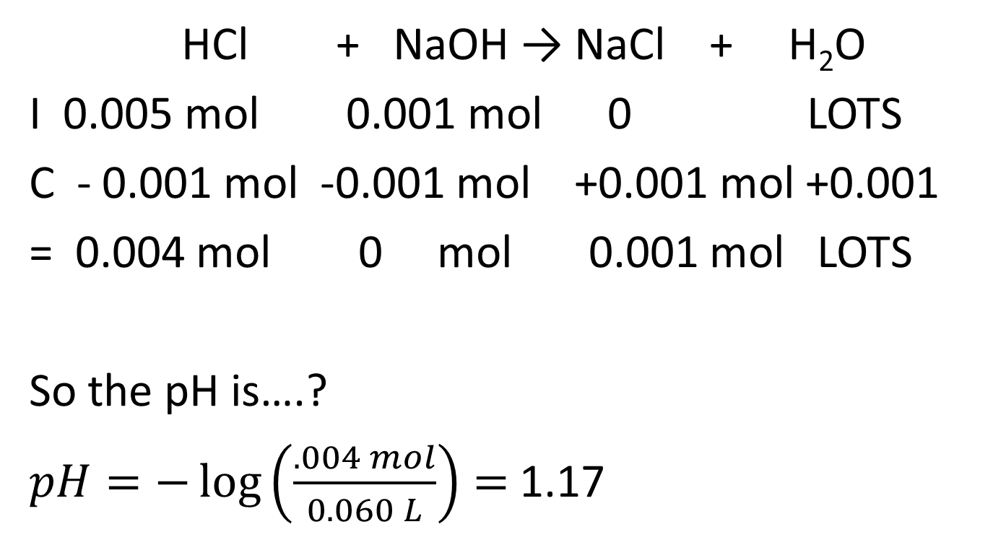
Add 10.0 mL of 0.100 M NaOH
HCl + NaOH → NaCl + H₂O
I 0.005 mol 0.001 mol 0 LOTS
C - 0.001 mol -0.001 mol +0.001 mol +0.001
= 0.004 mol 0 mol 0.001 mol LOTS
So the pH is….?
$pH=−\log\left(\frac{.004 mol}{0.060 L}\right)=$1.17

Slide 24
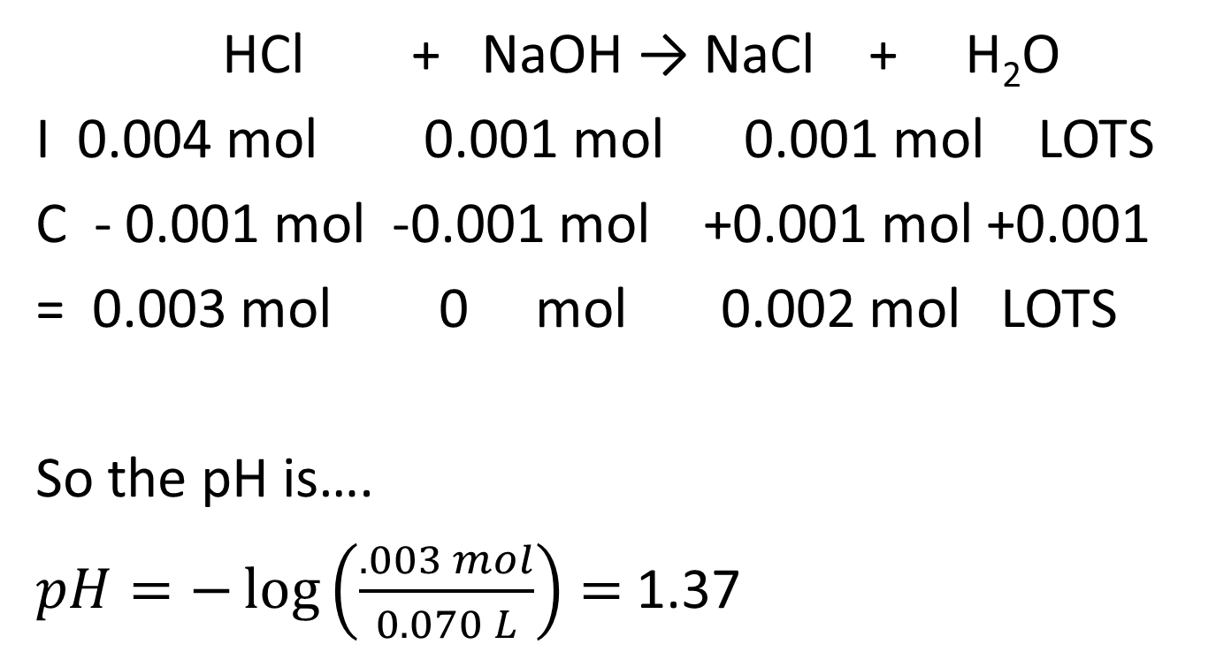
Add another 10.0 mL of 0.100 M NaOH
HCl + NaOH → NaCl + H₂O
I 0.004 mol 0.001 mol 0.001 mol LOTS
C - 0.001 mol -0.001 mol +0.001 mol +0.001
= 0.003 mol 0 mol 0.002 mol LOTS
So the pH is….
$pH=−\log\left(\frac{.003 mol}{0.070 L}\right)=$1.37

Slide 25
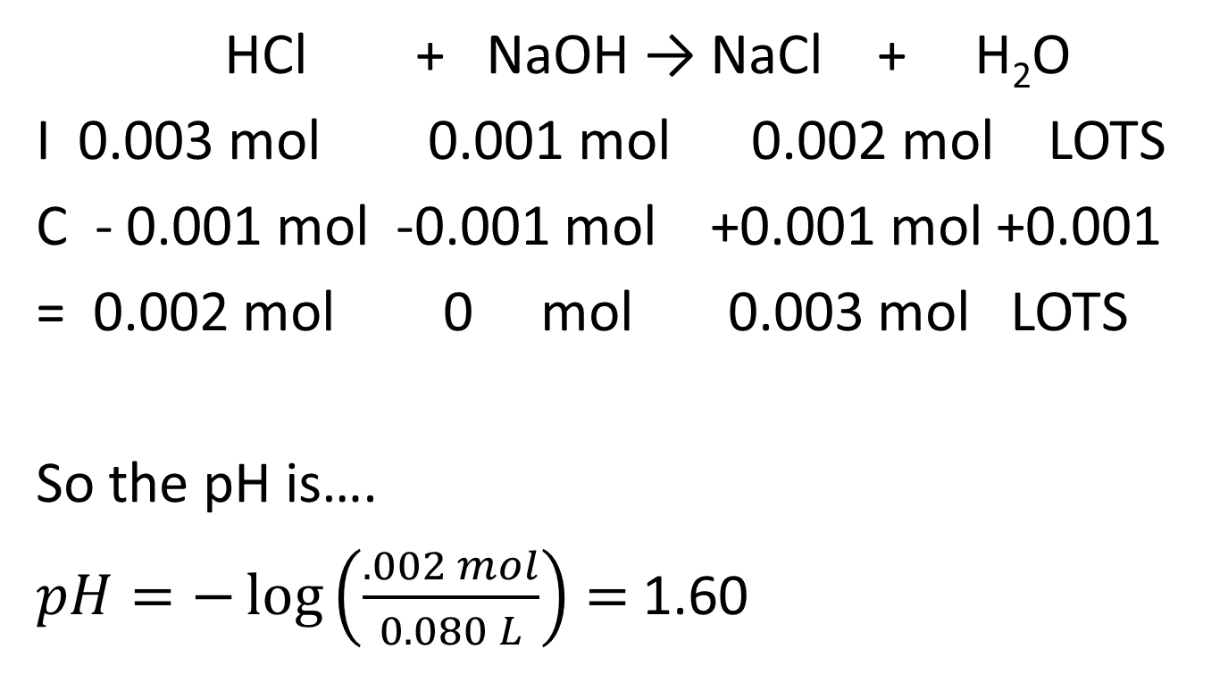
Add another 10.0 mL of 0.100 M NaOH
HCl + NaOH → NaCl + H₂O
I 0.003 mol 0.001 mol 0.002 mol LOTS
C - 0.001 mol -0.001 mol +0.001 mol +0.001
= 0.002 mol 0 mol 0.003 mol LOTS
So the pH is….
$pH=−\log\left(\frac{.002 mol}{0.080 L}\right)=$1.60

Slide 26
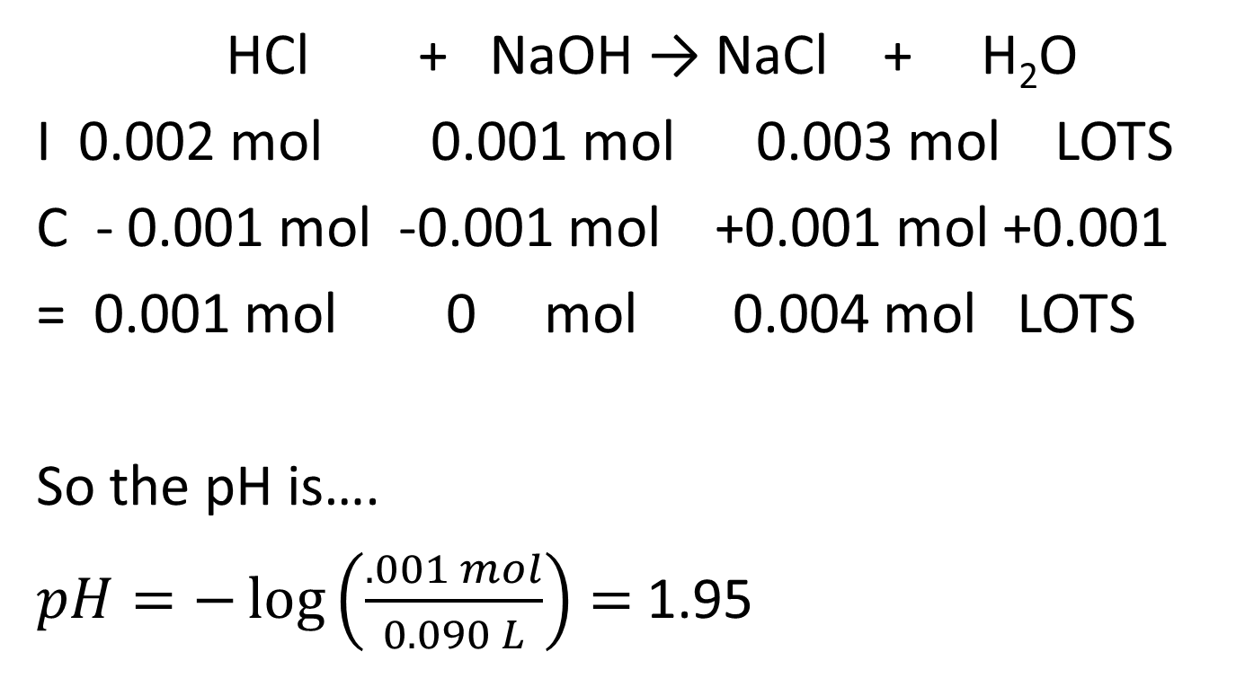
Add another 10.0 mL of 0.100 M NaOH
HCl + NaOH → NaCl + H₂O
I 0.002 mol 0.001 mol 0.003 mol LOTS
C - 0.001 mol -0.001 mol +0.001 mol +0.001
= 0.001 mol 0 mol 0.004 mol LOTS
So the pH is….
$pH=−\log\left(\frac{.001 mol}{0.090 L}\right)=$1.95

Slide 27
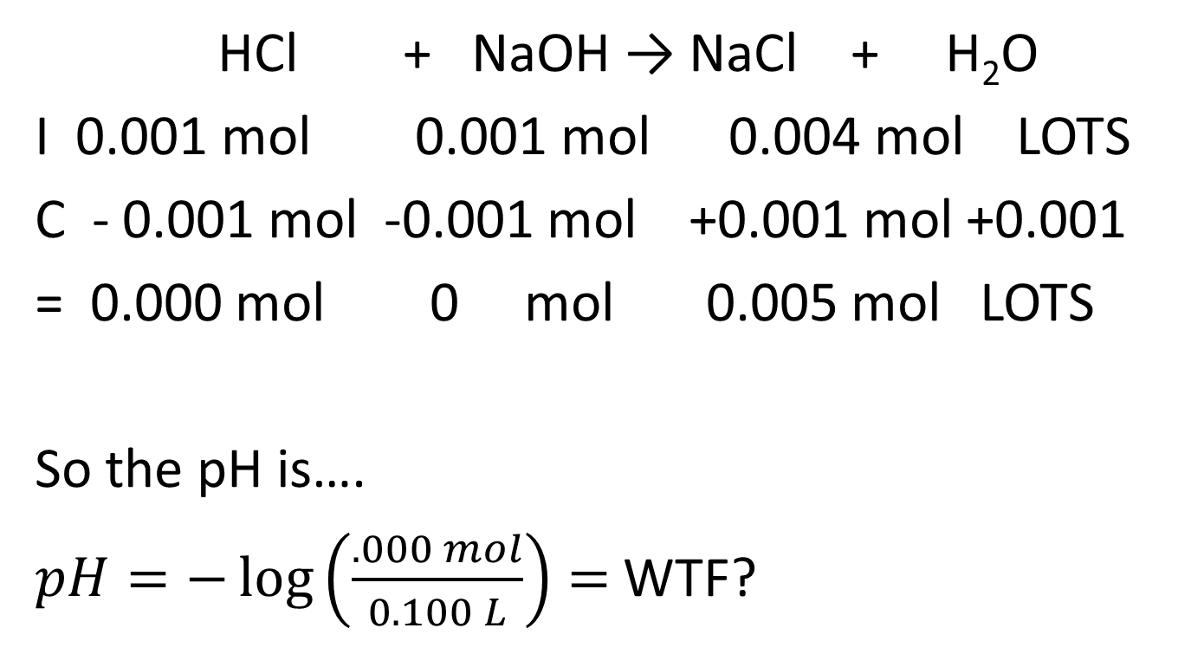
Add another 10.0 mL of 0.100 M NaOH
HCl + NaOH → NaCl + H₂O
I 0.001 mol 0.001 mol 0.004 mol LOTS
C - 0.001 mol -0.001 mol +0.001 mol +0.001
= 0.000 mol 0 mol 0.005 mol LOTS
So the pH is….
$pH=−\log\left(\frac{.000 mol}{0.100 L}\right)=$WTF?

Slide 28
WHAT’S IN THE BEAKER?
HCl + NaOH → NaCl + H₂O
I 0.001 mol 0.001 mol 0.004 mol LOTS
C - 0.001 mol -0.001 mol +0.001 mol +0.001
= 0.000 mol 0 mol 0.005 mol LOTS
NO HCl, so NO H⁺ from there. I have NaCl which is…
A salt
Acidic or basic?
Neither
What else is in the beaker?
Water
So what?
K_{w}

Slide 29
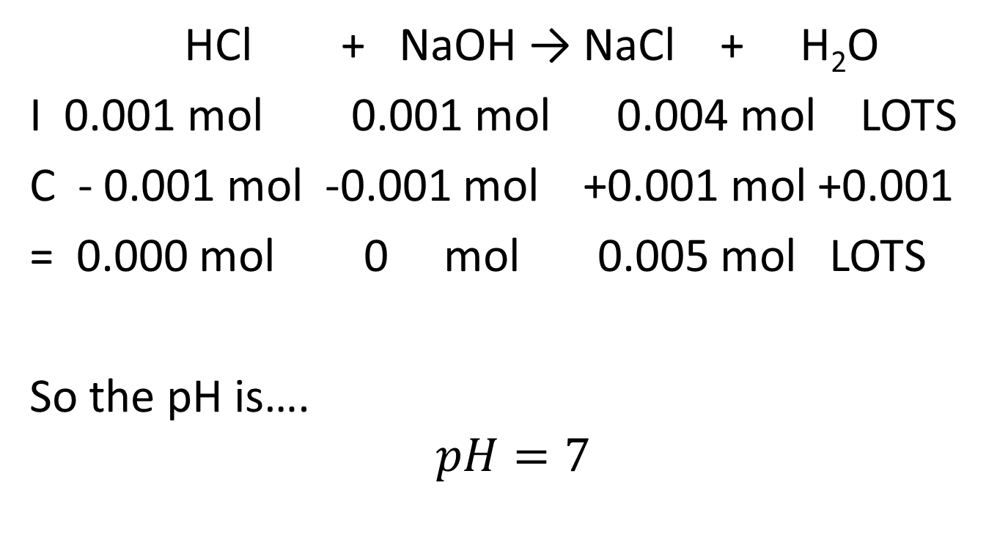
Add another 10.0 mL of 0.100 M NaOH
HCl + NaOH → NaCl + H₂O
I 0.001 mol 0.001 mol 0.004 mol LOTS
C - 0.001 mol -0.001 mol +0.001 mol +0.001
= 0.000 mol 0 mol 0.005 mol LOTS
So the pH is….
$$pH=7$$

Slide 30
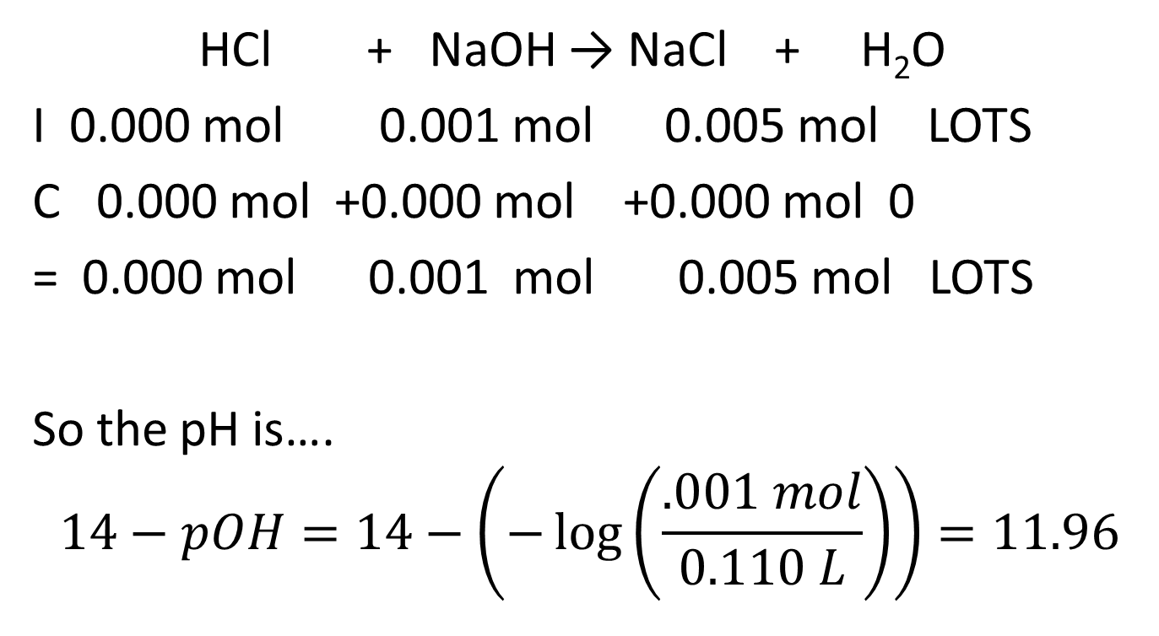
Add another 10.0 mL of 0.100 M NaOH
HCl + NaOH → NaCl + H₂O
I 0.000 mol 0.001 mol 0.005 mol LOTS
C 0.000 mol +0.000 mol +0.000 mol 0
= 0.000 mol 0.001 mol 0.005 mol LOTS
So the pH is….
$$14−pOH=14−\left(−\log\left(\frac{.001 mol}{0.110 L}\right)\right)=11.96$$

Slide 31
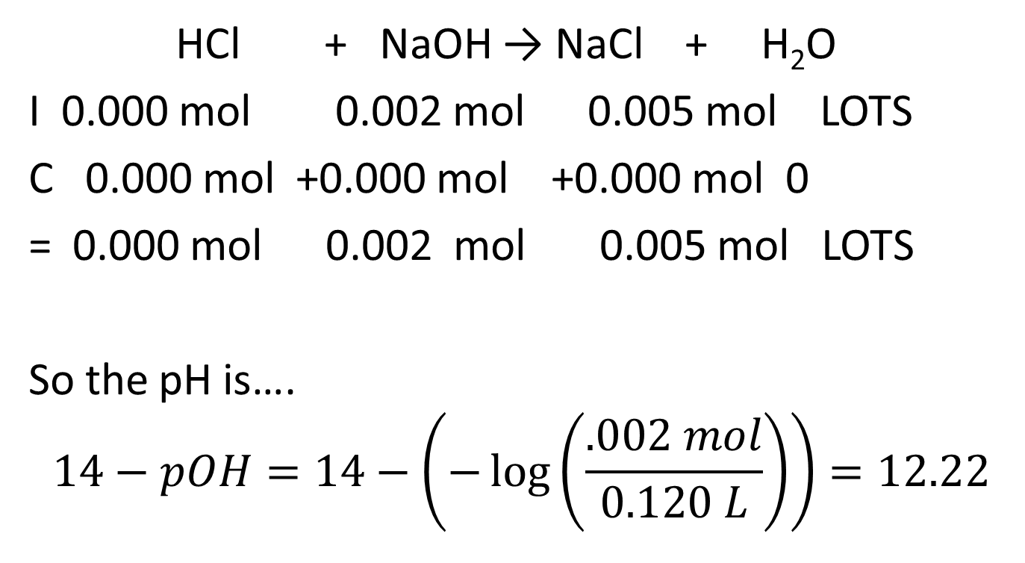
Add another 10.0 mL of 0.100 M NaOH
HCl + NaOH → NaCl + H₂O
I 0.000 mol 0.002 mol 0.005 mol LOTS
C 0.000 mol +0.000 mol +0.000 mol 0
= 0.000 mol 0.002 mol 0.005 mol LOTS
So the pH is….
$$14−pOH=14−\left(−\log\left(\frac{.002 mol}{0.120 L}\right)\right)=12.22$$

Slide 32
Summarizing
mL 0.100 M NaOH added | pH
0 | 1.00
10 | 1.17
20 | 1.37
30 | 1.60
40 | 1.95
50 | 7
60 | 11.96
70 | 12.22
80 | 12.36
90 | 12.46
100 | 12.52

Slide 33
pH vs. mL Base added
pH
7
mL OH- added

Slide 34
Do they all look like that?
No, it depends on what’s in the beaker!

Slide 35
50.00 mL of 0.100 M HOAc is titrated with 0.100 M NaOH. Calculate the pH at 10.0 mL increments from 0.00 mL titrant added until 100.0 mL of titrant.
We begin with…

Slide 36
A Balanced Equation!
HOAc + NaOH → NaOAc + H₂O
At 0.00 mL added, what’s in the beaker?
50.00 mL of 0.100 M HOAc
– nothing but HOAc and H₂O

Slide 37
pH of 50.00 mL of 0.100 M HOAc
What do we know about HOAc?
It’s a weak acid!
What do we do about weak acids?
Equilibrium, baby! 3 parts!

Slide 38

K_{a}=1.8x10⁻⁵
HOAc + H₂O ↔ OAc⁻ + H₃O⁺
I
C
E
$1.8×10−5 =\frac{[x][x]}{0.100−x}$
x=1.34x10⁻³ M
pH = -log (1.34x10⁻³ M) = 2.87
0.100 M |  | - |  | 0 |  | 0
-x |  | - |  | +x |  | +x
0.100-x |  | - |  | x |  | x

Slide 39
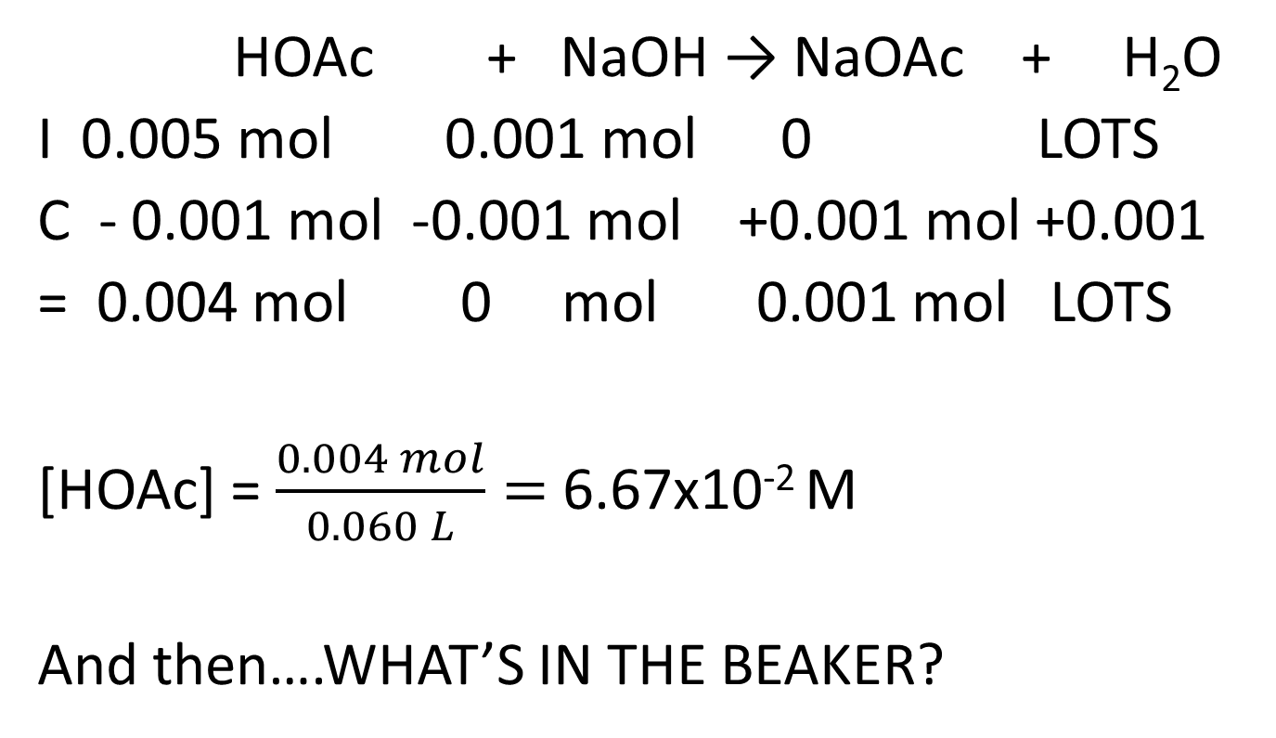
Add 10.0 mL of 0.100 M NaOH
HOAc + NaOH → NaOAc + H₂O
I 0.005 mol 0.001 mol 0 LOTS
C - 0.001 mol -0.001 mol +0.001 mol +0.001
= 0.004 mol 0 mol 0.001 mol LOTS
[HOAc] = $\frac{0.004 mol}{0.060 L}=$ 6.67x10⁻² M
And then….WHAT’S IN THE BEAKER?

Slide 40
To get the pH, I now have to
HOAc + NaOH → NaOAc + H₂O
I 0.005 mol 0.001 mol 0 LOTS
C - 0.001 mol -0.001 mol +0.001 mol +0.001
= 0.004 mol 0 mol 0.001 mol LOTS
Ka
Kb
Henderson-Hasselbach
All of the above
None of the above

Slide 41
K_{a}=1.8x10⁻⁵
HOAc + H₂O↔OAc⁻ + H₃O⁺
I
C
E
What is this?
It’s a BUFFER!!!
0.0667 M |  | - |  | 0.0167 M |  | 0
-x |  | - |  | +x |  | +x
0.0667-x |  | - |  | 0.0167 +x |  | x

Slide 42

K_{a}=1.8x10⁻⁵
HOAc + H₂O  OAc⁻ + H₃O⁺
I
C
E
$$pH=pKa+log\frac{[Base]}{[Acid]}$$
$pH=4.74+log\frac{[0.0167]}{[0.0667]}$=4.14
0.0667 M |  | - |  | 0.0167 M |  | 0
-x |  | - |  | +x |  | +x
0.0667-x |  | - |  | 0.0167 +x |  | x

Slide 43
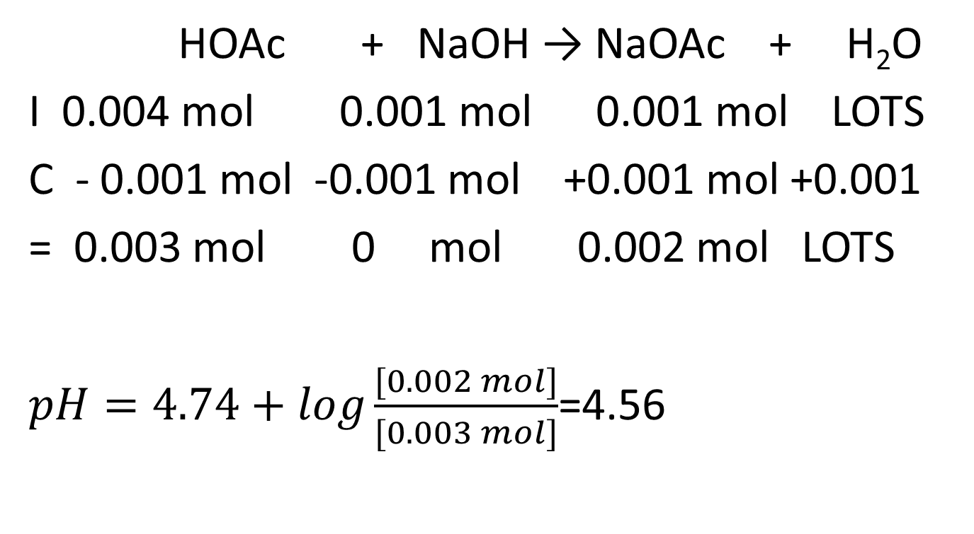
Add another 10.0 mL of 0.100 M NaOH
HOAc + NaOH → NaOAc + H₂O
I 0.004 mol 0.001 mol 0.001 mol LOTS
C - 0.001 mol -0.001 mol +0.001 mol +0.001
= 0.003 mol 0 mol 0.002 mol LOTS
$pH=4.74+log\frac{[0.002 mol]}{[0.003 mol]}$=4.56

Slide 44
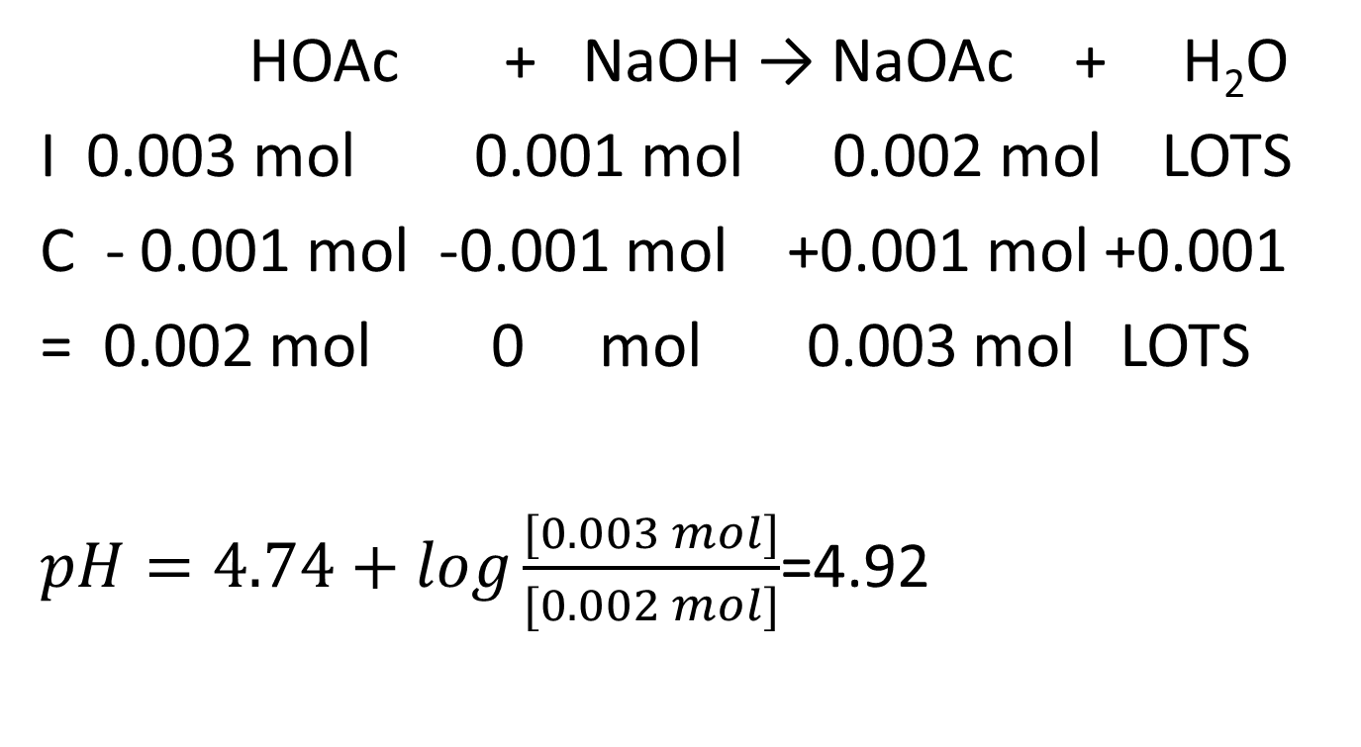
Add another 10.0 mL of 0.100 M NaOH
HOAc + NaOH → NaOAc + H₂O
I 0.003 mol 0.001 mol 0.002 mol LOTS
C - 0.001 mol -0.001 mol +0.001 mol +0.001
= 0.002 mol 0 mol 0.003 mol LOTS
$pH=4.74+log\frac{[0.003 mol]}{[0.002 mol]}$=4.92

Slide 45
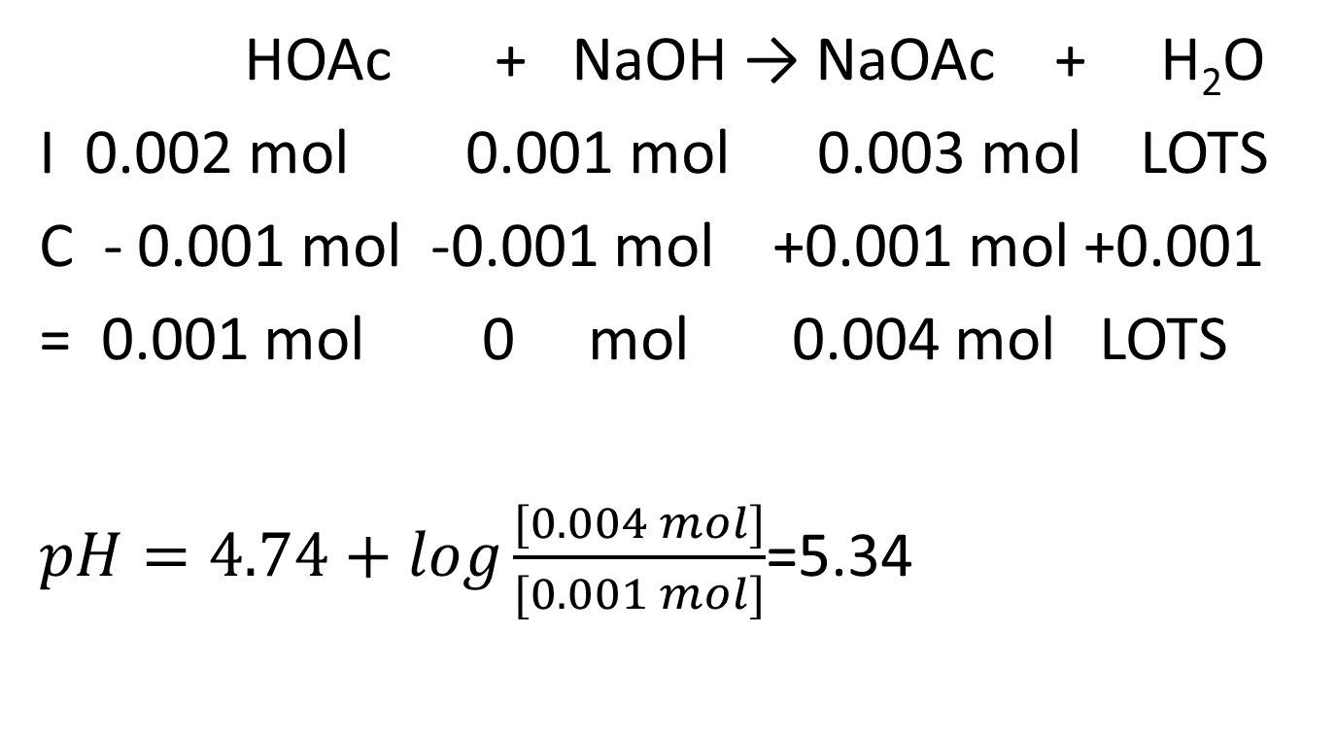
Add another 10.0 mL of 0.100 M NaOH
HOAc + NaOH → NaOAc + H₂O
I 0.002 mol 0.001 mol 0.003 mol LOTS
C - 0.001 mol -0.001 mol +0.001 mol +0.001
= 0.001 mol 0 mol 0.004 mol LOTS
$pH=4.74+log\frac{[0.004 mol]}{[0.001 mol]}$=5.34

Slide 46
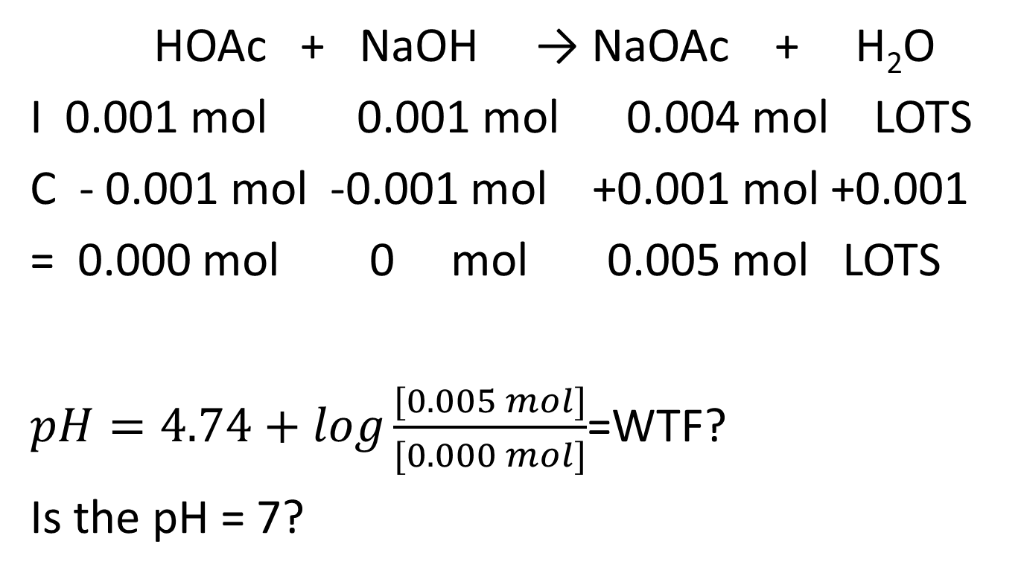
Add another 10.0 mL of 0.100 M NaOH
HOAc + NaOH → NaOAc + H₂O
I 0.001 mol 0.001 mol 0.004 mol LOTS
C - 0.001 mol -0.001 mol +0.001 mol +0.001
= 0.000 mol 0 mol 0.005 mol LOTS
$pH=4.74+log\frac{[0.005 mol]}{[0.000 mol]}$=WTF?
Is the pH = 7?

Slide 47
Is the pH=7?
Yes, still Kw
No. No Kw
No. There is a Kw but that’s not the only thing.
None of the above
All of the above
30 degrees tomorrow, WTF?

Slide 48
Is the pH 7?
A Yes, it’s 7
B. No, it’s less than 7
C. No, it’s more than 7

Slide 49
WHAT’S IN THE BEAKER?
HOAc + NaOH → NaOAc + H₂O
I 0.001 mol 0.001 mol 0.004 mol LOTS
C - 0.001 mol -0.001 mol +0.001 mol +0.001
= 0.000 mol 0 mol 0.005 mol LOTS
I have NaOAc which is…
A salt
Acidic or basic?
NaOH is a strong base, HOAc is a weak acid. OAc⁻ is a weak base.

Slide 50
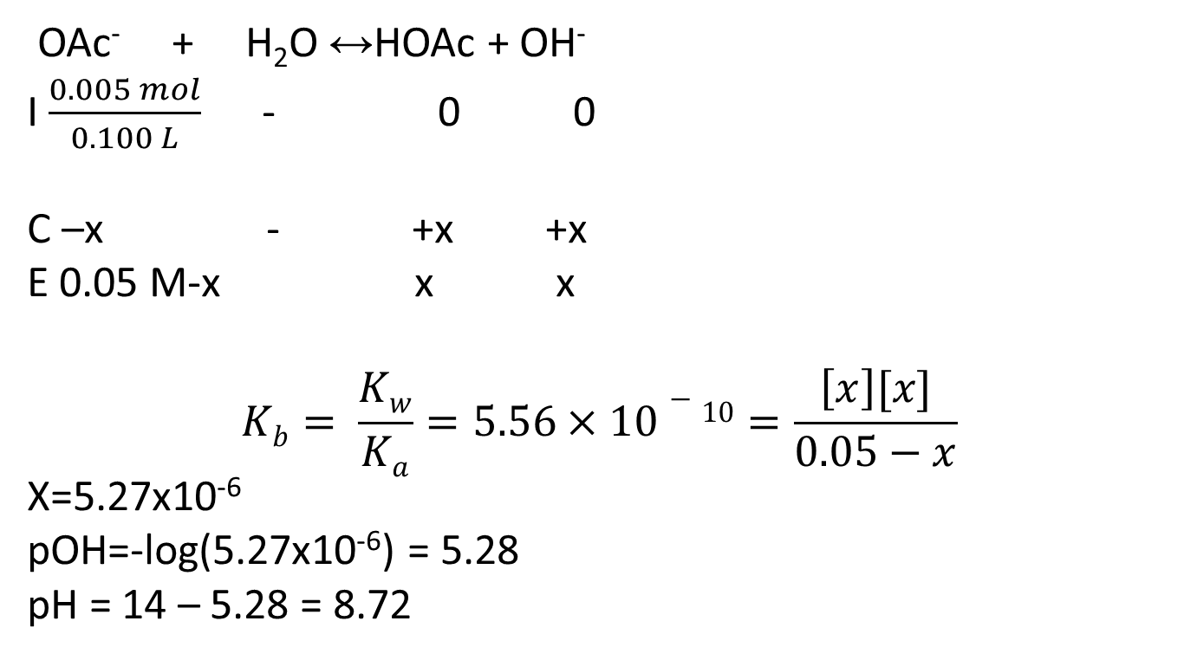
OMG IT’S A K_{B} PROBLEM!
OAc⁻ + H₂O ↔HOAc + OH⁻
I $\frac{0.005 mol}{0.100 L}$ - 0 0
C –x - +x +x
E 0.05 M-x x x
$$Kb= \frac{Kw}{Ka}=5.56×10−10=\frac{\left[x\right][x]}{0.05−x}$$
X=5.27x10⁻⁶
pOH=-log(5.27x10⁻⁶) = 5.28
pH = 14 – 5.28 = 8.72

Slide 51
Add another 10.0 mL of 0.100 M NaOH
Now it’s just all about the excess NaOH!
Just like before.

Slide 52
Summarizing
mL 0.100 M NaOH added | pH
0 | 2.87
10 | 4.14
20 | 4.56
30 | 4.92
40 | 5.34
50 | 8.72
60 | 11.96
70 | 12.22
80 | 12.36
90 | 12.46
100 | 12.52

Slide 53
Comparing
mL 0.100 M NaOH weak acid | pH
0 | 2.87
10 | 4.14
20 | 4.56
30 | 4.92
40 | 5.34
50 | 8.72
60 | 11.96
70 | 12.22
80 | 12.36
90 | 12.46
100 | 12.52
mL 0.100 M NaOH Strong acid | pH
0 | 1.00
10 | 1.17
20 | 1.37
30 | 1.60
40 | 1.95
50 | 7
60 | 11.96
70 | 12.22
80 | 12.36
90 | 12.46
100 | 12.52

Slide 54
pH vs. mL Base added weak acid/strong base
Excess Base
pH
7
Equivalence
Buffer Region
mL OH- added

Slide 55
CB If benzoic acid, pKa = 4.05, is titrated with
NaOH(aq), the equivalence point is:
A. Acidic if the initial concentration of acid
was higher than that of base.
B. Always Acidic
C. Basic if the initial concentration of base was higher than that of acid.
D. Always Basic
E. Neutral

Slide 56
CB If methyl amine, pKb = 9.2, is titrated with
HCl(aq), the equivalence point is:
A. Acidic if the initial concentration of acid
was higher than that of base.
B. Always Acidic
C. Basic if the initial concentration of base
was higher than that of acid.
D. Always Basic
E. Neutral

Slide 57
The reverse happens with a weak base/strong acid
HCl + NH₄OH → NH₄Cl + H₂O
When you start adding base, you’ve got excess strong acid, so only [HCl] matters - “excess strong acid”
At equivalence, you have an acidic salt, so the pH is less than 7.
After equivalence, you’ve got a weak base and its conjugate acid – buffer region!

